Slide 1
Backpacking Guide
Course #1
Terry McKibben
Troop 344/9344
Pemberville, OH
troop344leaders@gmail.com

Slide 2
CONTENTS
01
Boots
Boot Fit, Boot Care
02
Socks
Selecting Socks, Liner Socks
03
Clothing
Layering, Fabric Options

Slide 3
01
Boot Fit
Boot Care
Boots

Slide 4
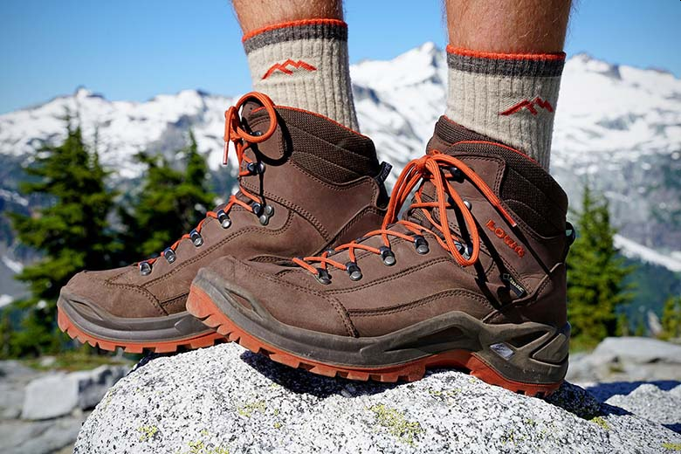
Boots
What's the big deal about boots? Jeez, they're expensive, aren't they? Most look like they could take you up the north face of Everest. Do you really need such an expensive item to start out?
I would say, "Yes". Hiking boots are recommended for long distance hikes over rough terrain.
Old-style heavyweight mountain boots are usually unnecessary now that good quality lightweight boots are widely available.
The most important thing is that your boots fit well and are well broken-in before you hit the trail. Nothing ends a hike quicker than blistered feet, and even minor blisters can become infected and cause serious trouble.

Slide 5
Good Hiking Boots
Boots are built to protect your feet and accomplish this protection in a number of different ways.
Good boots are "solid" on the bottom.
  You shouldn't be able to feel rocks or stones through the soles.
  If you can, there's a good likelihood that after many miles on the trail, your feet are going to start hurting.
  If you can press in the bottom of the sole with your thumb, the soles are probably too soft to give your foot proper protection.
  If you can "twist" the soles of the boot, it's also probably too soft.
  Trails are rocky, and you need good protection to avoid bruising the bottom of your feet.
Good boots provide good protection on the sides.
  They are heavy because they either have extra padding to protect your foot from stones, rocks, and branches you may step on which could gouge into the side of the boot.
  Some fabric boots have protective "welts" 1/2-inch or more up from the soles to give added protection.

Slide 6
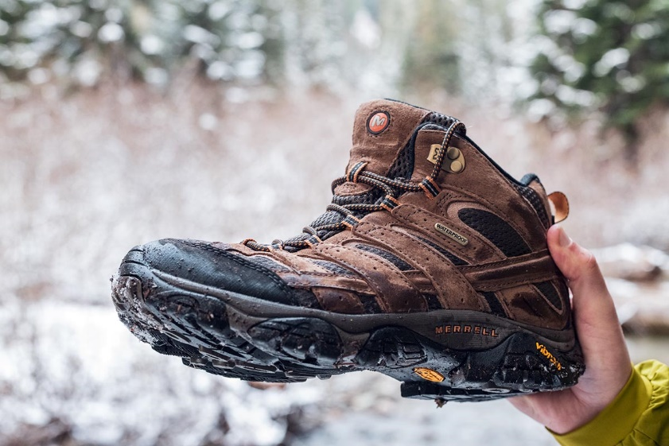
Good Hiking Boots
Good boots provide good ankle support.
  Grab the top of the boot and try to bend it over side-ways.
  If it bends easily, it's probably not going to provide the level of protection needed on the trail.
  The top of the boot should be stiff to hold the ankle in place and provide it with good support.
Good boots are either waterproof, or are capable of being waterproofed with special waterproofing solutions.
  Wet feet cause blisters.
  Stick with waterproof fabric boots, or leather boots that can be treated with Nikwax, beeswax solution, or other more durable waterproofing solutions.
Good boots are heavy enough for their intended use.
  A "lighter" boot used for hiking may not have the necessary rigidity to provide your feet with good support under the heavier load of a backpack.

Slide 7
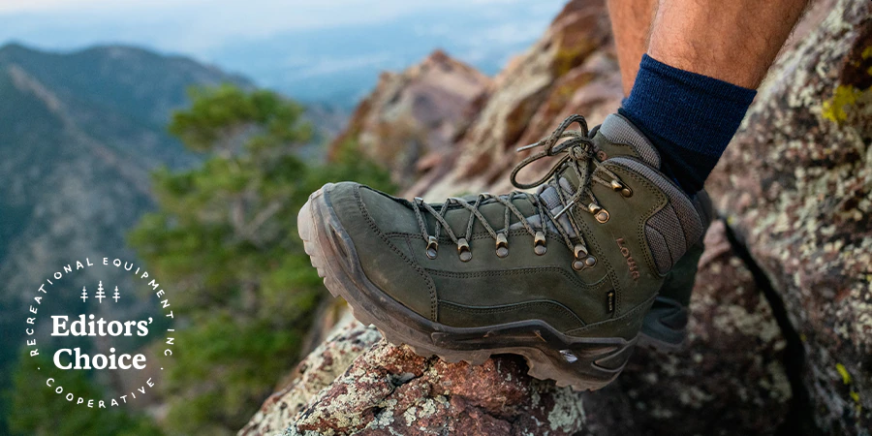
What’s a Good Brand of Hiking Boots to Buy?
Anyone who tells you that "you should buy [insert your favorite company name here] brand boots" doesn't know what he or she is talking about.
On the flip side of the coin, anyone who asks, "What boots should I buy?" is also asking the wrong question.
The best boot for you, and the one you should buy, is the one that fits YOUR foot.
The two questions you should really ask are:
  "Which boot fits MY foot?“
  "What do I need to know in order to find this boot?"
Unfortunately, the answer to the first question can only be supplied by one person - YOU. The salesman can't help you with this. No one in the backcountry can either. You have to let your feet "talk to you" on the matter.

Slide 8
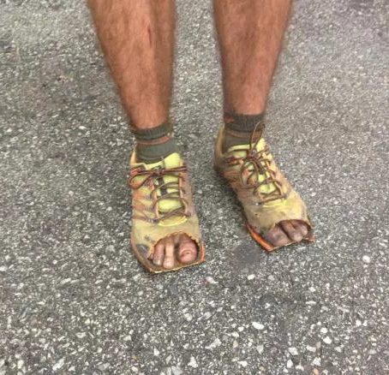
Finding Your Perfect Fit
Shop at a reputable outdoor shop that specializes in hiking and backpacking equipment.
  These shops generally carry well-designed outdoor footwear for the hiker/backpacker.
A boot that fits well will not slip in the heel area, and provides your toes with plenty of room in the front when you're going downhill with a full pack load.
For this reason, hiking boots are generally sized a little longer than your standard street shoe.

Slide 9
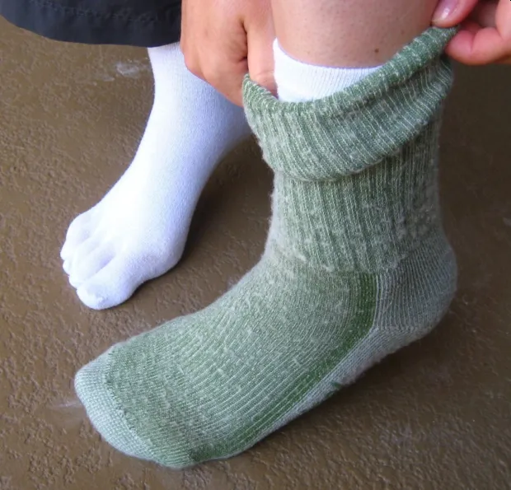
Finding Your Perfect Fit (continued)
Before you head to your local outdoor shop, grab the socks that you intend to wear in the boots (More on this later).
For beginners, wear two pair - a thin or lightweight pair on the inside, and a thicker pair on the outside.
  Two socks rub against each other, whereas one sock generally rubs against your foot, potentially raising blisters.
Ideally, the socks should be synthetic or wool.
  Cotton socks get damp and soggy, and will raise blisters on your feet.
  Synthetic and wool socks do a much better job of wicking moisture away from your feet, thereby keeping them relatively dry.

Slide 10
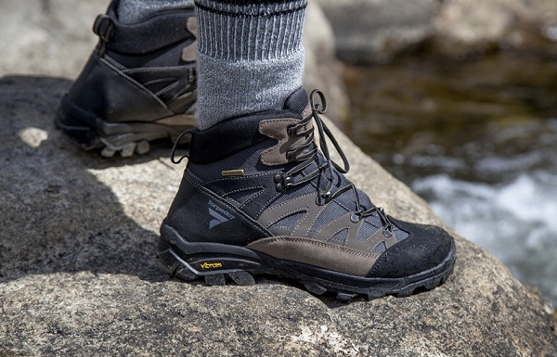
In the Store
Choosing a well-designed boot with the right fit is the greatest challenge in reviewing your boot choices.
Don't let the rugged appearance of the boot, the salesman's recommendation, or even the brand name steer you to a boot that won't work for your foot.
After you have reviewed your choices and "tested" each boot design for sole and ankle rigidity (see the points outlined in previous slides), ask the salesman to bring you a pair.

Slide 11
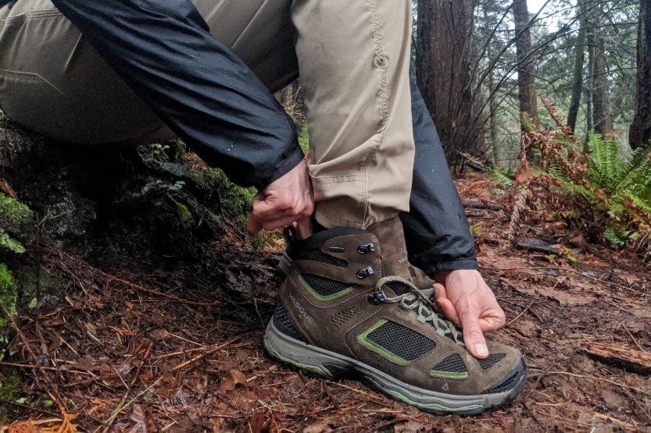
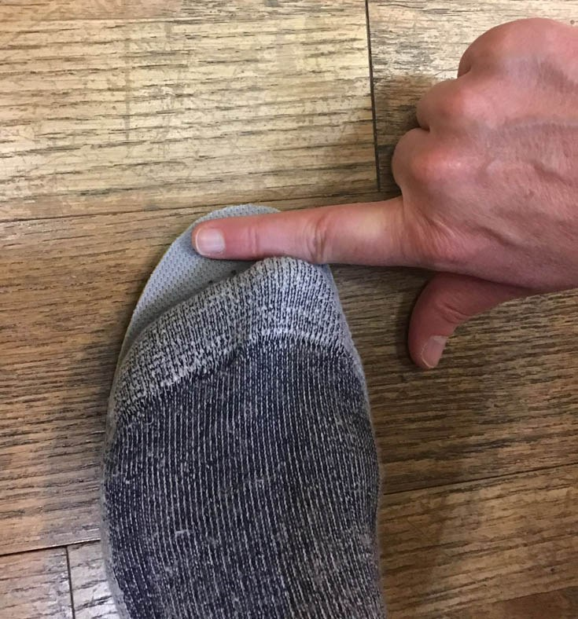
The Finger Test
With the boot fully unlaced, move your foot as far forward in the boot as possible.
  If the boot is the proper size for your feet, you should be able to slip your index finger down inside the boot at the back of the ankle.
  Your finger is just about the right size for determining if that all-important extra space is available in the front.
  Backpackers can expect their feet to swell.
  The extra space is also needed when backpacking downhill, when your foot has a tendency to slide forward in the boot under load.
Another trick to ensure the hiking boots fit in length is by measuring the insoles.
  Take the insoles out of the boots and stand on them.
  Check if there is space between your longest toe and the end of the insole.
  Space should be as wide as the thumb.

Slide 12
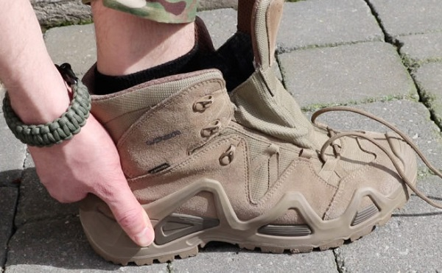
The Sensory Test
Next, take off your thick socks (leave the thin liner sock on) and slip your foot into the boot.
  Using all your sensory powers, try to determine if any part of the boot feels tight.
  This is especially important in the area where the small toes are located.
  Some boots may be designed in such a way that your small toes will feel "pinched" or "jammed".
  This can be very difficult to feel through two pairs of socks.
  Does the boot feel too narrow on the sides in the area just behind your toes (the "ball" of the foot)?
  Is it too tight in the middle part of your foot on either side of the arch?
  This test will quickly eliminate any boots that are clearly not designed for your foot.

Slide 13
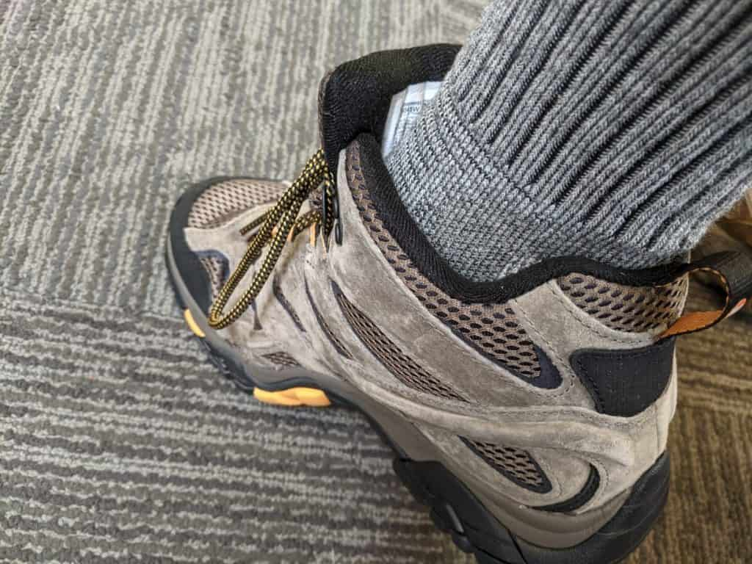
The Sensory Test (continued)
Now perform the same sensory tests with your thick socks on.
  Make sure your socks are stretched smoothly over your foot, not loose, which can cause the sock to fold over when you slide your foot into the boot.
  The boot should not feel tight in any area.
  Inversely, it shouldn't feet loose in any area either.
  It should fit comfortably "snug".
  If any part of your foot feels "jammed", try a lighter, medium-weight sock on the outside.
  Using different thicknesses of socks can always be used as an option for making size/fit adjustments.
  If the foot still feels jammed (or inversely, loose), look for another boot.

Slide 14
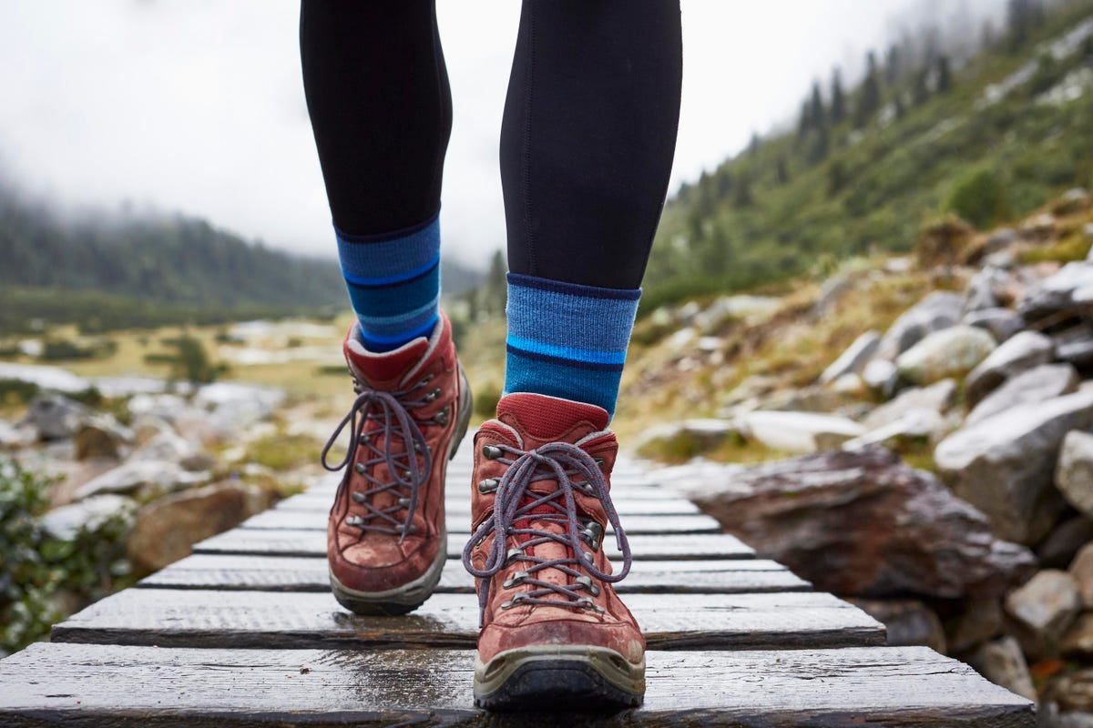
The Stride Test
Walk around in the boots.
Do they feel good? Does the boot "break" (or crease) across the top of the toes comfortably when you stride forward?
If the top of the boot feels like it's jamming the back of your toes when you stride forward, then look for another pair.
What about the heel? If you feel your heel sliding noticeably in the heel area, you probably have a boot that's a little too large, or one that's not going to work for you.
New, rigid boots will always cause your heel to slide a little (and I emphasize, a little) when they're new, due to the newness and stiffness of the sole.
If you think the sliding is due to a boot that's too large, go 1/2-size smaller, ensuring that the smaller size passes the "finger test".

Slide 15
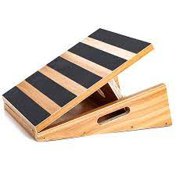
The Slant Board Test
If everything still feels okay, ask the salesman if they have a "slant board" where you can test how they feel on an incline.
  Walk down the incline.
  If your foot jams into the front of the boot and your toes feels pinched, look for another pair.
  If your toes touch the end of the boot, ask the salesman for the next half-size larger.
If you've managed to locate a pair that meets all the criteria above, there's a good chance that you've found a reasonably good fit for your foot.
If you haven't, keep trying on different brands until you find a pair that "makes the grade" so to speak.
If none of the boots available meet the criteria, visit another outdoor shop.
Boots can be expensive. Take the time to choose wisely. Your bank account and feet depend on it.

Slide 16
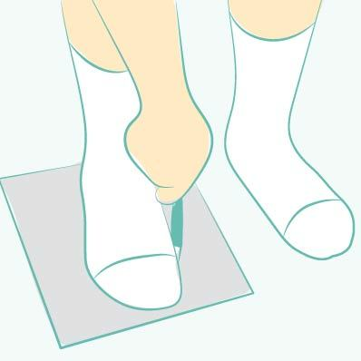
At Home
The "Paper Doll" Test:
  Once you have your boots home, slip on the socks you intend to wear while you're hiking.
  Then, place a blank sheet of paper under your foot, and carefully trace an outline of your foot with a pencil.
  Using scissors cut the foot outline from the paper.
  Then, very gently, slide your "foot cut-out" into the boot.
  Press the paper flat onto the bottom of the boot, working the paper into all corners of the boot, just as you would press pizza dough into the corner of a cookie sheet.
  Then, remove the cutout.
  Any spot where the paper is folded up (i.e. not flat) is a spot where the boot is tight.
  Remember, some snugness is okay, but if you have spots where the paper is folded up 1/2", you may well have some problems later on down the trail.

Slide 17
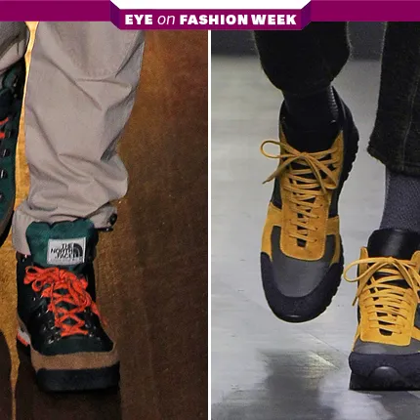
At Home
The Long Walk Test:
  Next, wear them around and see how they feel.
  Perform a "long walk" inside your home, or even better, inside a local shopping mall to see how they feel after a little distance.
  Wearing them while lounging at home will not give them the proper test.
  Put a little "indoor distance" on the boot. If they still feel good, you've found a reasonably good boot for your foot.
  If they don't feel good, resist the temptation to keep them - take them back and keep looking.

Slide 18
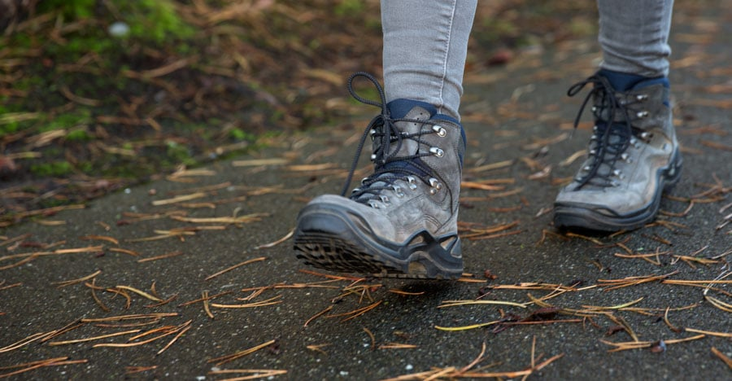
On the Trail
Break-in
  Assuming that you've found the "Perfect Fit", the final step is breaking in your boots before you take them out on the trail.
  With the evolution of fabric Gore-Tex boots, this is not as great a factor as it used to be, but should still be performed.
  All-leather boots will definitely require some break-in time prior to backpacking.
  Wear your boots on progressively longer hikes until you're certain you can do some comfortable distance with the added weight of a backpack.

Slide 19
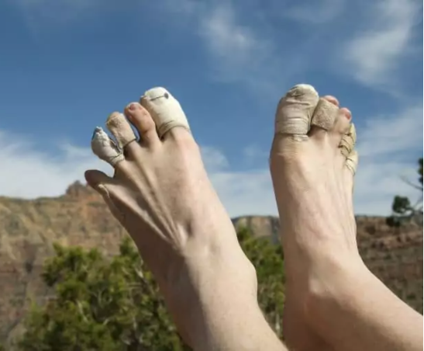
On the Trail
Being Prepared for Problems
  Even the best fitting boots can still cause you problems.
  Small spots may rub, or tender feet may require some toughening.
  Be sure to take along some "moleskin" on your hikes and backpacking trips.
  Moleskin, and other similarly designed abrasion padding with adhesive on one side, and a felt-like padding on the other, will minimize the possibility that blisters are raised. (It will minimize, not eliminate the possibility.)
  Medical adhesive tape, with a smooth, slick covering (or duct tape) on the outside can also be used.
  Spenco "second skin" is also an outstanding option for providing relief for boot "hot spots".
  And finally, remember that sometimes it's your foot that needs conditioning, not the boot.
  Regular hiking and backpacking will help toughen your feet until they are prepared for the abuse you'll give them on the trail.

Slide 20
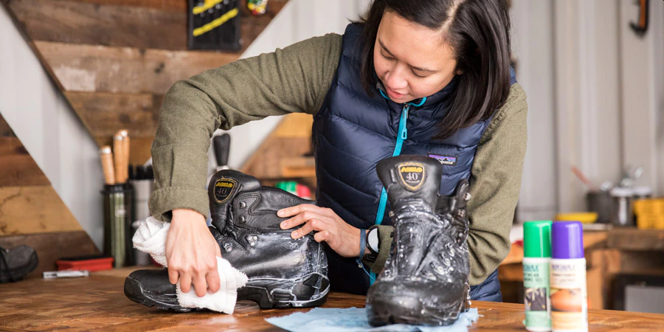
Hiking Boot Care
The old adage, "Take care of your equipment and it will take care of you" is an important truth to live by for campers, hikers and backpackers, and one that is absolutely true when it comes to your hiking boots.
Throughout a long day of hiking, you'll want your boots to be well-fitted, comfortable and able to withstand the constant punishment of climbing up rocks, down hills and through streams.
It makes absolutely no sense to purchase an expensive pair of hiking boots if you don't know how to keep your hiking boots safe.
Just remember that the boots are only the perfect boots if you learn how to take care of them.
Taking a little extra time to care for your hiking boots can add years to their useful lives.

Slide 21
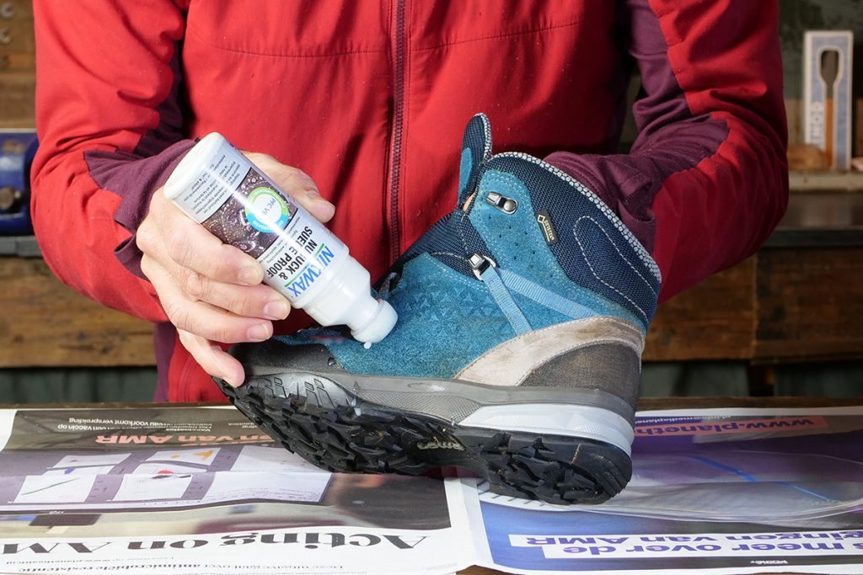
Waterproofing Boots
Consult the manufacturer for the proper products to put on the boots for waterproofing.
Whatever waterproof product is chosen, use a reputable brand product such as Nikwax for those expensive boots.
Waterproof the boots before you use them for the first time.
After returning from the wilderness, clean your boots and then when they are dry, make them waterproof so that they will stay dry once you return to the wilderness.

Slide 22
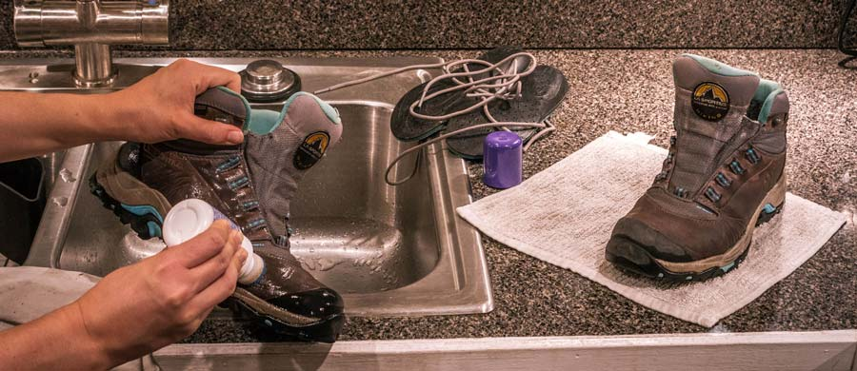
Waterproofing Boots
When waterproofing your boots, try not to overdo it because you’ll just be wasting excess product in the end.
If your boots have a Gore-Tex lining, make sure to use silicon-based treatment on them instead of a wax-based one.
This is to allow the boot to ‘breathe’ which is one of the functions of the special lining.
Always make sure the attachment area where the boot and the sole meets has enough waterproofing.
A very soft toothbrush or Q-tips will help get into those tough boot areas.

Slide 23
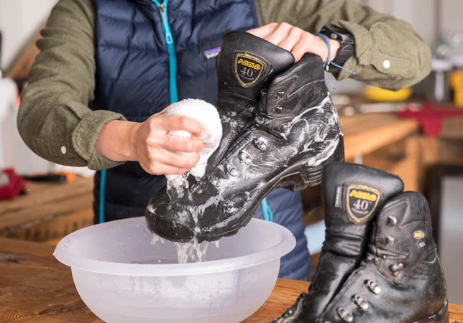
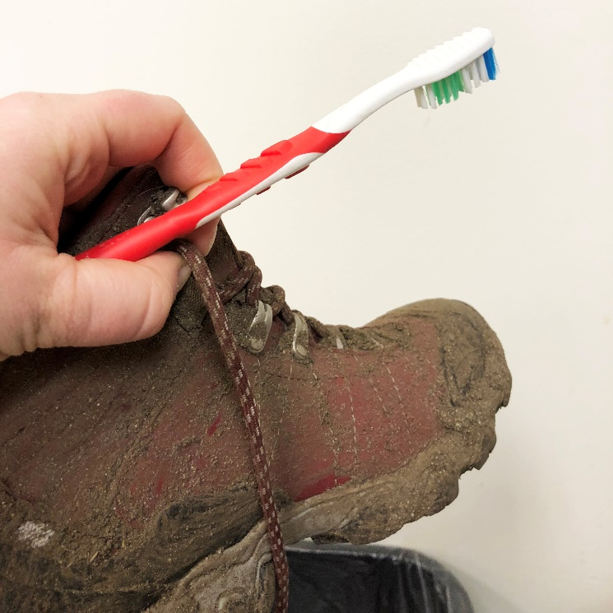
Cleaning Boots
When you have finished using the hiking boots for the day and are ready to put them away, completely clean and wash the boots.
Take the stones out of the bottom of the soles and remove all mud. Most fabric boots can be washed on the outside with non-detergent soap and water to remove built-up dirt.
Leather boots can also be rinsed off, but repeated washing and drying can dry out the leather over time and make it brittle.
A soft toothbrush with a little water will help clean those hard to get areas.
If the boots become really scuffed, check to see if it is time to waterproof the hiking boots again.
NOTE: If your boots are wet and dirty, it's best to dry them first, and then brush the dirt off.

Slide 24
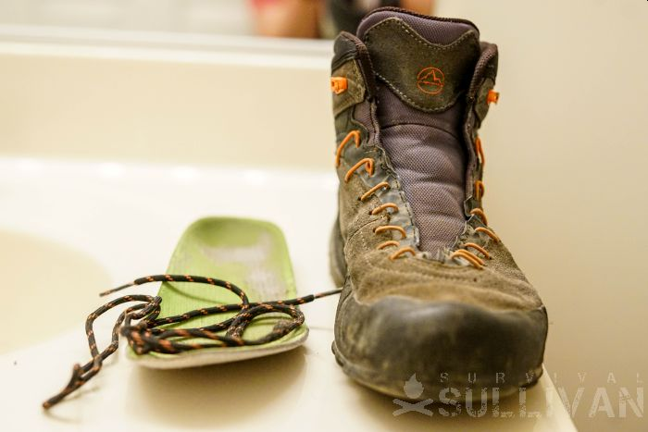
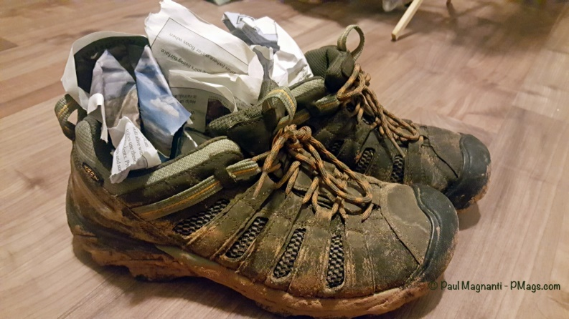
Drying Boots
Dry your boots completely after each trip.
  Remove the insoles to help aid in the drying process.
  Allow your hiking boots to air out in a shaded and ventilated spot, such as the garage with an open window.
  Keep the boots away from direct sunlight.
  Don't set your boots near a fire (or other heat source) to dry them more quickly, since high temperatures can damage boot materials and the cements used to hold them together. It might even effect how the boot fits.
  If you need to speed up the drying process, try stuffing dry newspaper inside your boots to absorb water. Replace the newspaper frequently for best results.
  The boots should dry slowly or else the leather might crack.
Damp boots, if left alone, can become smelly.
  A light amount of regular foot powder or baking soda will remove most of the boot odor. Just don't overdo it and use light amounts.

Slide 25
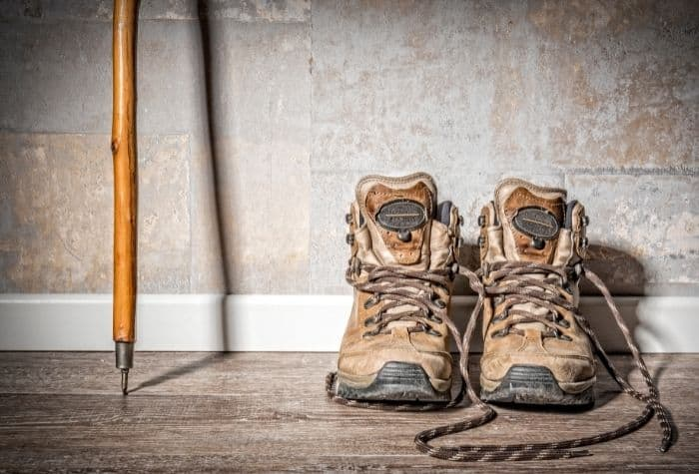
Boot Storage
If you are a seasonal hiker and the boots are only used for a couple of seasons, don't store the boots in a cold attic or a hot basement for an extensive period of time.
Keep the boots in a place that have normal air temperature.
Always put them on every once and a while to keep the proper shape of the boot and also to keep the leather soft.

Slide 26
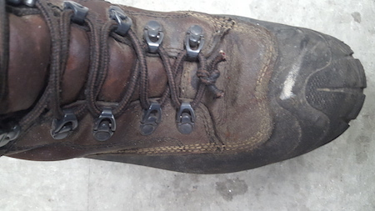
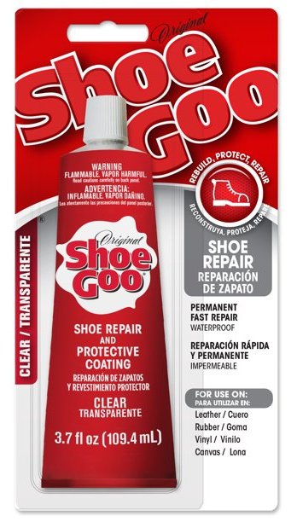
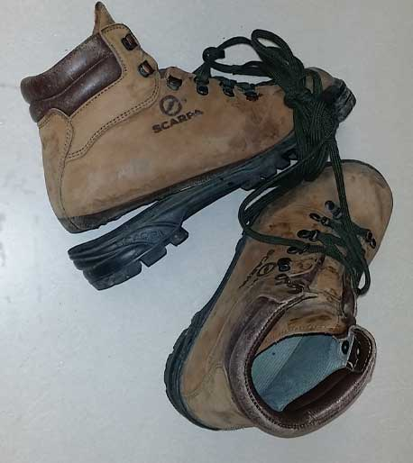
Boots - Miscellaneous
Check Laces
  Always check the boot laces for potential lace breaks. Catch the defective laces at home and replace them before they break on the trail.
Footwear Repair
  If the boot is starting to separate from the sole, use a rubber glue (such as Shoe Goo), not super glue (super glue will shatter) to glue them back together.

Slide 27
02
Selecting Socks
Liner Socks
Socks

Slide 28
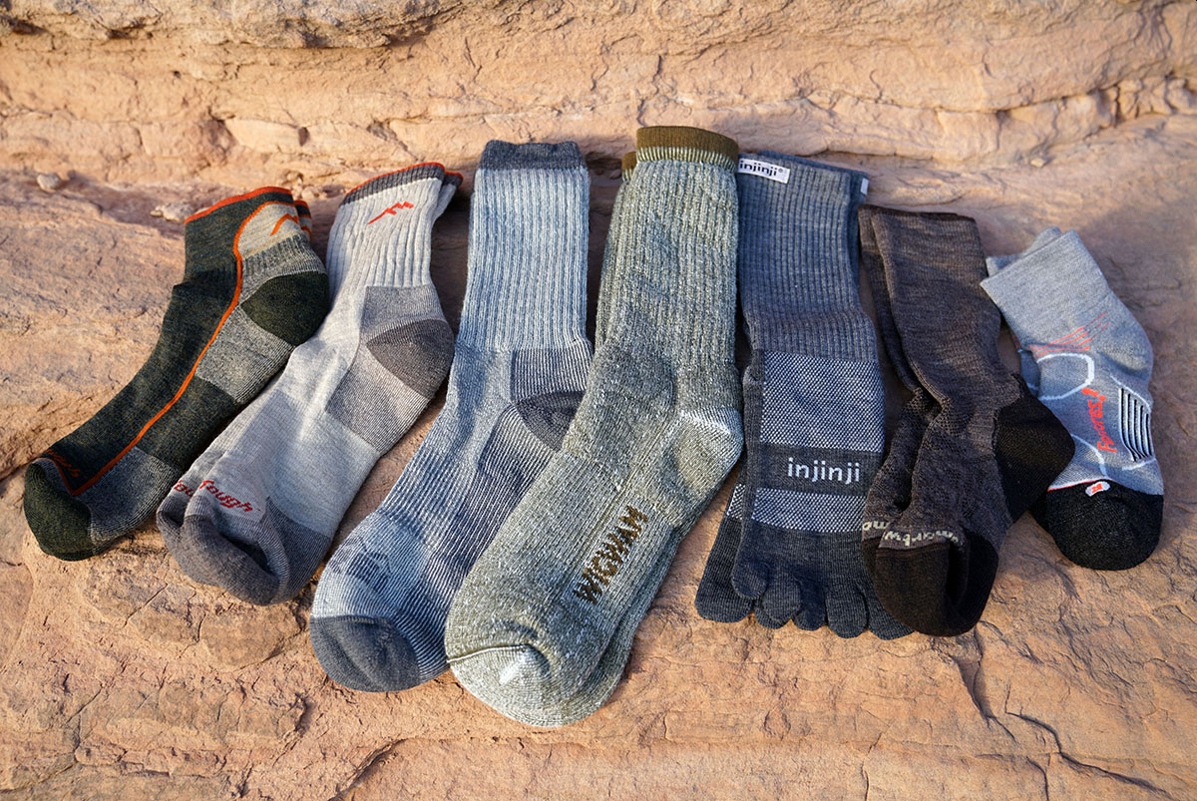
How to Choose Hiking Socks
The average person takes 2,000 steps to travel one mile. Factor in the up and down of a hiking trail and the roots and rocks you’ll encounter along the way, and that number only gets higher. With every step, the right socks play a critical role in keeping your feet comfortable and blister-free throughout your journey.
To choose the best hiking socks for your trip, it’s important to consider these four things:
  Sock height: The right height sock protects against abrasion with your footwear
  Cushioning: The amount of cushioning affects comfort and warmth
  Fabric: Most hiking socks feature merino wool as the primary ingredient, but some are made mostly from polyester or nylon
  Fit: Be sure your socks fit well to fend off blisters

Slide 29
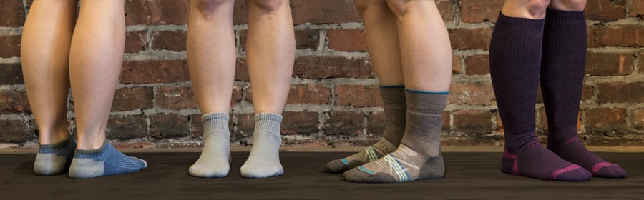
Hiking Sock Height
Hiking socks come in different heights, from so short that they don’t even show above your shoes to tall enough to nearly touch your knees. To choose the right height, take a look at your footwear. The higher the cuffs are on your boots or shoes, the taller you want your socks to be so they can protect your skin from rubbing directly against your footwear.
These are the four main sock heights:
  No-show: These shorty socks provide very little protection against skin-to-boot abrasion, so they should only be worn with low-cut footwear, like trail-running shoes or light hiking shoes.
  Ankle: Slightly higher than no-show socks, these will usually cover your ankle bone for a bit more protection. They are good for low- to mid-cut shoes and boots.
  Crew: This is the classic height for a hiking sock. Crew socks typically land a few inches above your ankle bones to protect against abrasion with boots that have high cuffs. There’s no reason you can’t wear crew socks with low-cut boots or shoes, just know that the extra coverage could be warm on a hot day.
  Knee-high: You’ll only find a few options in the knee-high category, and they’ll probably be for mountaineering. High socks protect against abrasion that big, burly boots can cause around your shins and calves. The coverage can also help keep your lower legs warm when you’re climbing through the night and crossing glaciers.

Slide 30
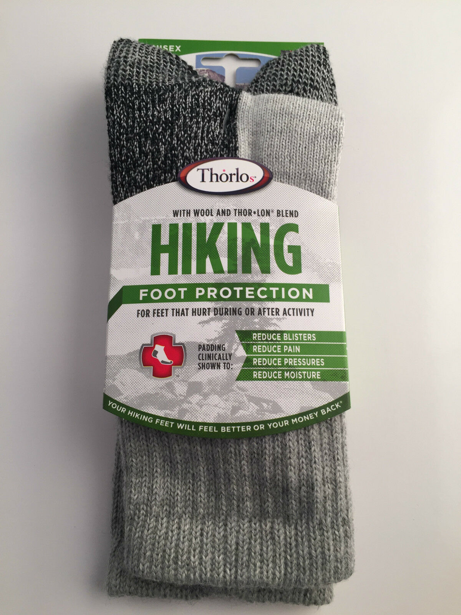
Hiking Sock Cushioning
The amount of cushioning a sock has gives you an idea of how thick the sock is and how warm it will be.
The right amount of cushioning for you depends mostly on the types of trips you go on and the weather you expect.
A bit of cushion can protect your feet during high-impact activities like running and backpacking, but keep in mind that thicker socks are warmer and can cause your feet to sweat.
You may have to experiment to find the right balance of cushion-to-warmth that works for you.
Having a variety of socks to choose from in your sock drawer is helpful.

Slide 31
Hiking Sock Cushioning
The four types of cushioning in socks are:
  No cushioning: These ultralight socks are designed for use in hot weather. They are very breathable and have little padding. A handful of socks in this category are liner socks, which some hikers like to wear underneath a lightweight, midweight or heavyweight hiking sock. Liner socks were once very popular for their ability to wick moisture and to keep feet dry, but nowadays many hiking socks perform well enough to not require a liner sock. However, if you know liner socks work for you, you can certainly keep on using them.
  Light cushioning: Great for warm conditions, socks with light cushioning prioritize moisture wicking and comfort over warmth. They are relatively thin, but have some light cushioning in key places, like the heel and ball of the foot.
  Medium cushioning: These socks provide a good amount of cushioning in the heel and ball of the foot for hiking and backpacking and enough warmth for use in moderate to cold conditions.
  Heavy cushioning: These are generally the thickest, warmest and most cushioned socks available. They are made for long trips, tough terrain and cold temperatures. They’re often too thick and warm for backpacking journeys in warm weather, and are recommended for mountaineering or on cold-weather backpacking trips.

Slide 32
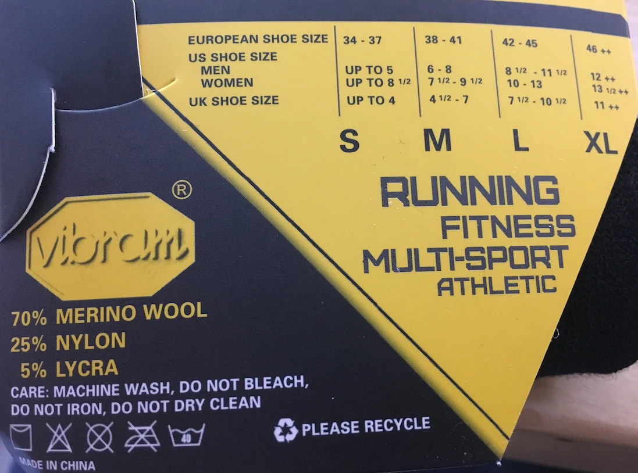
Hiking Sock Fabric Type
Hiking socks are rarely made from a single fabric, but rather from a blend that creates the right balance of comfort, warmth, durability and fast drying.
These are the most common materials you’ll find in hiking socks:
  Wool: Wool is the most popular hiking sock material and the one that our footwear specialists recommend above all others. It regulates temperature well to keep your feet from getting sweaty and it provides cushioning. Another plus is that wool is naturally antimicrobial so it tends to retain smells less than synthetic fabrics. These days most socks are made of merino wool, which is essentially itch-free compared to older types of rag wool socks. And most wool socks use blends of wool and synthetic materials for better durability and faster drying.
  Polyester: Polyester is a synthetic material that insulates, wicks moisture and dries quickly. It is sometimes blended with wool and/or nylon to create a good combination of warmth, comfort, durability and fast drying.

Slide 33
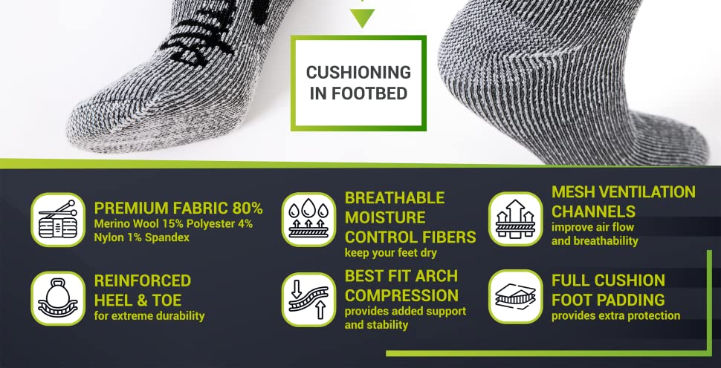
Hiking Sock Fabric Type (continued)
These are the most common materials you’ll find in hiking socks:
  Nylon: This is another synthetic option that is occasionally used as the primary material. It adds durability and can help improve drying times.
  Silk: A natural insulator, silk is comfortable and lightweight, but not as durable as other options. It's occasionally used in sock liners for reliable moisture wicking.
  Spandex: Many hiking socks include a small percentage of spandex. This elastic material helps socks hold their shape and keep bunching and wrinkling to a minimum.

Slide 34
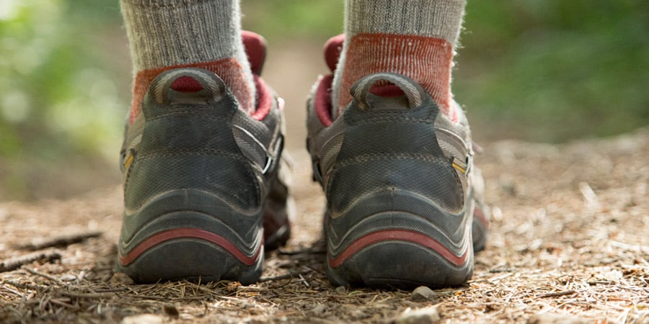
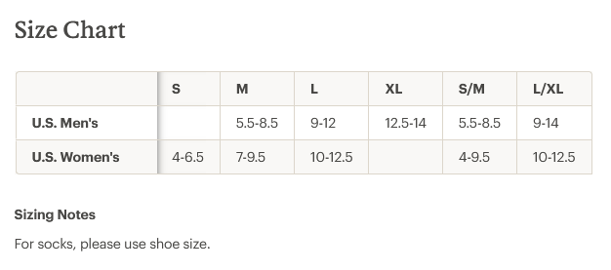
Hiking Sock Fit
Getting socks that fit right will help keep your feet comfortable on hiking trips. If your socks are too big they can have wrinkles that will rub and may cause a blister. Too small and they can create pressure points and sock slippage.
  To find the right size, it’s helpful to know the size of your actual foot rather than your shoe size because sometimes people size-up in shoes, which can lead to buying socks that are too large. If you don’t know your foot size, stop into your local shoe store.
  Once you know your foot size, use that number with the size charts to locate the correct size socks. If you’re in a store, look for a size chart on the sock packaging. If you are between sizes, size down to avoid excess material that can bunch up and cause blisters.
  How socks should fit: When you try socks on, look for a snug, but not overly tight fit. A sock fits properly when the heel cup lines up with the heel of your foot.

Slide 35
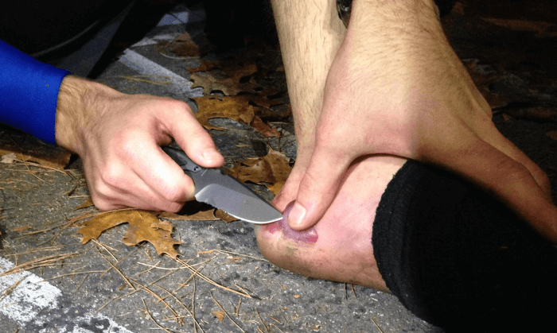
Liner Socks
Today, most socks are individually designed to suit feet when hiking or backpacking.
  The fabric blends will insulate, wick moisture and cushion all at the same time.
Yet another method to achieve these same results is a two-sock system that teams a thin, liner sock with a thicker, outer sock.
If you’re prone to blisters , you may want to try liner socks on your next hike.
  Hiking blisters form as a result of friction and most frequently appear under warm, moist conditions, such as inside a sweaty hiking boot.
  Liner socks work by “wicking” the sweat away from your skin and sending it towards the outer layers of your clothing, keeping your feet dry to reduce the friction that causes blisters.
  Liners also limit the amount of abrasion between your outer sock and your skin.
Whether you prefer to wear one or two socks is really a matter of personal preference as both approaches can work.

Slide 36
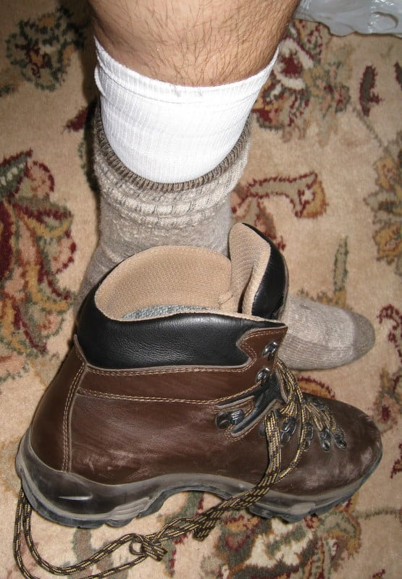
Liner Socks
What to consider when buying your first pair of liner socks for hiking.
  Avoid cotton liners. Cotton won’t keep your feet dry therefore it won’t prevent rubbing.
  The best fabrics for liner socks are the synthetic ones like nylon and polyester.
  Wool has the added benefit of regulating temperature to keep you cool in summer and warm in winter.
  Make sure your liners have a snug fit. If they are too loose they might rub and cause blisters themselves!
  Sock liners come in different lengths, from low-cut to high-. You’ll want to pick the cut that matches your choice of sock and shoe. If you wear high-top hiking boots, make sure you find a sock liner that comes higher than the top of your boot to prevent rubbing.

Slide 37
03
Fabric Options
Layering
Clothing

Slide 38
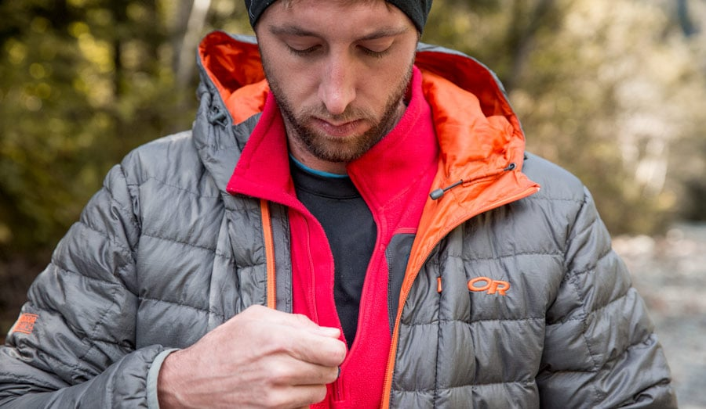
What to Wear Backpacking
Whether you’re backpacking for two nights or two months, you’ll need basically the same fundamental pieces of clothing for layering, with variations to address the specific weather or environmental conditions you’re likely to encounter.
Layers are key. You can stop and remove a layer when you start to sweat, and add a layer when you start to feel chilled.
The individual clothing choices you make will likely be based on a combination of the following factors, which may require tradeoffs:
  Functionality: Fabrics that are moisture-wicking and quick-drying, sun-protective, antimicrobial to avoid odors, and able to rebuff insects where ticks, mosquitoes and other pests are a nuisance.
  Weight vs. comfort: Some will forgo the convenience of added features in order to save ounces while others will opt for comfort despite the added weight.

Slide 39
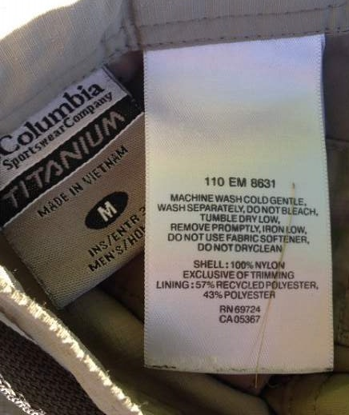
Fabric Options
Typical fabric choices for key layering pieces:
  Wool: Once maligned for being itchy, wool is now getting its day in the sun. Ultra-fine merino wool is itch-free, naturally breathable and moisture-wicking, fairly fast-drying and not prone to odors. Wool makes ideal socks, hats, tees and base layers. Despite all these benefits, some people avoid wool because they feel their skin is sensitive to it, and it can be expensive.
  Polyester/nylon: These synthetics tend to be very quick-drying and quite durable. They make excellent pants and shirts. Some people find that synthetics can feel a bit clammy and they start to stink more quickly than natural fabrics.
  Silk: Because silk moves moisture off your skin more slowly than synthetics, it is considered best only for moderate cool-weather activities. “Treated” silk has been chemically modified to enhance wicking. Silk makes a soft, luxurious layer and adds no bulk, but it can be prone to odor and is potentially vulnerable to abrasion and sunlight.

Slide 40
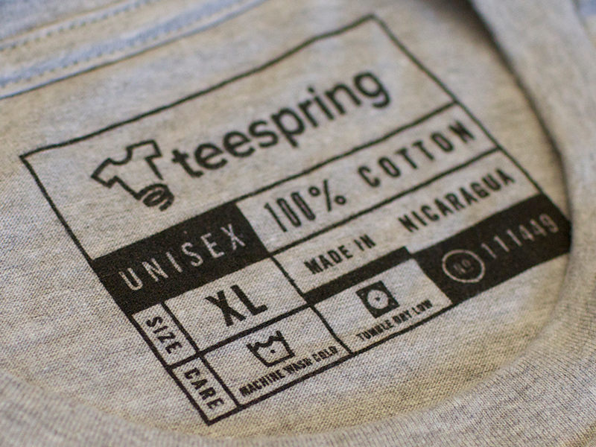
Why Cotton is Bad for Hiking
Absorbs too much moisture:
  Cotton is in general heavier than competitive synthetic fabrics and because it absorbs so much moisture it gets even heavier when soaked with sweat.
  Cotton can absorb as much as 2700% of its own weight in moisture.
  Polyester absorbs only up to 0.4% of its own weight in moisture, silk 30% and Merino wool 33%.
Poor at regulating temperature:
  Clothing that offers great temperature regulation is able to keep you warm when it’s cold and cool when it’s hot. This is only possible if your skin and clothing stay relatively dry – even when you are sweating. If your apparel gets soaked with sweat (or rain), your body heat is rapidly transmitted to it (in a process called conduction) and you lose warmth very fast. This can in severe cases lead to hypothermia.
Long drying time:
  As cotton absorbs so much moisture it also dries very slowly.
  Hiking requires clothing that dries fast and thus reduces conductive heat loss, keeping you at your body’s natural temperature.

Slide 41
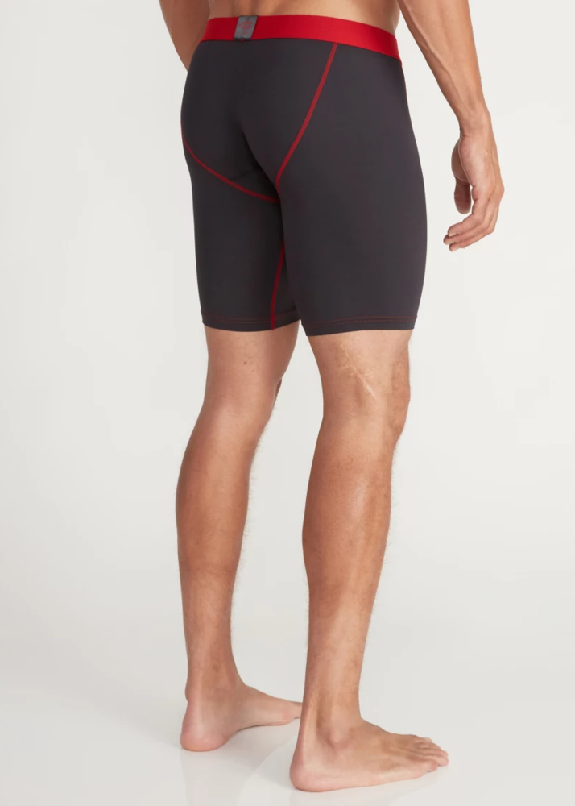
Base Layers
Your base layers are important because they manage moisture and keep a layer of warm air near your body. Choose a wicking fabric such as polyester or ultra-fine merino wool to keep your skin dry so you stay warm and comfortable. Wool can have a cozier feel than a slick synthetic fabric, a nice touch in colder temps.
  Underwear: For backpacking trips, underwear is a matter of preference: Some men prefer boxer length, some women prefer the boy-short cut. Some women swear by wool undies, others only wear nylon-spandex mesh undies. Make sure they’re airy and breathable, (which means not super tight) and are not cotton—once damp, cotton takes a long time to dry, which is uncomfortable and can cause chafing and yeast infections.
  A general rule of thumb: Bring two to three pairs of underwear. Rinse out a pair as often as you feel it’s warranted.

Slide 42
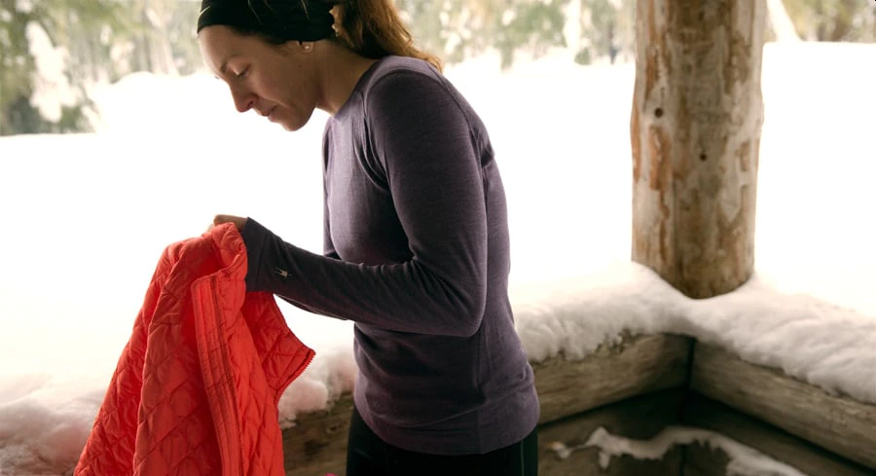
Base Layers (continued)
  Bras: Choose a pullover sports bra without any clasps. Those metal or plastic parts can dig into your skin if they end up under your pack straps. Consider bringing an extra bra, or bring a super-lightweight camisole to wear while your bra is drying.
  Tank top/camisole: A versatile piece, this lightweight top has many functions: adds to core warmth, makes a lighter alternative to a T-shirt and makes a good sleep top on warm nights. They may be made of silk, fine wool or synthetic fabrics.
  Base layer top and bottoms: Also called long underwear, and available in different weights, these are a must for cool- or cold-weather backpacking. Choose from crew necks or zip-necks, which are a nice option for their ease of venting. Bottoms are multifunctional: You can hike in them under rain pants on rainy, chilly or windy days; they feel good to put on when you arrive in camp; and you can reserve a clean pair to sleep in.

Slide 43
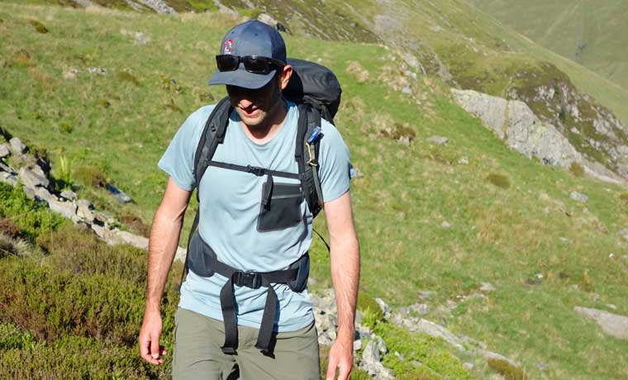
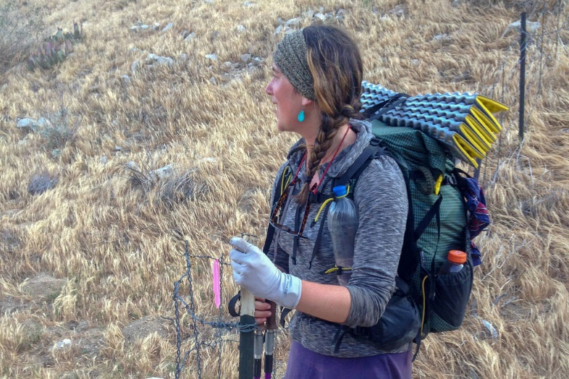
Shirts, Pants, and Shorts
In general, bring one to two T-shirts, one long-sleeve shirt and one pair of lightweight yet durable synthetic pants. A pair of ultralight running shorts with a built-in brief can be a boon for hot weather: You can also swim in them and wear them while you wash and dry your pants.
  T-shirt: Again, go with wool or synthetic. Bring 2-3 tees: 1-2 for hiking, and one to keep clean for sleeping in.
  Long-sleeve shirt: Here’s where locale comes in and where specific fabric benefits come into play. If you’ll be hiking in the sun-drenched Southwest, for example, it’s smart to bring a long-sleeve shirt rated UPF 50+. If you’ll be trekking Northeastern forests, consider a long-sleeve shirt as well as long pants that contain an insect repellent to discourage ticks, mosquitoes, no-see-ums, black flies and more.

Slide 44
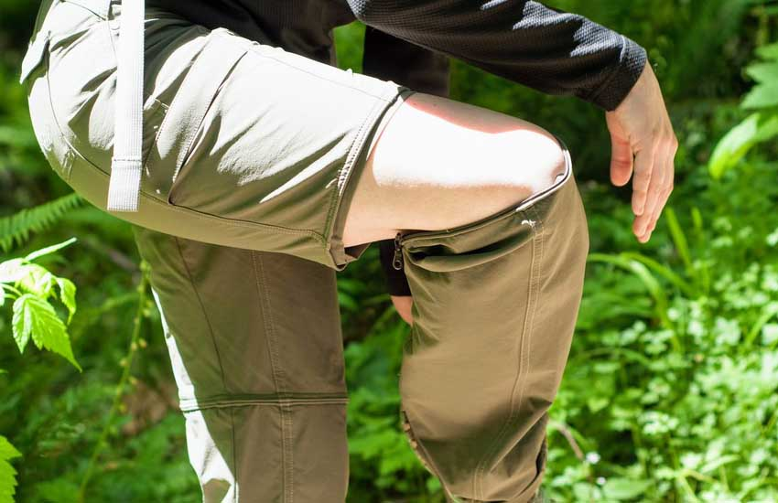
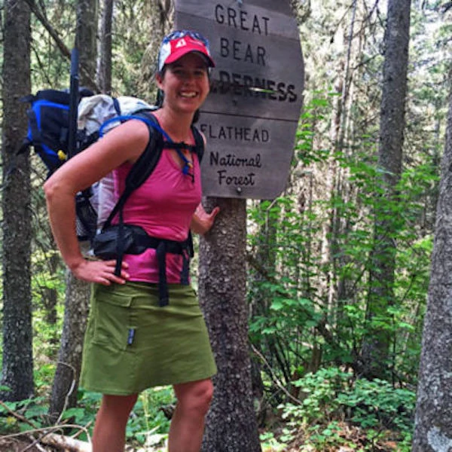
Shirts, Pants, and Shorts (continued)
  Convertible pants: Creek crossings and hot weather make convertible pants a good choice. Zip-off pants give you a real pair of shorts with nice gear pockets, but can be fussy to reattach; also, some find that the zipper can dig into their legs. Roll-up pants are a popular option, with button tabs above the ankle or near the knee. Cinch-pants also let you adjust the length.
  Yoga pants/tights: These are a comfy choice for putting on at camp. While stretchy and easy to hike in, if your trail involves any rock scrambling or dense brush, think twice: They won’t be as durable as nylon pants. (Tight clothing also does a poor job of protecting you from mosquitoes.)
  Hiking skirt, dress or skort: Most are stretchy and skorts have a built-in liner.

Slide 45
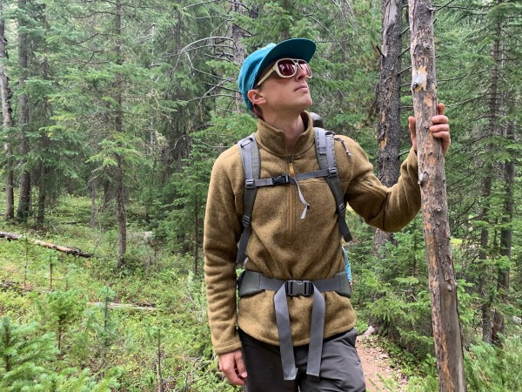
Mid Layers
Here’s where warmth comes in. A standard recommendation is to bring two of these layers, usually a simple lightweight zip-neck fleece top and a puffy jacket, but adjust as needed for your specific trip.
  Fleece top: This is one of your most versatile pieces. On colder days, you can wear it while hiking and/or sleeping. On warmer nights when you don’t need to wear it sleeping, it serves as a soft pillow. Even if you’ve been hiking in a tee all day, a fleece feels good to pull on as the sun goes down. To save ounces, choose one with a quarter zip and no pockets.

Slide 46
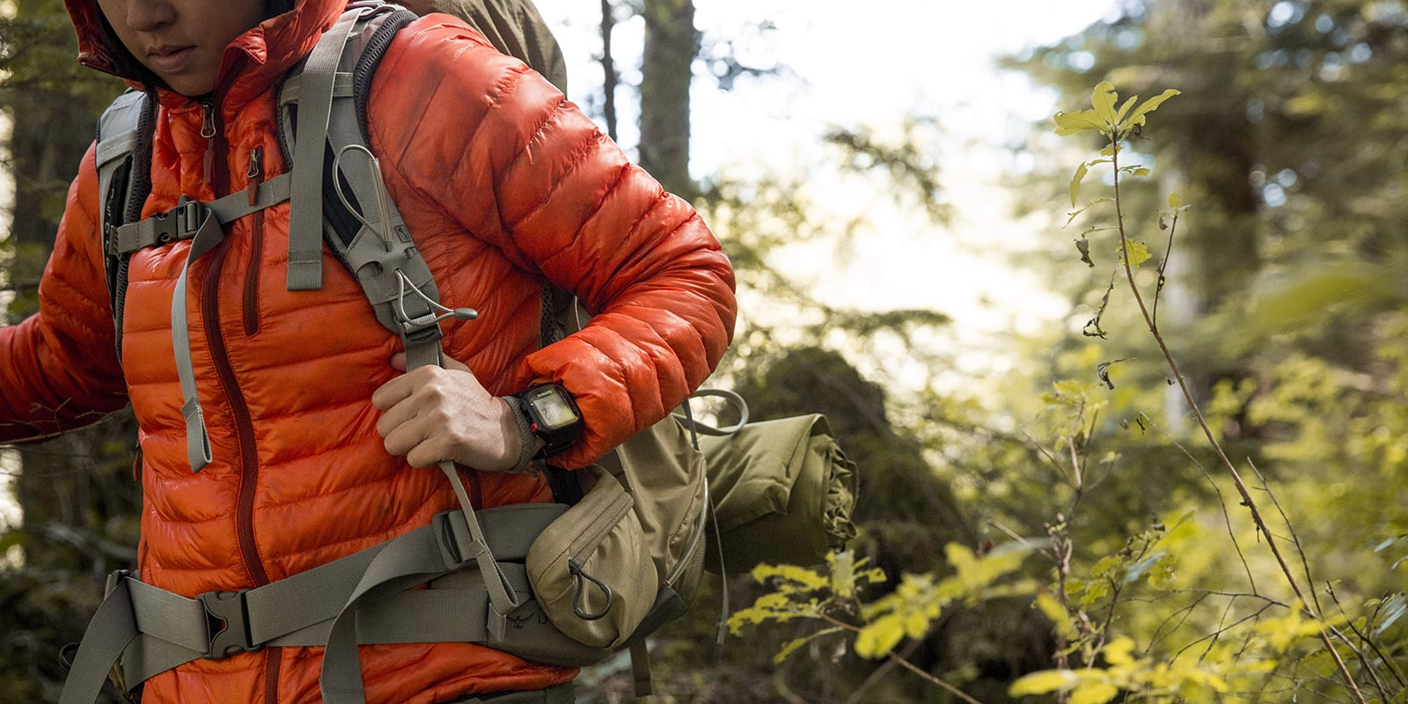
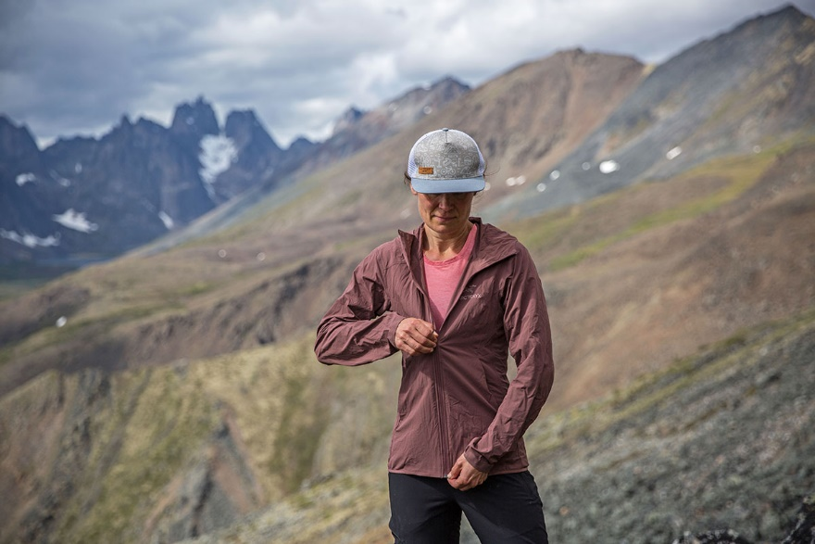
Mid Layers (continued)
  Puffy insulated jacket or vest: Again, depending on the weather forecast, you may want a fairly substantial down jacket if it’s going to be cold or snowy. If milder temps are on tap, bring a down vest, lighter-weight down jacket or synthetic insulated puffy. It’s good to be prepared for any sudden downturn in temperature. Any of these should compress compactly.
  Soft shell: A third option is a soft-shell jacket. Often these are water-resistant (not waterproof), may block wind, and may have a light fleecy lining for a bit of warmth. You still need to bring a solid rain jacket, though, for keeping dry in a storm, and soft shells are not very compressible.

Slide 47
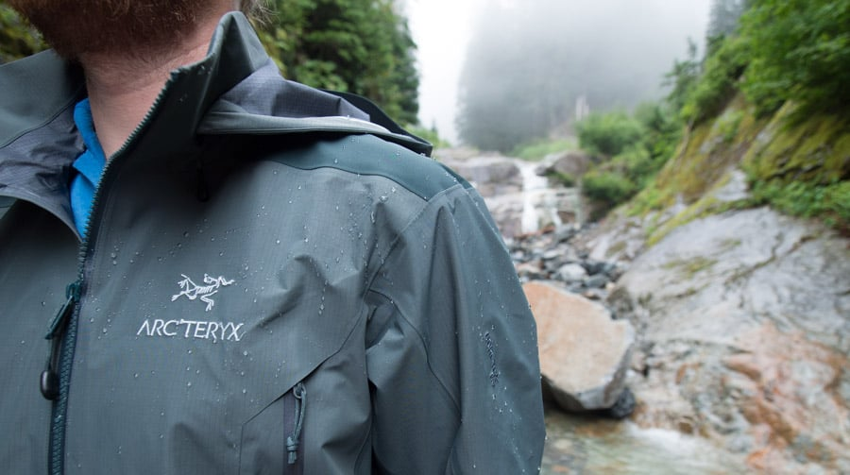
Rain Jackets and Pants
See those dark clouds gathering? You’ll be glad you have your hard-shell outerwear. Choose a rain jacket and pants that are waterproof and breathable, which makes them fairly comfortable to backpack in. Remember: Keeping dry is key to avoiding hypothermia.
Also choose a jacket that’s got pack-compatible pockets and an adjustable hood so you retain visibility as you hike. Pants with full-length side zippers can be the easiest to get on and off while leaving your boots on. Look for pants with an elastic or adjustable waist, and pockets, which are nice to have.
Tip: Even on dry days, some backpackers wear hard-shell outerwear as protection from wind and cold.

Slide 48
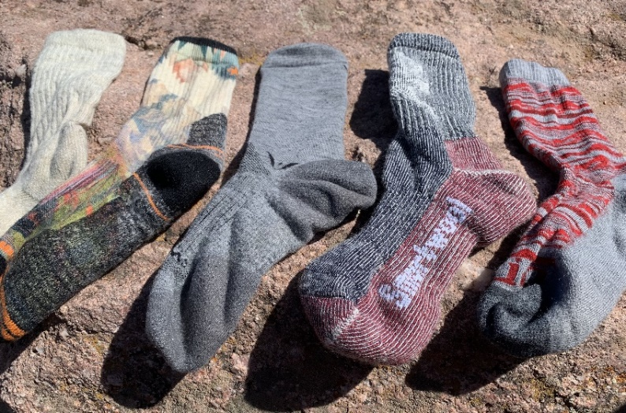

Accessories
Keeping your feet, head and hands comfortable is crucial to a successful backpacking trip.
  Socks: Socks are one of the most important items you can bring backpacking. If possible, try out all kinds of socks and sock combinations well in advance of a long backpacking trip so you know what feels good with the boots or shoes you’ll be wearing. A wool/synthetic blend with plenty of cushioning works best for a great many people, especially those wearing boots. Many people like to wear a pair of thin liner socks underneath a heavier pair. If you’ll be hiking in trail runners, you may want a lighter-weight pair of socks.
    Sock tip: When you stop for a lunch break during the day, take off your boots and socks and let your socks dry in the sun. Dip your feet in a stream or lake if there is one, and let them dry out too. Do the same at the end of the day in camp, so you go to bed with clean, happy feet in a clean pair of socks dedicated to sleep.

Slide 49


Accessories (continued)
  Hats: Bring two types: one for sun protection, one for warmth. If you’re fighting sun in the desert, consider a wide-brimmed hat or a billed cap with a sun cape attached. Your warm hat can be a simple wool or synthetic cap, one you can also sleep in.
  Gloves: As long as the weather stays fairly mild, you can get by with a pair of stretch three-season gloves with a smooth exterior that resists light moisture and a fleecy interior that offers a little warmth.

Slide 50


Accessories (continued)
  Other accessories: A cotton bandana (finally, cotton gets its day) or a polyester neck gaiter are great to have for all kinds of reasons. Either can be worn on your head to keep hair out of your eyes, or around the neck for sun protection (or warmth, in the case of the neck gaiter).

Slide 51
Questions?
Terry McKibben
Troop 344/9344
Pemberville, OH
troop344leaders@gmail.com

