Slide 1
Backpacking Guide Course #4
Terry McKibben
Troop 344/9344
Pemberville, OH
troop344leaders@gmail.com

Slide 2
CONTENTS
01
Tents
Choosing a Tent, Tent Care and Cleaning
02
Moisture Control
Rain Gear, Keeping the Pack and Contents Dry, Rain Fly
03
Trekking Poles
Advantages of Trekking Poles, Selecting Trekking Poles, Care of Trekking Poles

Slide 3
01
Choosing a Tent
Tent Care and Cleaning
Tents

Slide 4
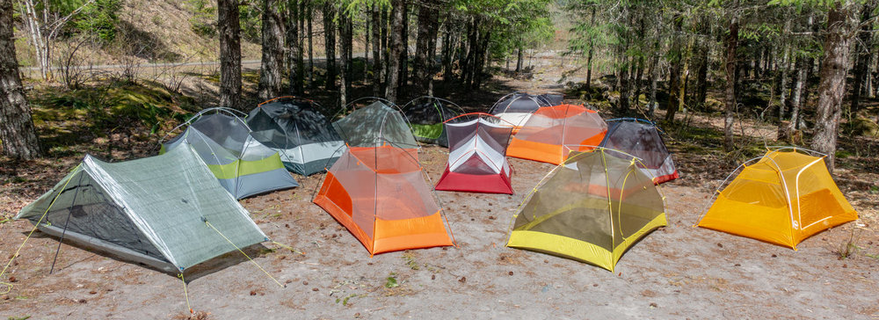
How to Choose a Backpacking Tent
Because it has a big effect on both your budget and your pack weight, the backcountry shelter you choose is one of your most important gear-buying decisions.
To complicate matters, backpacking tents come in an astounding variety of designs, from minimalist to mansion-esque.
To simplify choosing the right backpacking tent, you can break the process down into the following decision points:
Capacity: likely number of sleepers
Seasonality: tent construction relative to expected weather conditions
Weight: ounces carried vs. dollars spent
Livability: well-placed interior space, ease of access, ease of setup and more

Slide 5
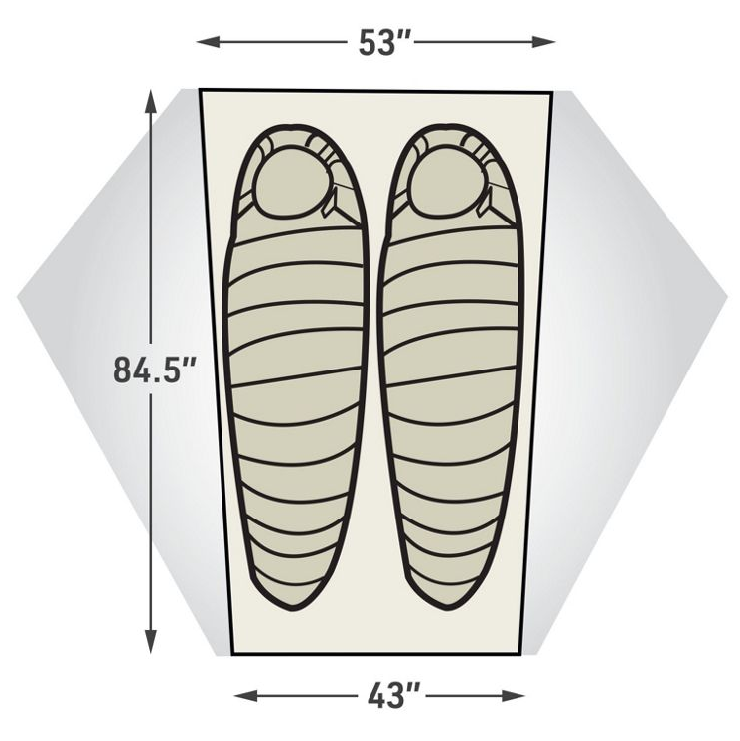
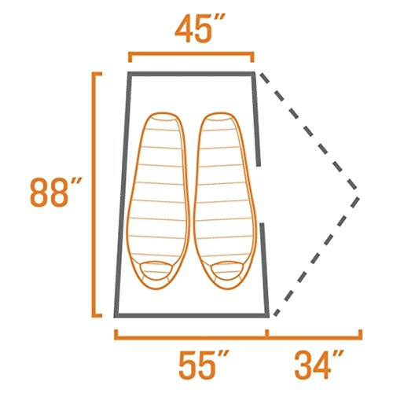
Backpacking Tent Capacity
Backpacking tents are categorized by capacity: from 1- to 4-person models. Most tent names include a number for the capacity: REI Half Dome 2, for example.
To save weight, tent interiors are “cozy.” No industry standard defines per-person dimensions, so a 2-person tent size can vary from brand to brand. Ultralight models are likely to be extra compact.
If you’re larger than average, or you simply crave a little more space, one option is to look at tents designated one-person larger than your group. Alternatively, you can hunt for a tent that’s one or two inches wider or longer than average. Some offer clues in the name: adding a “plus,” for example. Always compare exact dimensions between tents you’re considering, though, if having more floor space is important to you.

Slide 6
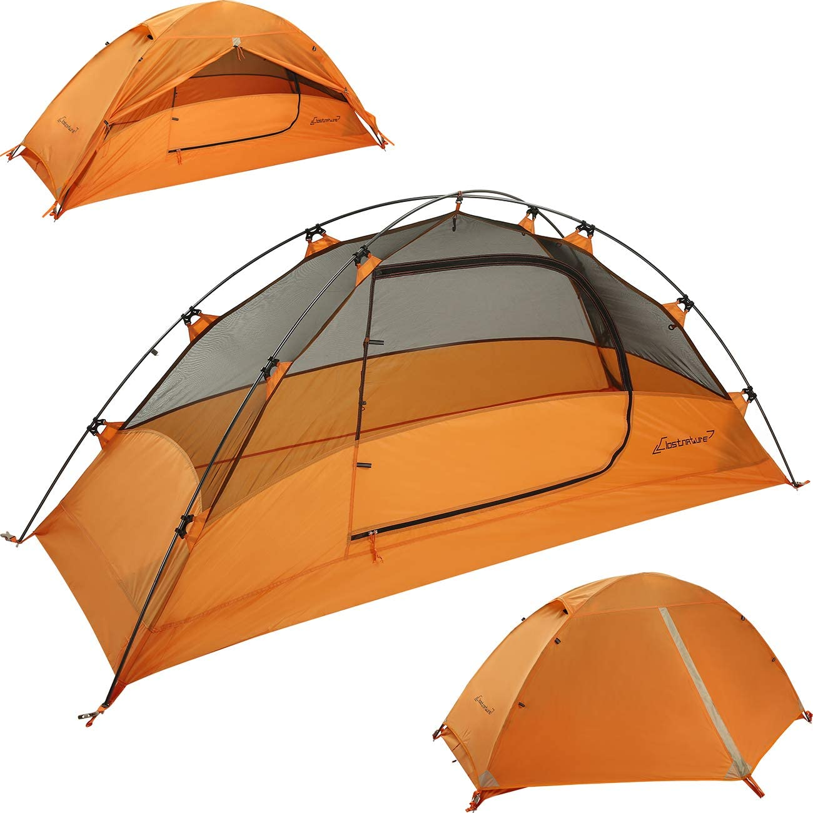
Backpacking Tent Seasonality
The vast majority of hikers, especially newcomers to the backcountry, will choose a 3-Season Backpacking Tent.
These tents balance the need to keep weight low with the need to handle the wide range of conditions that spring, summer and fall can conjure up. Properly pitched, 3-season tents can withstand downpours and light snow but are not built for sustained exposure to harsh storms, violent winds or heavy snow. Key features:
Ample mesh panels to boost airflow and keep out insects
More upright walls to create more interior headroom
Fewer poles and lighter fabrics to keep weight low
Four-season tents are engineered to withstand fierce winds and substantial snow loads; however, they have less ventilation, feel stuffy in mild weather, and weigh more.

Slide 7
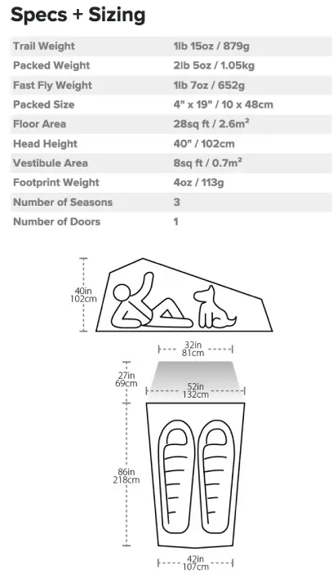
Backpacking Tent Weight
The weight of your backpacking tent is a big part of your overall load. Your biggest tradeoffs to cut weight are having less space, fewer features and less durability over the long haul.
Key Tent Specs
Minimum trail weight: The weight of the tent body, rainfly and poles only. You will probably pack more tent-related gear (e.g., stakes, footprint), but this is the best spec for comparison.
Packaged weight: This is the weight of all the components you get with a purchase: body, rainfly, poles, stakes, stuff sack pole sack, instructions and more. The weight you’ll carry on the trail will be somewhere between this and the minimum weight.
Packed size: The amount of space the tent takes up in a pack also relates to how easy a tent is to carry. You can reduce this space by splitting up components—have your partner take the poles and rainfly while you carry the tent body.

Slide 8
Minimalist Shelters
Most backpacking tents have a double-wall design that includes a main tent body (also known as the canopy) plus an exterior rainfly. If you’re a hiker who focuses on saving every possible ounce, you have additional options.
Fly/footprint option: Many double-wall tents have an ultralight setup option, where the footprint (sold separately), poles and rainfly can be pitched together without the main tent canopy.

Slide 9
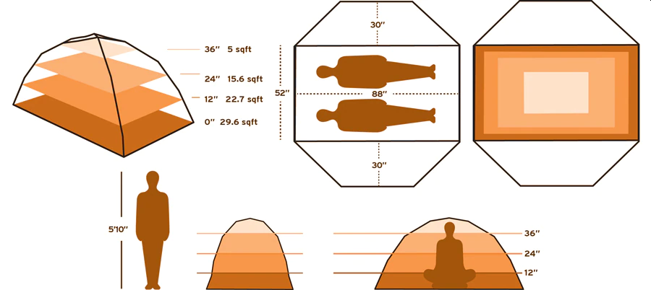
Backpacking Tent Livability
“Livability” is a catchall word for features that make the time you spend inside your tent more enjoyable. A big part of livability is how roomy—or cramped—a tent feels to you.
Test-pitch tents: Visit a store and ask to set up prospective tents so you can hop inside them. Then make your mountain-storm pick: Which is the one model would you choose if you had to ride out a storm for hours on end?

Slide 10
Backpacking Tent Livability (continued)
To further assess a tent’s interior space, you can also look at the following specs:
Floor dimensions (floor plan): Length and width measurements offer a rough idea of floor size. Many tents don’t have perfectly rectangular floors, so you might see dimensions like 85” x 51”/43” (L x W head/foot). A tapered floor provides needed room for shoulders and arms, while also saving weight by having a narrower foot.
Floor area: This number indicates total square footage of floor-level space. While helpful for comparison between tents, this number alone won’t tell you how efficiently the space is laid out.
Peak height: No one likes to bump their head when they sit up. Peak height, though, is measured at a single spot, so don’t rely solely on this spec to assess overall headroom. The test pitch (noted above) is much better way to assess that.
Wall shape: This is an even bigger factor in head and shoulder room—and overall tent livability—than peak height. The more vertical the walls, the more open the tent’s interior will feel. If you’re unable to go to a store to test pitch tents, then study the pitch of a tent’s walls in online photos: If they angle steeply toward the tent's ceiling, you're looking at a more weight-efficient tent (great!) that offers only modest interior volume (the tradeoff).

Slide 11
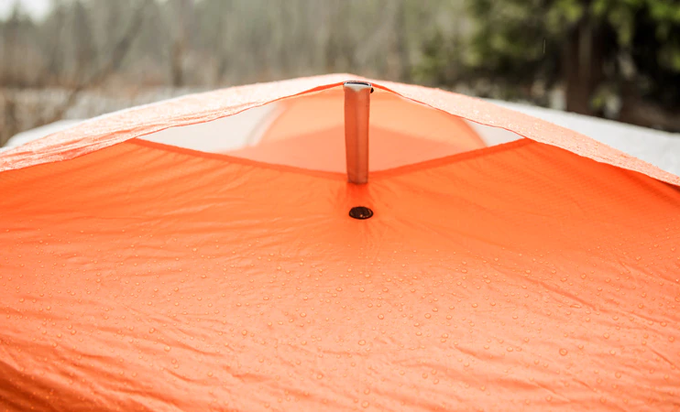
Additional Features that Improve Tent Livability
Rainfly color: Light, bright fly colors transmit more light inside, making the interior brighter. That will make a tent feel more spacious and make it a more pleasant place to be if a storm keeps you tentbound for an extended time.
Doors: Tent designers focus on door shape, zippers and other adjustments, but the most important question is: How many? It’s nice when every sleeper has a door. Choosing a multiperson tent with a single door, though, cuts weight and cost.
Vestibules. These rainfly extensions offer sheltered storage for boots and other gear. An oversized floor area would offer the same advantage, but it would also create a heavier tent. Most tents have vestibules and their size is included in the specs. Bigger is better, but cavernous vestibules can add weight and cost.
Ventilation: You exhale moisture as you sleep and a tent needs ways to deal with that. That’s why features like mesh windows or panels and adjustable rainfly vents are important: They let you increase airflow to prevent condensation buildup inside. Being able to roll up rainfly doors or panels can also boost ventilation. As a bonus, it also lets you open up views to gaze at stars or witness the sunrise.

Slide 12
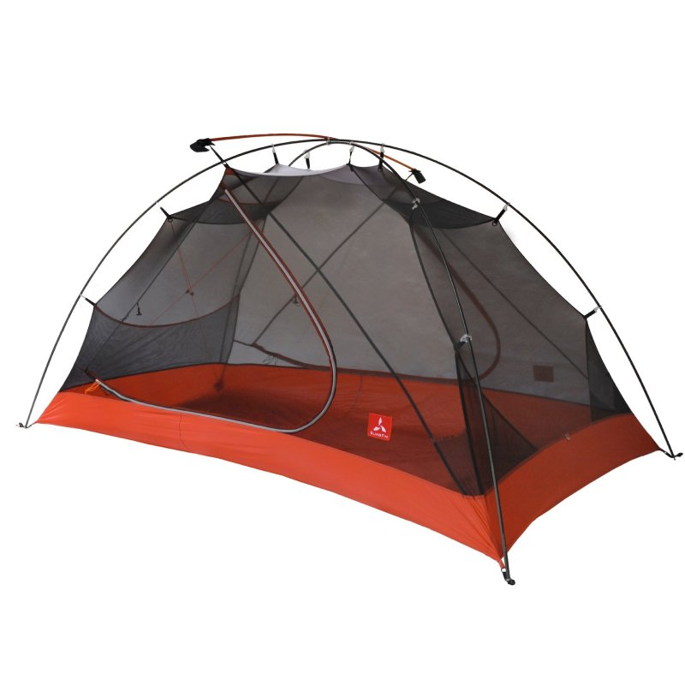
Tent Setup
It’s always wise to set up a tent once or twice before trying to do it in the wilderness. Regardless of where you pitch it, the following features can make setup easier:
Freestanding design: This simply means the tent can stand without the use of stakes, which speeds setup and makes a tent easy to reposition—just lift and move it to a new spot.
Most tents are freestanding for this reason, though non-freestanding tents can be lighter because the pole structure doesn’t have to be as robust.

Slide 13
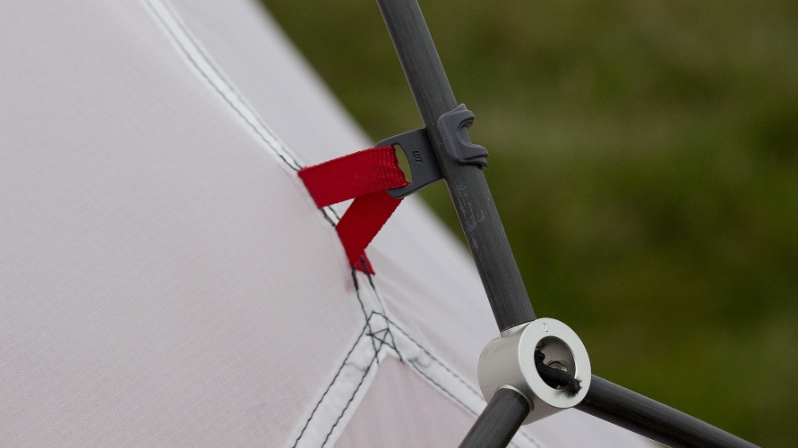
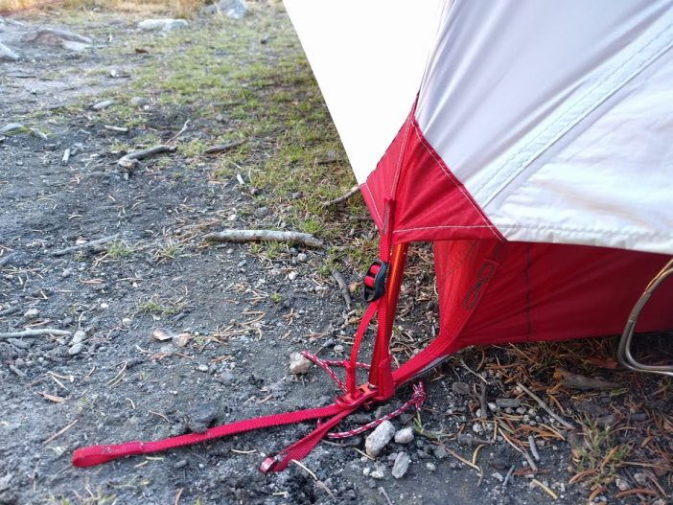
Tent Setup
Pole hubs: The beauty of hubs is that they take the guesswork out of assembly. You take the folded pole sections out of the bag and unfurl the skeleton, seating segments as you go. Smaller cross poles might be separate from the hub, but those are easily identified after the main pole assembly is complete. The other major benefit of hubs is that they allow tent walls to be more vertical to create a more livable interior space.
Pole clips: Poles connect to tent canopies via clips, sleeves or a combination of the two. Pole sleeves’ fabric tension provides a stronger pitch, but threading poles through them can be a challenge. Pole clips are lighter and easier to attach. They also allow more airflow underneath the rainfly, which reduces condensation.
Color coding: This helps you quickly orient each pole tip to the correct tent corner and helps you find which sleeves or clips go with which pole sections.

Slide 14
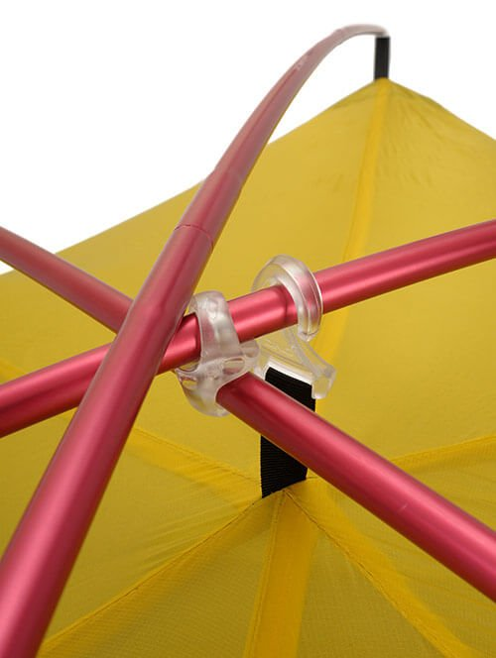
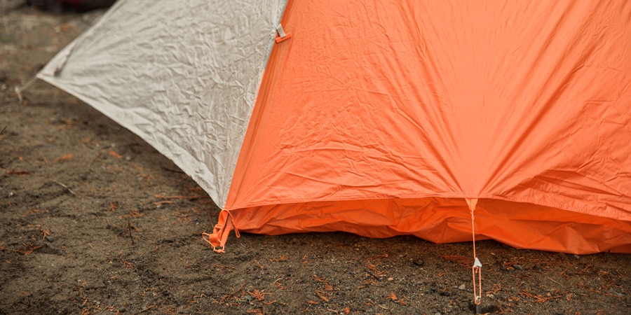
Tent Materials
Poles: Backpacking tents have high-strength, low-weight aluminum poles. You often see DAC (Dongah Aluminum Corp.) in specs because this company is the world’s pre-eminent pole maker.
Tent fabrics and denier: A wide range of specialized nylons and polyesters are used in tents. One spec you occasionally see is denier (D), which is a fabric yarn’s weight (in grams) based on a 9,000-meter length of the yarn. More rugged fabrics have higher denier numbers, while lower deniers are found in more lightweight—and less durable—fabrics. Don’t compare denier unless fabrics are identical, though, because inherent differences in fabric properties have a greater effect on strength than the denier spec.

Slide 15
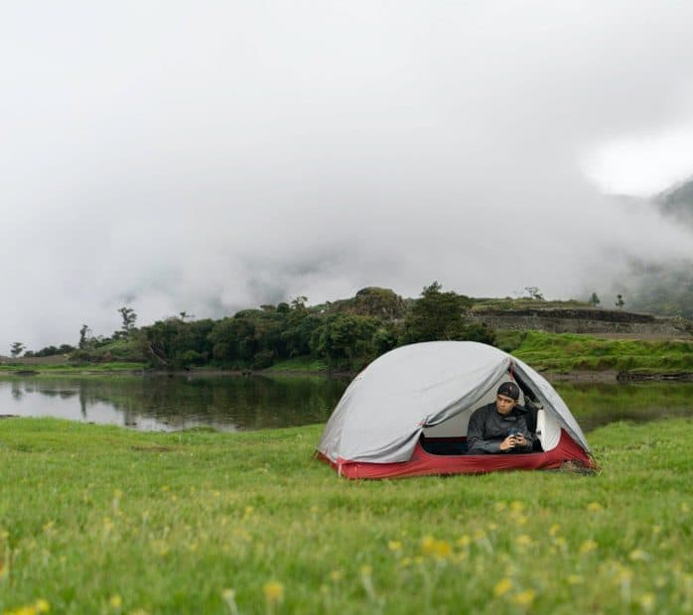
Tent Care and Cleaning
Your tent is your shelter in bad weather and your protection from the elements in the great outdoors.
Unlike an urban dwelling, your home in the outdoors requires only a modest amount of love and attention.
Treated well, a quality tent will provide years of faithful service in the field.
The following slides offer a wide range of tips on how to care for your tent.
If you do nothing else, though, follow these four important rules:
Always read the directions.
Be gentle with zippers and poles.
Clean your tent and fly from time to time.
Never store a tent wet.

Slide 16
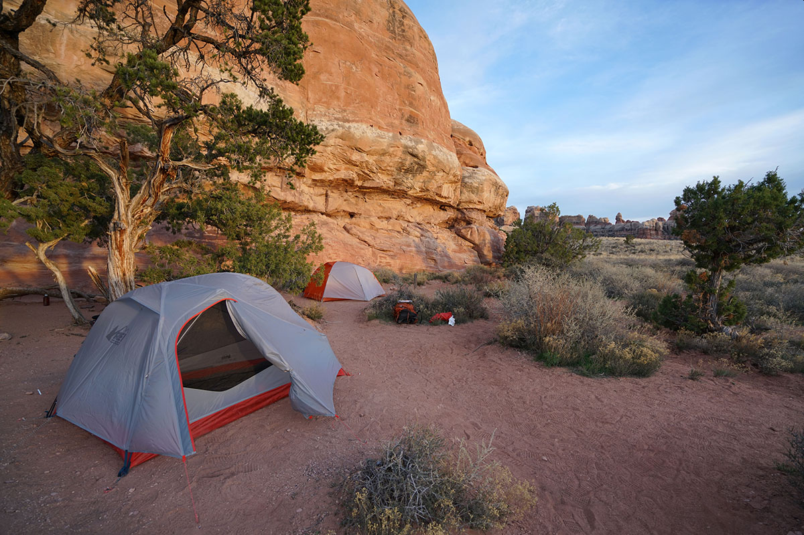
Tent Care During Setup
Before heading into the wild, do a practice pitch. Learn how to set your tent up in a no-pressure setting. Confirm that you have all the stakes, guylines and accessories you need.
When you’re in the field, follow these guidelines and you’ll extend the life of your tent:
Look for an established campsite. This key Leave No Trace principle should lead you to setup spots that are smooth, level and relatively free of vegetation.
After that, you only need to clear away debris (pine cones, twigs, small rocks) that could poke a hole in your tent floor.
Avoid disturbing your tent site any more than that.

Slide 17
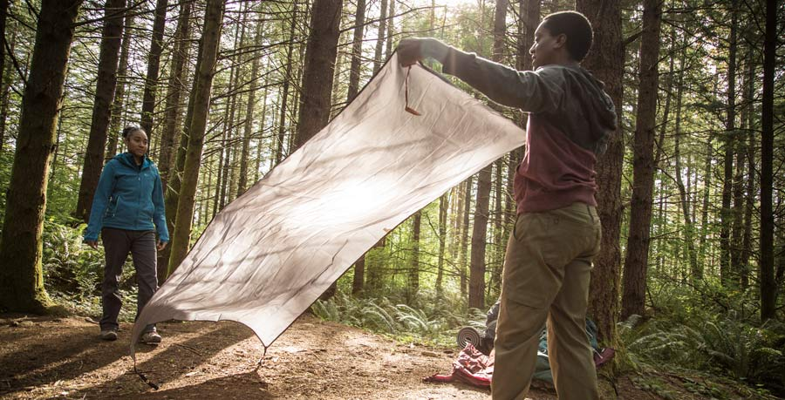
Tent Care During Setup
Use a footprint. This custom-cut ground cloth is designed specifically for the floor plan of your tent.
A footprint protects your tent floor from abrasion and provides a clean surface where you can pack up your tent.
Also, because it doesn’t extend beyond the perimeter of your tent floor, a footprint won’t collect rainwater the way a generic ground cloth or tarp can.
If using a generic ground cloth, tuck any excess material under the tent floor.

Slide 18
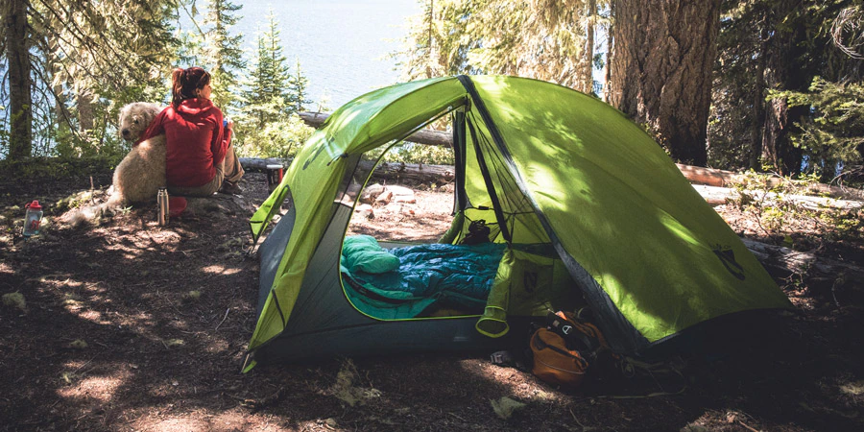
Tent Care During Setup
Avoid leaving your tent set up in direct sun for extended periods. Minimizing the exposure to ultraviolet (UV) rays is a key element to increasing the life of your tent.
Over time, UV rays degrade the fabrics in the canopy and rainfly.
Because the fly is more UV resistant, you can leave it on if the tent will be basking in the sun while you’re off bagging peaks or exploring.
Polyester flies, which many tents have, are more UV resistant than nylon rainflies.
If you’ll be away for a long time, the best practice—regardless of fly material—is to move your tent completely out of the sun.

Slide 19
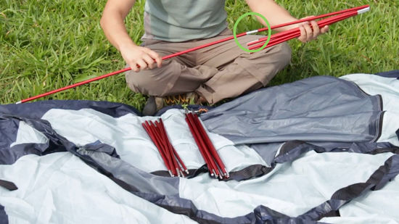
Tent Care During Setup
Go slow with the poles. Don’t whip a pole around, trying to snap its shockcorded sections into place. You can chip a section and weaken the pole—or whack your hiking companion. Setup will go more smoothly if you unfold and fit pole sections together one at a time.

Slide 20
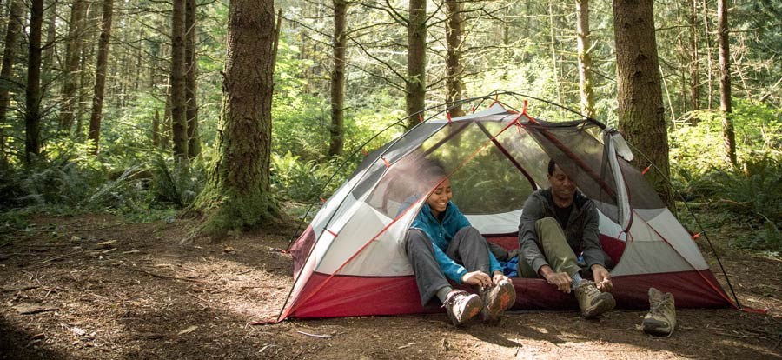
Tent Care During Use
Be gentle with your zippers. Don’t force a stuck zipper. Instead, hold the zipper track with one hand and gently back the slider up, wiggling it from side to side until the stuck fabric is free. If the zipper splits, gently back it up until it re-engages. If it continues to split, take a pair of pliers and gently squeeze the zipper slider to give it a slightly tighter hold on the zipper track. Be careful not to overtighten and jam the slider, though.
Leave boots outside or in the vestibule. Dirt, grit and pebbles falling onto the tent floor will be perfectly positioned to abrade and puncture your tent.

Slide 21
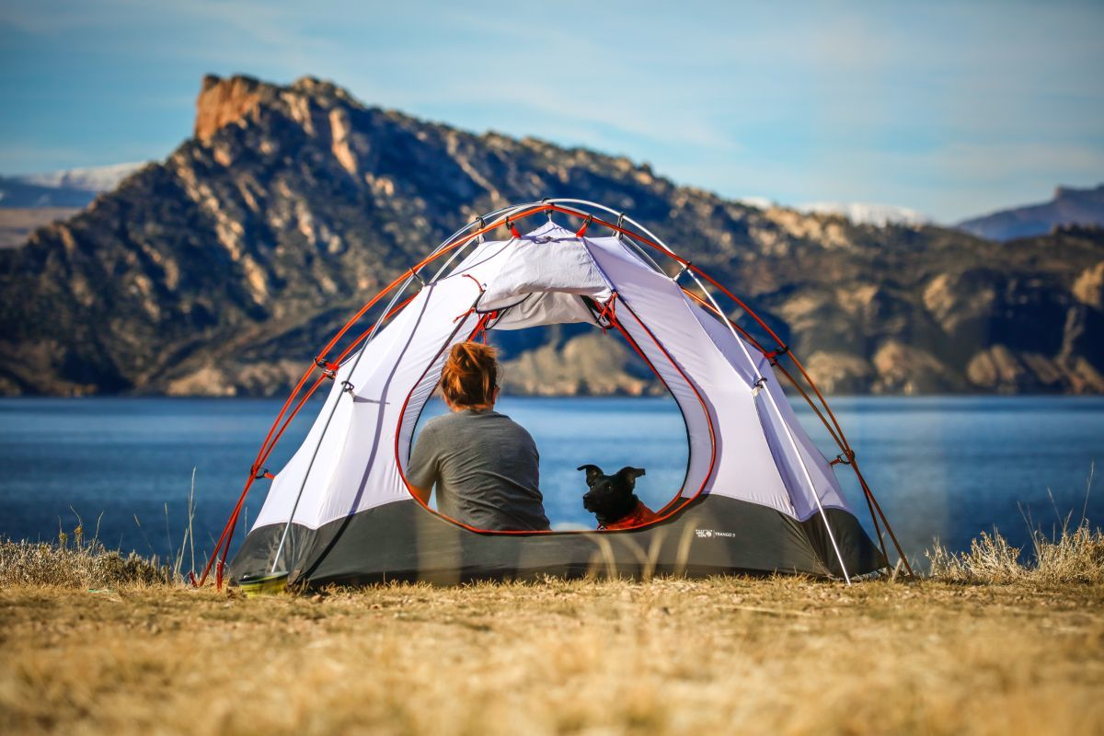
Tent Care During Use
Keep food and fragrant personal products in a secure container outside of the tent. Little creatures will chew through the fabric in search of their next meal.
Your tent is not a dog kennel, so never leave an unsupervised dog inside it. Teeth and claws can do serious damage to tent materials when your faithful companion decides it’s time to join you outside.

Slide 22
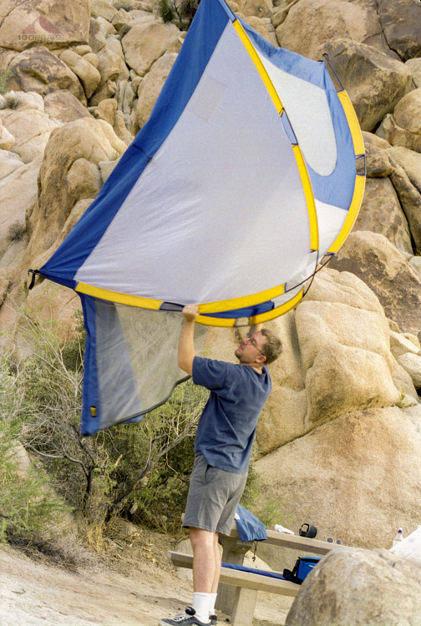
Tent Care During Break Down
Shake your tent out. Clean out dirt and debris and remove trash before you pack up. If your tent is freestanding, this is easier because the poles help hold the tent open while you dump out the dirt.
When removing a shockcorded pole from your tent, push rather than pull. If you pull and the other pole end or a pole section gets hung up, then you can put undue stress on the elastic cord.
Start in the middle when you break down your poles . This evenly distributes tension along the cord. Repeat this trick on each subsequent half section until your pole is fully folded.

Slide 23
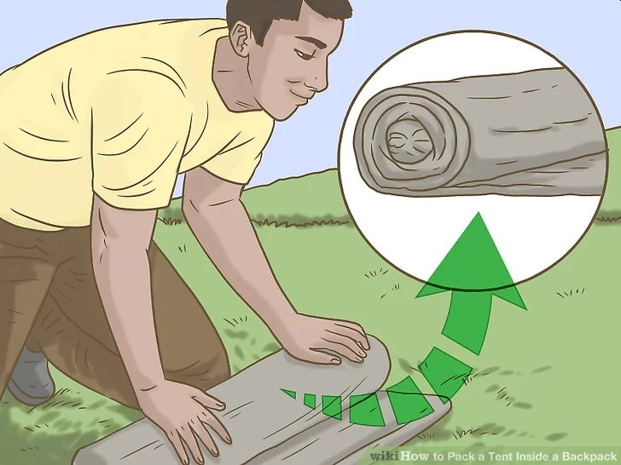
Tent Care During Break Down
Dry before stuff-sacking. Even a well-ventilated tent accumulates condensation, often under the floor and rainfly. Moisture left on a tent does damage (see below), so dry it as much as possible before packing up and hitting the trail each day. You can drape your tent and fly over a branch, a bush or a boulder, but be careful not to poke or snag the fabric.
If you must pack up in wet conditions, make sure to dry the tent as soon as you get back. If it’s a sunny day, set it up in the yard; if the weather is wet, hang your tent to dry in a garage or a non-carpeted room.
Roll up your tent rather than stuffing it like a sleeping bag. That’s less stressful on fabrics and coatings.

Slide 24
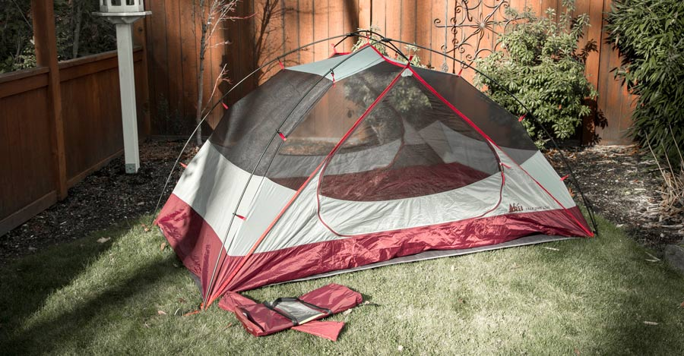
Tent Care at Home
Thoroughly air-dry your tent after trips and cleanings. There’s no such thing as too much drying time. Set it up indoors or in a shaded outdoor spot. If you don’t have enough space to pitch it, drape it or hang it until dry.

Slide 25
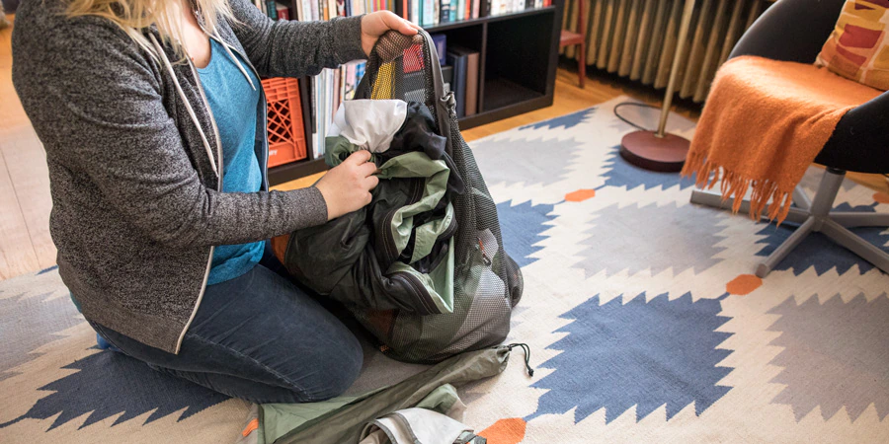
Tent Care at Home
Make sure your tent is 100 percent dry before storing it. No tent-care rule is more important. Damp fabrics grow mildew, giving tents a funky smell and harming polyurethane waterproof coatings. Over time, moisture also starts to chemically break down coatings. A neglected tent that becomes flaky, tacky or smelly is a candidate for serious intervention or replacement.
Store your tent loosely in a cool, dry place. Though nicely compact for backpacking, the stuff sack is a poor choice for long-term storage. You want tent fabrics to relax and breathe. An old pillowcase or similarly sized mesh bag is ideal.

Slide 26
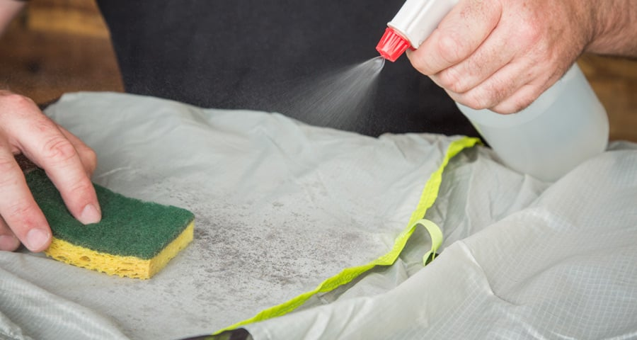
How to Clean Your Tent
Clean your tent after any long camping trip, especially if it was exposed to sand, fine dust, bird droppings or tree sap. If you do a lot of short trips, give your tent a gentle cleaning once per season.
Never machine-wash or machine-dry a tent. A washer, especially a top-loader with an agitator, can stretch or tear fabric, mesh and seams. Dryers can do the same, and can generate enough heat to do damage as well.
Do a basic cleaning. Use a non-abrasive sponge, cold water and a non-detergent soap. Gently scrub soiled areas by hand, being extra gentle on coated areas of the floor and fly.
Avoid household cleaners such as harsh dish soaps, bleach, spot removers or laundry presoaking products. Most household soaps are perfumed, which will ultimately attract insects, rodents and bigger creatures. Most of these soaps also impair a tent's durable water repellent (DWR) coating.

Slide 27
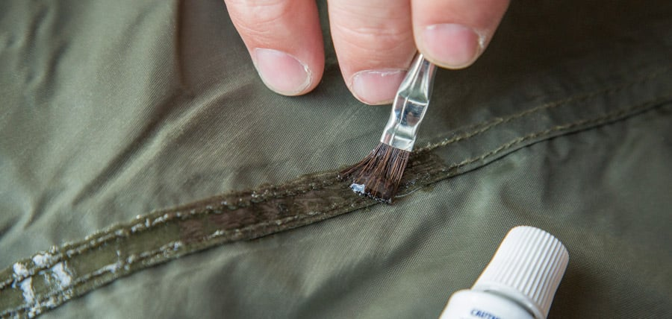
Waterproofing Tent Seams and Coatings
Re-waterproofing a tent or rainfly is an easy way to extend the life of your tent. Most tent sealing products need 24 hours to dry completely, so make sure you have a designated space free from debris where the tent can be spread out for a day to dry.
Reseal leaky seams. Most tents are sold with seams already sealed, usually via seam tape. Seams are vulnerable areas, so inspect them periodically for damage. If the seam tape fails, gently remove the sections of tape that are peeling off. The tape leaves a residue on the inside of the seam, so apply new seam sealer to the outside of the fabric. You can also fix tiny holes in the main tent fabric with seam sealer.
Be sure to get the correct product for your tent’s fabric and coatings. Most rainflies are polyester or nylon and have a polyurethane coating. A few are lightweight nylon infused with silicone (which never needs recoating). Each type of material requires a coating and seam sealer formulated specifically for that fabric.

Slide 28
02
Rain Gear
Keeping Pack and Contents Dry
Rain Fly
Moisture Control

Slide 29
Keeping Moisture Out and Letting It Out
While backpacking during an all-day rain presents its own challenges when it comes to staying dry – or as dry as possible – protecting your gear and the items in your pack that must stay dry comes with its own set of considerations.
Having a dry jacket, clothes, and a dry sleep system at the end of a long rainy day is not only backpacking luxury, it’s also critical to our safety on the trail (think hypothermia).
And whether rain is in the forecast or not, in most backpacking locations we still need a strategy to keep our gear dry in the case of an unexpected dunk during a creek crossing, or even in the event of a leaky hydration reservoir inside our pack.
One common fallacy is to seek the "ONE" solution to this problem rather than to think in terms of redundant moisture barriers.
The combination of properly fitted pack cover, water resistant pack fabric, and waterproof packaging provides good assurance against moisture spoiling packed gear.
Redundancy may add some weight, but plastic bags, the usual efficient solutions, are light in weight relative to other gear -- and a lot lighter than water soaked gear.

Slide 30
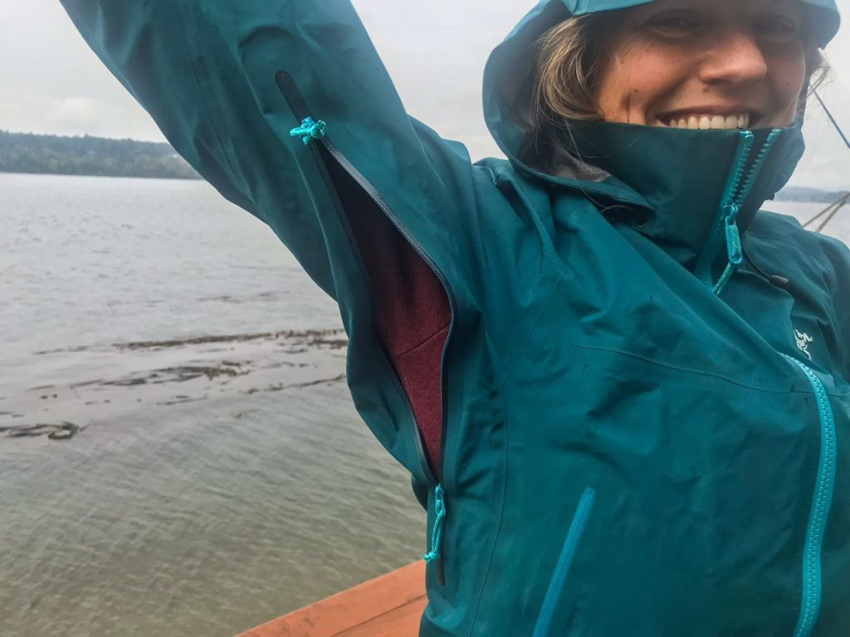
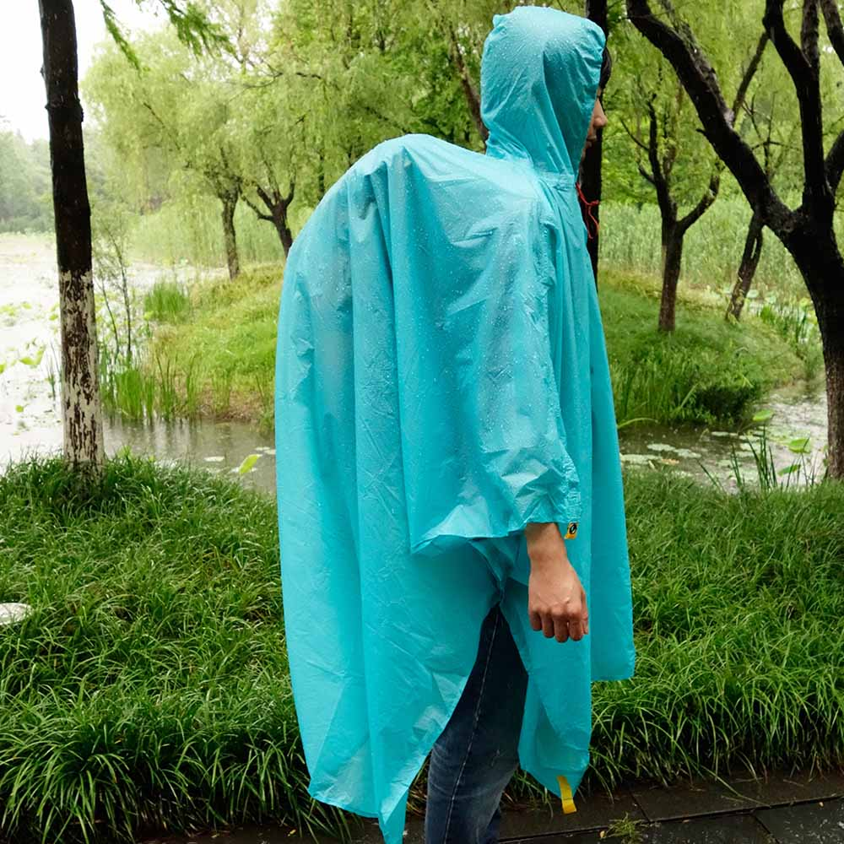
Things to Consider about Getting Wet while Backpacking
Raingear (for you).
It should be "vented", or else the moisture you avoid from outside will be replaced by moisture from your body that can't escape.
Traditional raingear includes mesh vents protected by overhanging flats across the back and under the armpits.
New, and more expensive, solutions are raingear made of waterproof "breathable" materials such as Gore-Tex.
Two approaches to raingear are a jacket and pants "rain suit" combination and use of a poncho.
Regardless of the approach, at the first sign of rain, stop and don your rain gear and cover your pack.
Don’t assume it will be a short, light rain.
Raingear doesn’t function well inside your pack or once you are wet.

Slide 31
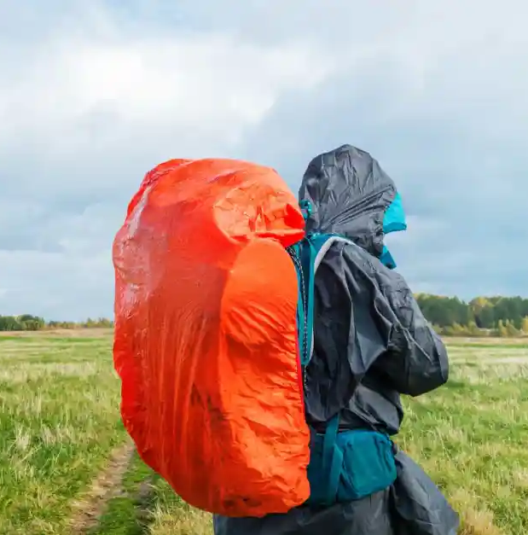
Things to Consider about Getting Wet while Backpacking
Pack cover.
Your pack cover should always be accessible.
Nylon coated ones are readily available and a heavy garbage bag can be fashioned into one.
Water resistant pack fabric.
Quality packs will have some kind of coating (urethane or silicon) to make the bag moisture resistant -- but don't count on it keeping everything dry by itself.
Few or none are totally waterproof, at least not at the seams and compartment openings, so a pack cover is a necessity.
Further, the best assurance of dry food, clothes and sleeping bag is to pack them in Ziploc or roll top dry bags.

Slide 32
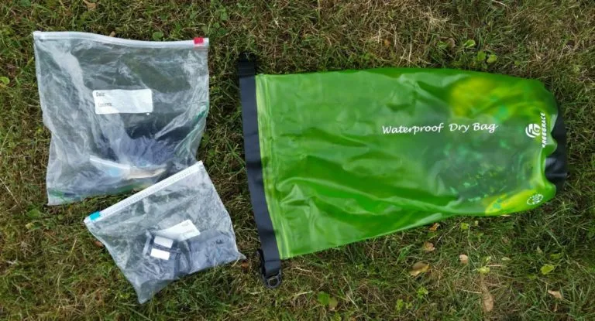
Things to Consider about Getting Wet while Backpacking
Packaging in waterproof bags.
Packing several small similar items together in heavy plastic (Ziploc) bags organizes items that could get "lost" inside the pack and keeps the contents dry even if the pack gets soaked.
When clothes and other pliable material are rolled tightly and placed in these bags they become more rigid, less spacious and waterproof.
If you sit on the bag while zipping the lock, when you get off it will have that "vacuum-sealed" look, be less "puffy", and store in about half the space.
Smaller, separate roll top dry bag stuff sacks can be used in place of Ziploc bags.

Slide 33
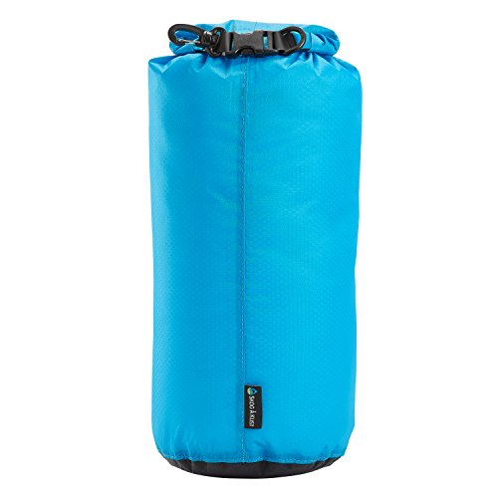
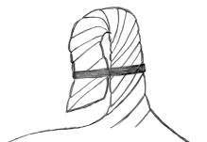
Things to Consider about Getting Wet while Backpacking
Hanging a bear bag.
Use a roll top waterproof bear bag to help keep contents dry.
Contents that might be damaged should already be in waterproof Ziploc bags from when they were in the pack.
When hanging a waterproof drawstring bear bag, use a gooseneck closure to keep water out.
The gooseneck closure is formed by twisting the bag end, folding it over, then fastening it in place with paracord.
Note that, unless the bag is completely submerged, water would have to run uphill to get in.

Slide 34
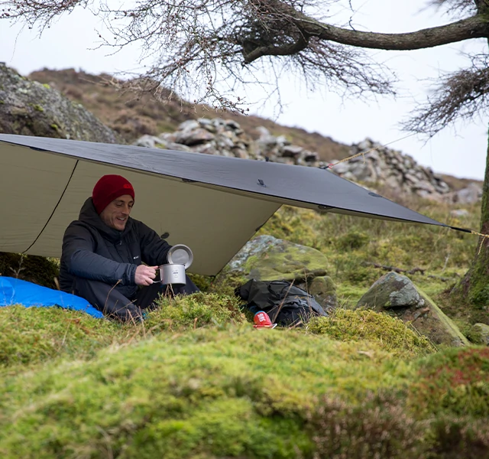
Things to Consider about Getting Wet while Backpacking
Rain Fly.
It is an optional item that comes in handy for the crew to "get under shelter", packs and all, in a hurry to wait out a flash downpour.
During a persistent rain, this may be your only escape from your tent to meet with other hikers and to prepare and eat food.
WARNING: Don't even think about using your stove in a tent and, even with a rain fly, the stove should be kept outside the edges.
A small polyethylene tarp gives protection at reasonable weight. Silnylon coated rainflies/tarps have reduced weight at a price.

Slide 35
03
Advantages of Trekking Poles
Selecting Trekking Poles
Care of Trekking Poles
Trekking Poles

Slide 36
The Advantages of Trekking Poles
They increase your stability when traveling with a heavy load or traversing difficult terrain.
Trekking poles reduce impact on your knees and other sensitive joints. When traveling downhill, they can reduce the force of impact by up to 30% making long hikes way more comfortable.
Poles makes you faster! Just like ski poles, trekking poles help to propel you forward.
Less stress on your back. Trekking poles help to keep you upright for better posture and support.
Trekking poles can come in handy for pitching tents or tarp shelters.
Backpackers with heavy loads and a higher center of gravity find them valuable for maintaining balance.
i.e. balancing along logs, crossing streams, walking on slippery surfaces, and hiking over loose rocks and scree.
And one final word of caution, once you use a pair of trekking poles, you may never go back.

Slide 37
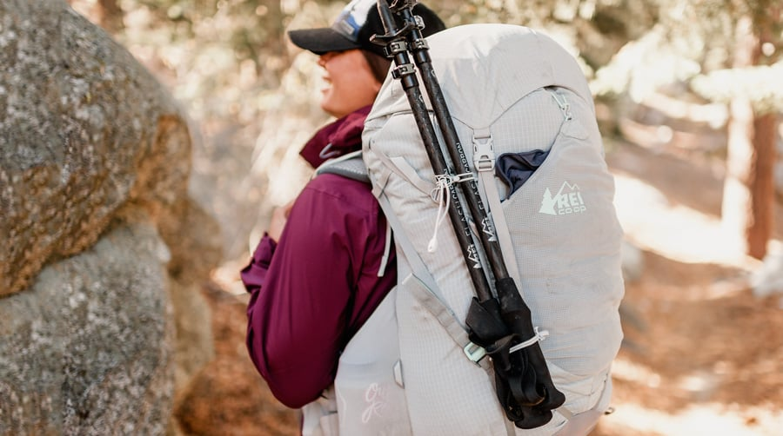
Trekking Pole Construction
Telescoping Poles
Telescoping poles are easy to adjust and have been around the longer.
With telescoping poles you can choose either, two sections or three sections.
Two-section poles are more durable and are best for folks who are tough on their gear. The major downside of two-piece poles is their large packed size and heavy trail weight. They are the tallest and heaviest option.
Three-section poles are what you’ll see most out on the trail. They don’t have the same durability compared to two-part poles but they tend to weigh less than their two-section counterpart. With more adjustability, you’ll find mountaineers, casual hikers, and thru hikers alike using this construction.

Slide 38
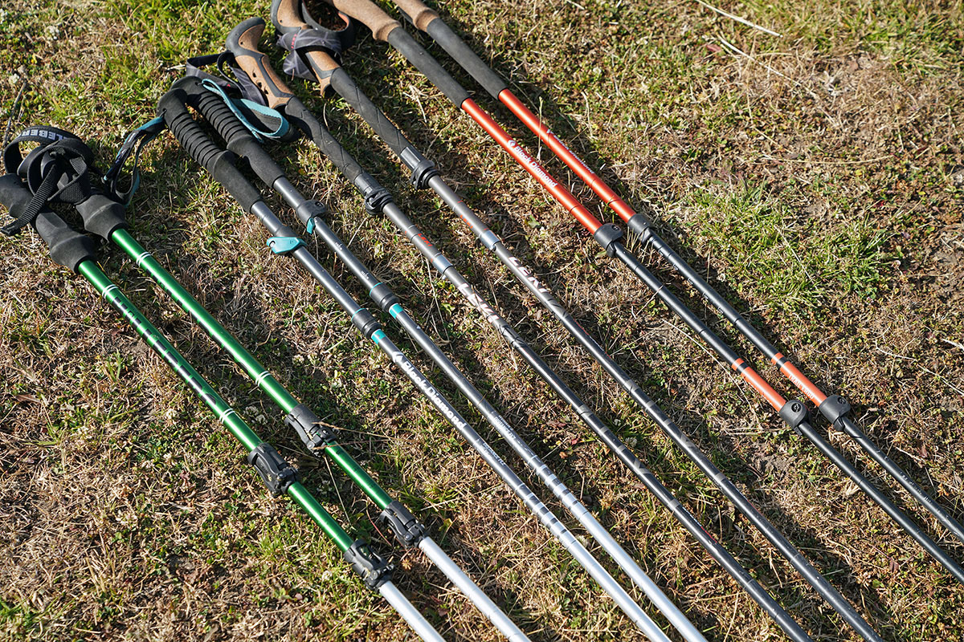
Trekking Pole Construction
Trekking Pole Shaft Materials: is a key determinant of the pole's overall weight.
Aluminum: The more durable and economical choice, aluminum poles usually weigh between 18 and 22 ounces per pair. The actual weight (and price) can vary a bit based on the gauge of the pole, which ranges from 12 to 16mm. Under high stress, aluminum can bend, but is unlikely to break.
Composite: These poles feature shafts that are made either entirely or partially from carbon. The lighter and more expensive option, these poles average between 12 and 18 ounces per pair. They are good at reducing vibration, but under high stress, carbon-fiber poles are more vulnerable to breakage or splintering than aluminum poles. If you hike in rugged, remote areas, this is something to keep in mind.

Slide 39
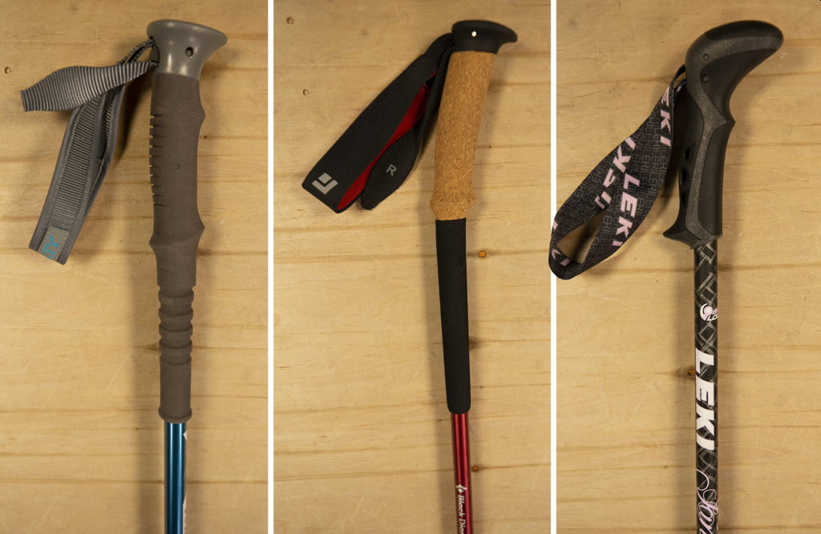
Trekking Pole Construction
Trekking Pole Grips
Some poles include ergonomic grips that have a 15-degree corrective angle to keep your wrists in a neutral and comfortable position.
Grip Materials: come in a variety of materials that affect how the poles feel in your hands.
Cork: This resists moisture from sweaty hands, decreases vibration and best conforms to the shape of your hands. If you sweat a lot and will be hiking in hot weather, go with cork grips.
Foam: This absorbs moisture from sweaty hands and is the softest to the touch.
Rubber: This insulates hands from cold, shock and vibration, so it's best for cold-weather activities. However, it's more likely to chafe or blister sweaty hands, so it's less suitable for warm-weather hiking.

Slide 40
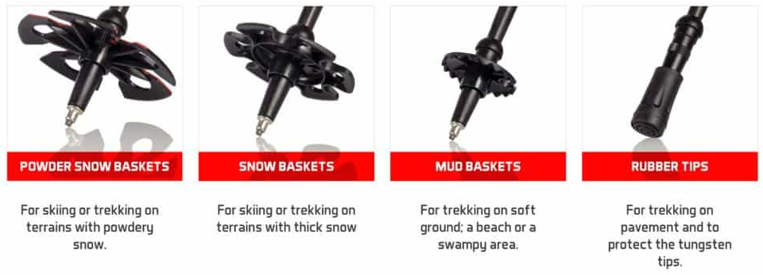
Trekking Pole Construction
Baskets: Trekking poles usually include a small, removable trekking basket at the tip end. Larger baskets can be substituted for use in snowy or muddy ground.
Pole tips: Carbide or steel tips are commonly used to provide traction, even on ice. Rubber tip protectors extend the life of the tips and protect your gear when poles are stowed in your pack. They are also good for use in sensitive areas to reduce impact to the ground..

Slide 41
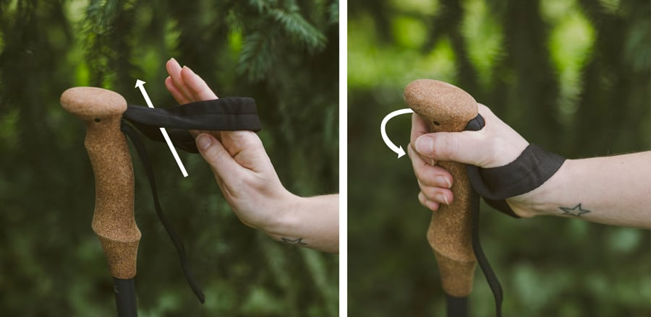
Trekking Pole Construction
Wrist straps: It’s actually pretty common to see hikers using their trekking pole wrist straps incorrectly. To use them the right way, put your hand up through the bottom of the strap and then pull down and grab the grip of the pole. This technique supports your wrist and heel of the hand and allows you to keep your hand relaxed on the grip.
You can adjust the length of the strap so that when you bring your hand down on the strap it lines up with where you want it to rest on the grip. Proper strap adjustment allows you to let go of the pole to take a picture, grab a snack or adjust your backpack and then easily grab the pole again in the right place.
Note that many trekking poles have right- and left-hand specific straps, and that some have padded or lined straps to help prevent chafing.

Slide 42
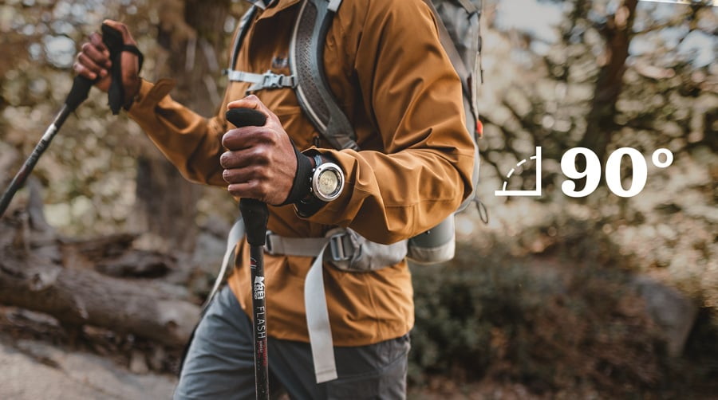
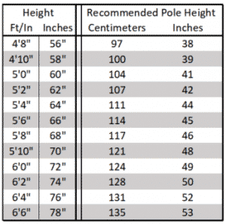
Trekking Pole Length
Properly sized poles will put your elbows at a 90-degree bend when you hold the poles with tips on the ground near your feet.
Many trekking poles come in adjustable lengths, which makes this easy to achieve.
For adjustable-length trekking poles:
Use the chart at the right to determine the appropriate length to set your poles at.

Slide 43
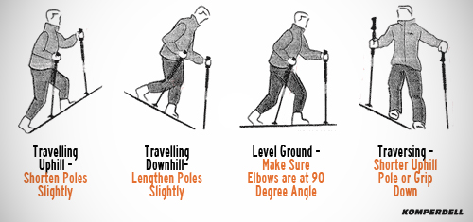
Adjusting Trekking Pole Length
For long uphill sections, you can shorten each pole by about 5–10cm to get more leverage and more secure pole plants. The steeper the slope, the more you shorten your poles. Your trekking poles should assist you in moving uphill without causing strain or fatigue to your shoulders and your shoulders should never feel as if they are in an unnatural, lifted position or as if they are being pushed up into your backpack straps. If so, you need to shorten your poles even more.
For long downhill sections, try lengthening each pole by about 5–10cm from the length you set it at for general hiking. Doing so will keep your body more upright for better balance.
If you’re on a long traversing section, you can shorten the pole on the uphill side and lengthen the pole on the downhill side as needed to improve comfort and stability.

Slide 44
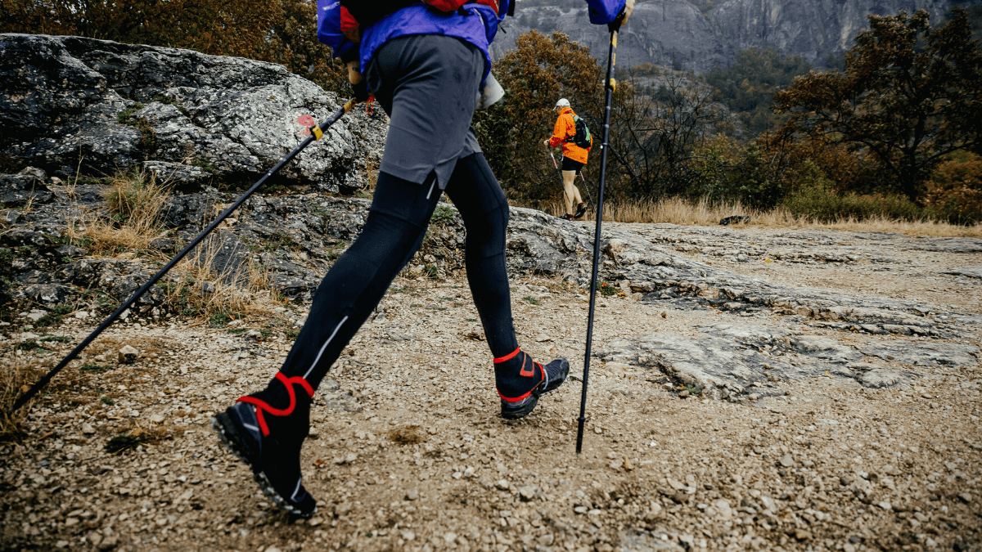
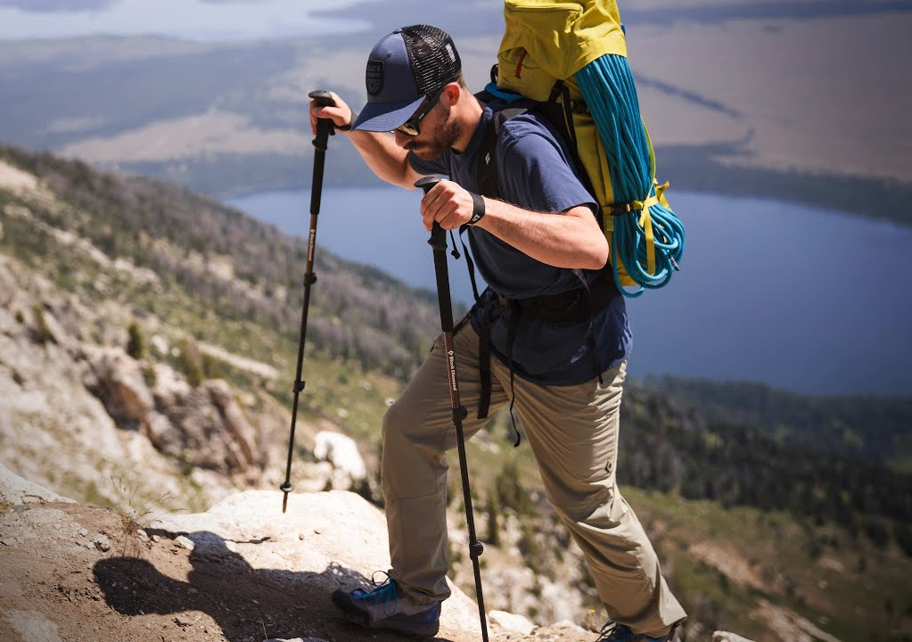
Tips for Using Trekking Poles
Alternating Your Poles and Legs
Most hikers take to using trekking poles quickly and fall into the proper rhythm of planting the opposing trekking pole in time with the opposing foot (right foot, left pole, left foot, right pole, etc.) If you fall out of the rhythm, just keep walking while lifting your poles off the ground for a moment so you can reset. Start planting the poles again as soon as you’re ready. Soon this will become completely natural and you won’t even have to think about it.
Double Planting
Occasionally you might want to plant both poles at the same time and then take two steps, plant both poles again and continue. This can be beneficial on steep climbs or descents where you need the stability of both poles on the ground at the same time.

Slide 45
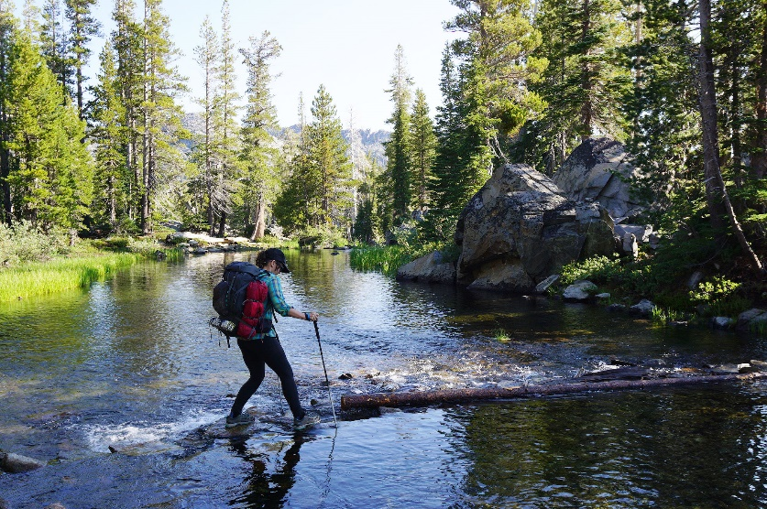
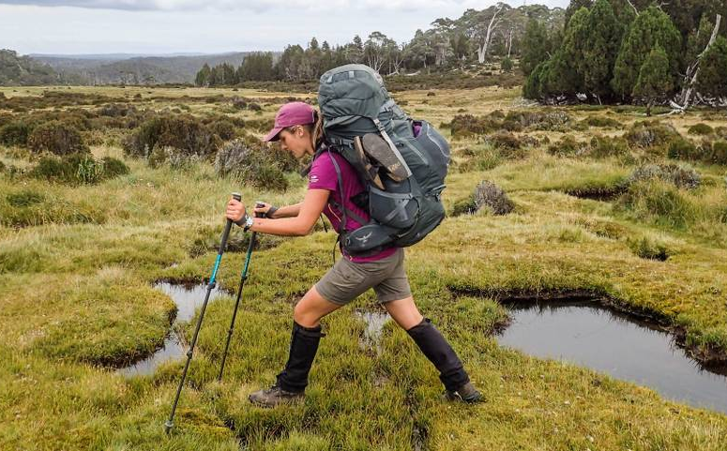
Tips for Using Trekking Poles
Negotiating Obstacles
Stream and river crossings: Trekking poles provide much-needed stability when you have to wade through water. Make sure each time you plant your pole, it’s secure on the bottom before moving forward. If the water is deep, lengthen your poles.
Puddles: You can maneuver around them, using your poles for stability, or you can do a “pole vault” to the other side by planting both poles and hopping over.
Large rocks: For getting up and over large rocks, poles can give you a helpful push. To do this, plant both poles in the ground and as you step up on the rock, push on the poles to get you all the way onto the rock.
Logs: To step over a log, simply plant the poles in the ground and use them for stability. If you’re walking on a log to get across water, you can use the poles to improve your balance by reaching them out to both sides (picture a tightrope walker using a large pole for balance).

Slide 46
Questions?
Terry McKibben
Troop 344/9344
Pemberville, OH
troop344leaders@gmail.com

