Slide 1
Backpacking Guide
Course #5
Terry McKibben
Troop 344/9344
Pemberville, OH
troop344leaders@gmail.com

Slide 2
CONTENTS
01
Stoves and Cookware
Stove Selection, How Much Fuel to Carry, Cookware and Dinner Ware
02
Camp Layout
“Bearmuda” Triangle, Bear Canisters vs. Bear Bagging, Cooking and Fires
03
Backpacking Etiquette
Duty Roster, The Finer Points

Slide 3
01
Stove Selection
How Much Fuel to Carry
Cookware and Dinner Ware
Stoves and Cookware

Slide 4
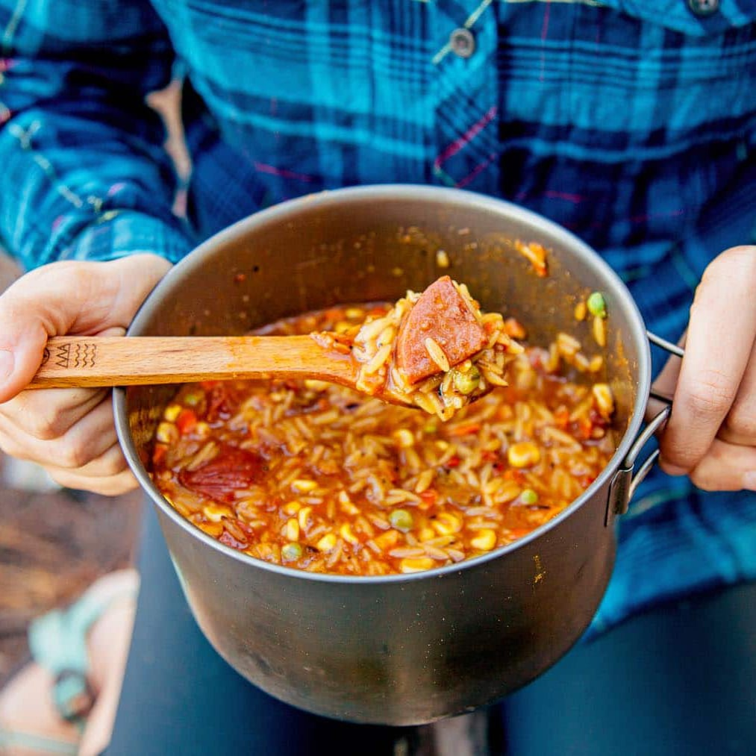
How to Choose a Backpacking Stove
When you’re backpacking, do you look forward to a cooked meal at night and hot coffee in the morning? If so, you’ll want to bring a stove. But what kind of stove to bring depends on many factors: How light do you want it to be? How versatile? Do you need a stove that simply boils quickly or do you want one that simmers? How many people are you cooking for? What type of fuel will be available to you?
The following decision points will help you choose a backpacking stove:
  Stove type: Backpacking stoves are loosely categorized by the type of fuel they use and how the fuel is stored.
  Stove specs and features: Burn time, average boil time, weight and convenience features may help you narrow your choices.
  Stove usage tips: Understanding some of the nuances of how a stove works will ensure that you’re making an informed decision and also getting the best out of your purchase when you’re out in the field.

Slide 5
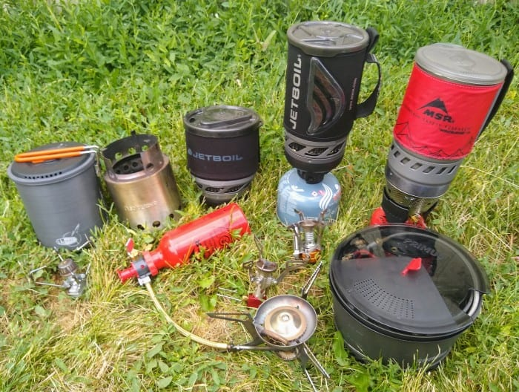
Types of Backpacking Stoves
There are three main categories of backpacking stoves:
  Canister stoves: These easy-to-use, low-maintenance stoves typically screw onto the threaded tops of self-sealing fuel canisters that contain two pre-pressurized gases: isobutane and propane.
  Liquid fuel stoves: These versatile stoves connect to refillable fuel bottles. While most liquid-fuel stoves run on white gas, you do have other options available, which can be a particular benefit if you’re traveling internationally.
  Alternative-fuel stoves: This growing category includes stoves that run on fuel pellets or wood.

Slide 6
Quick Guide to Backpacking Stoves
Good for: | Canister | Integrated Canister | Remote Canister | Liquid Fuel | Wood-burning | Alcohol/ Tablet
Cold weather / high elevation | (some) | (some) | no | yes | no | no
Larger groups | no | yes | yes | yes | no | no
Boiling water mainly | no | yes | no | yes | yes | yes
Simmering | yes | no | yes | yes | no | no
Ultralight hiking | yes | no | yes | no | yes | yes
International travel | no | no | no | (multi-fuel) | no | no
Ease of use | yes | yes | yes | no | no | yes

Slide 7
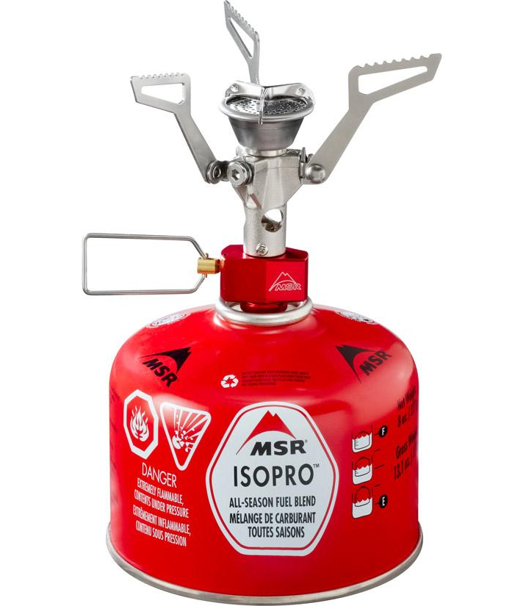
Canister Stoves
Canister stoves are easy to use and low-maintenance.
They screw onto the threaded tops of closed fuel canisters that contain two pre-pressurized gases: isobutane and propane.
Some of these stoves are incredibly small, fold up compactly and weigh only a few ounces.
They may be usable in some international destinations that cater to American trekkers.

Slide 8
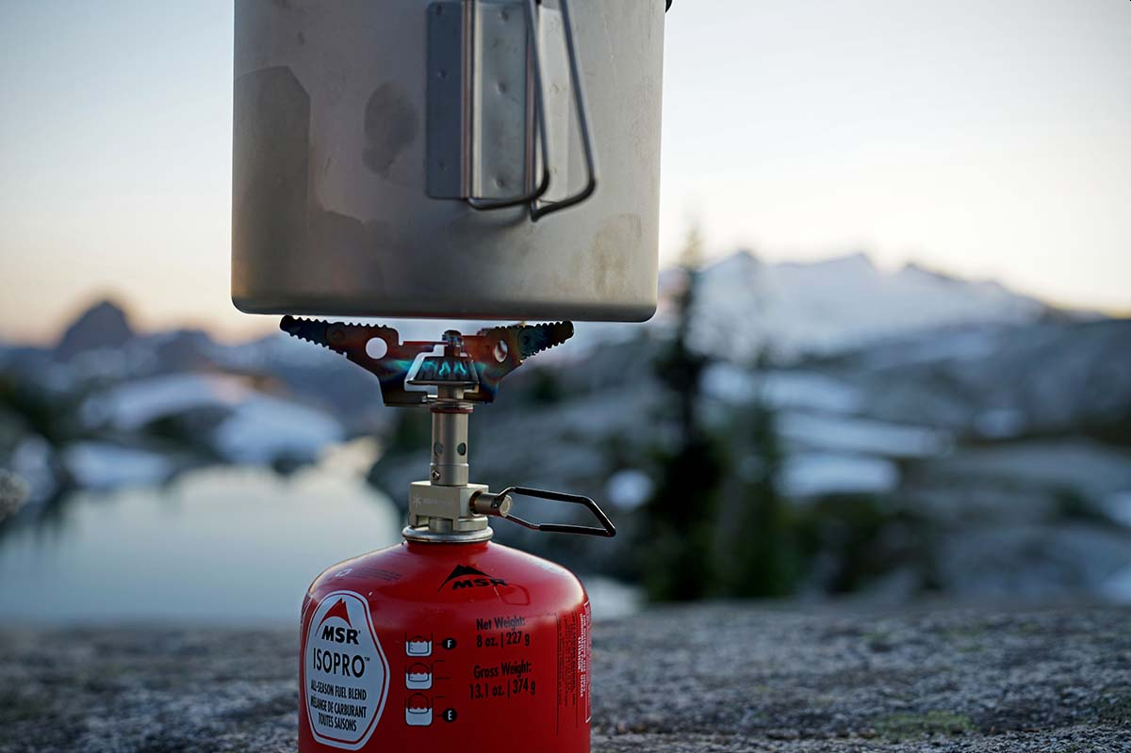
Canister Stoves
Pros:
  They’re small and lightweight.
  They’re quick to light. No priming is necessary before lighting a canister stove. Simply turn the valve and light with a match, lighter or piezo-igniter.
  The flame adjusts easily and simmers well (most models).
  The canister self-seals when you unscrew the stove, so there’s no worry about spills and leaks.
  Some canister stoves have a built-in pressure regulator to provide consistent heat output throughout the life of the canister. This improves cold weather and high-elevation performance, too.

Slide 9
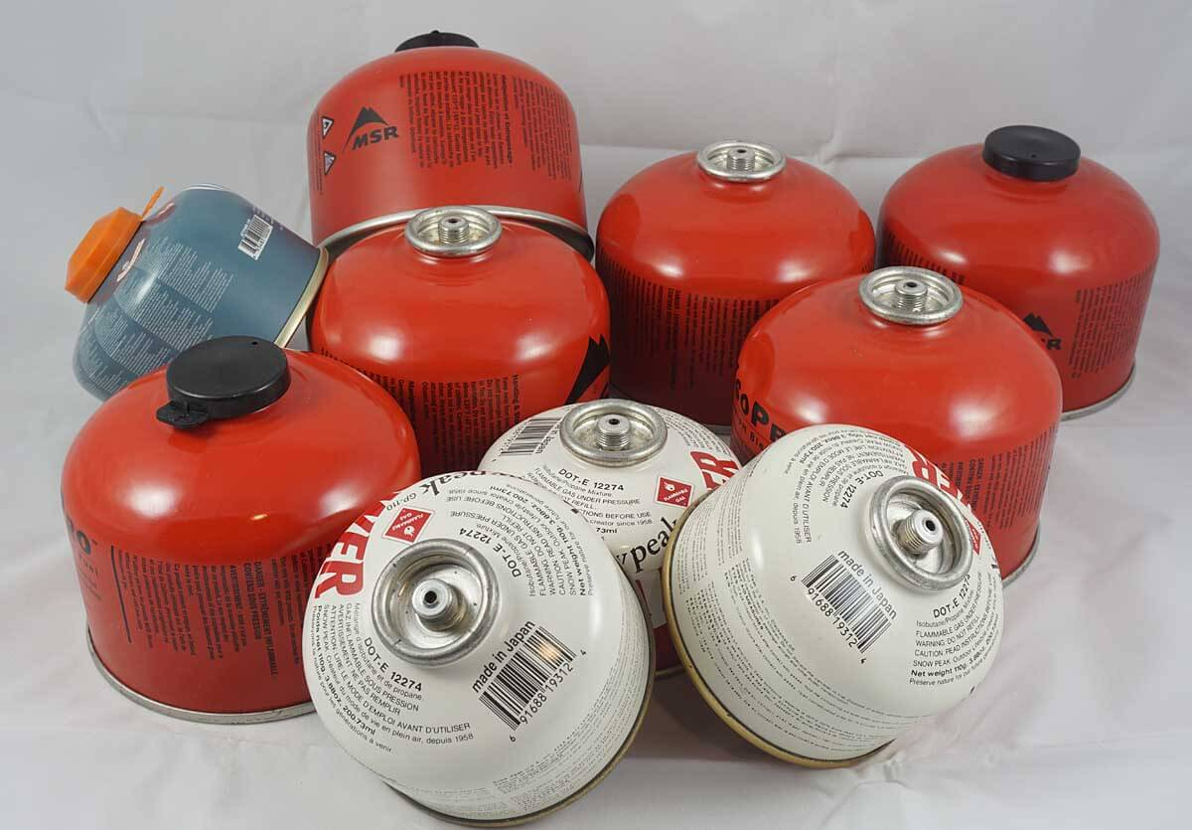
Canister Stoves
Cons:
  Their arms may not be long enough to hold large pots securely.
  It’s tough to know how much gas is left inside the closed canister, so you may want to carry an extra to be sure you don’t run out. (A small 4-ounce canister makes a good backup.)
  A windscreen should not be used with an on-canister stove because it can trap excessive heat and lead to fuel exploding.
  In cold weather, canisters can depressurize and produce a weak flame (unless the stove has a pressure regulator)
  Compared to liquid-fuel stoves, the cost of fuel is greater.
  Canister waste: Empty canisters need to be disposed of properly; you’ll want to research recycling options near you.

Slide 10
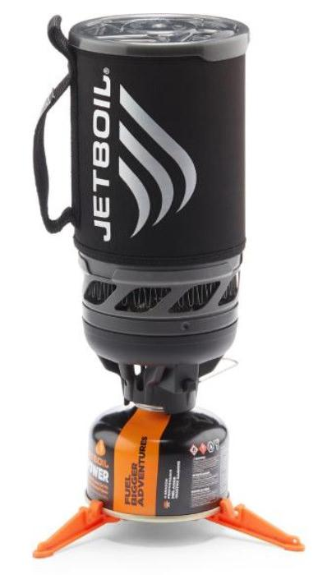
Integrated Canister Systems
These tall-profile cooking systems feature a burner that screws onto the fuel canister and pairs seamlessly with a twist-on, insulated cooking pot and a lid with drain holes and/or a pour/sip hole. They can be used with accessories such as a French press for coffee making. A 4-ounce fuel canister (sold separately) can nest inside.
In general, they’re designed to boil water quickly, not cook and simmer foods (though some models let you use a different pot from the one that comes with the set, and newer versions may be shorter and wider and easier to eat from). They boil water fast and efficiently, in part thanks to a built-in windscreen. Some of these stoves also have a built-in pressure regulator that allows for consistent performance in low temperatures and at higher elevations. However, compared to standard canister stoves, the integrated system is heavier and prone to tip-overs.

Slide 11
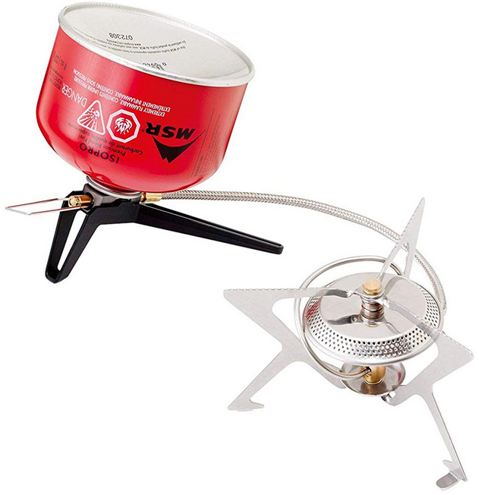
Remote Canister Stoves
This type of stove sits on its own base and has a fuel hose that connects it to the canister. They typically pack down small and are lightweight, though you’ll add a few more ounces and bulk compared to a standard canister stove.
On some models the canister can be used in an inverted position to improve cold-weather performance. These stoves may have wider support arms for large-pot stability. A windscreen may be used with off-canister stoves.

Slide 12
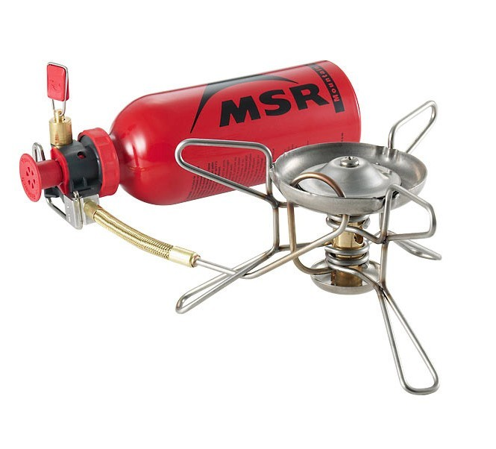
Liquid-fuel Stoves
All liquid-fuel stoves run on white gas, which is highly refined to have few or no impurities. It burns hot and clean, performs well in below-freezing temperatures and, compared to the per-ounce cost of canister fuel, is much less expensive.
Some multi-fuel stoves can also run on some or all of the following: unleaded auto gasoline, kerosene, jet fuel or diesel.
Fuel versatility makes multi-fuel stoves a great choice for international travelers who face limited fuel choices outside the U.S.

Slide 13
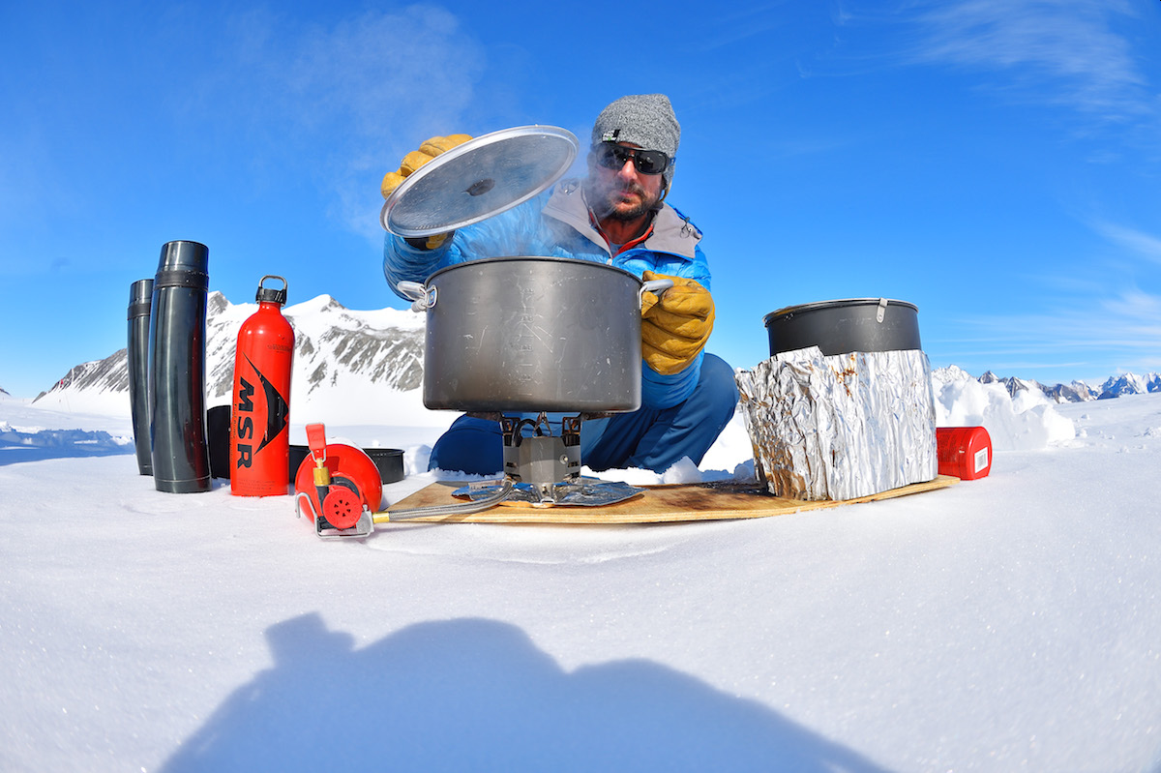
Liquid-fuel Stoves
Pros:
  Liquid-fuel stoves tend to be low-profile and offer greater stability on uneven ground.
  It’s easy to tell how much fuel you have left by peering into the fuel bottle.
  While you do have to buy a fuel bottle, there’s no canister to discard.
  These stoves perform better than other options at high elevations and in cold temperatures.

Slide 14
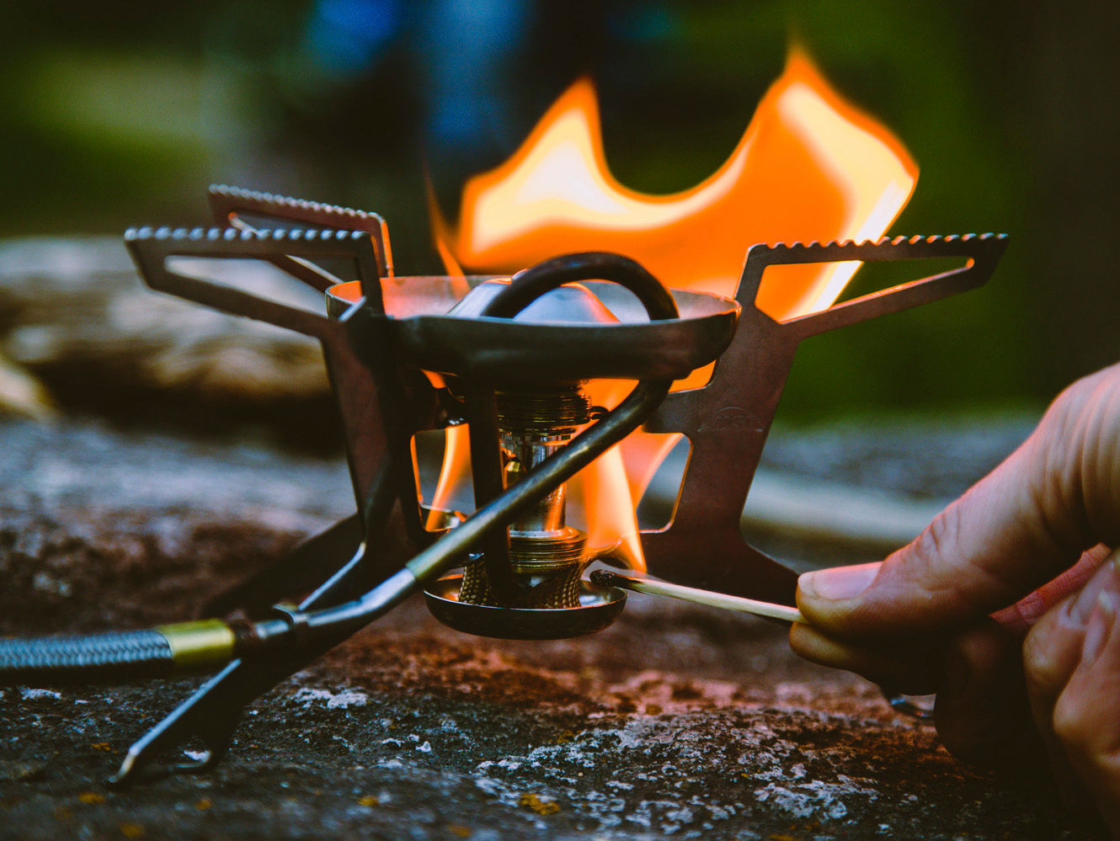
Liquid-fuel Stoves
Cons:
  Priming and maintenance are required.
  Fuel spills are possible.
  They tend to be heavier than canister stoves.
  Multi-fuel stoves can cost a bit more.
  Fuels other than white gas have more impurities that may, over time, clog stove parts such as the fuel tube.

Slide 15
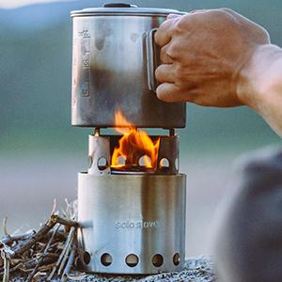
Alternative-fuel Stoves
Wood-burning Stoves
  Because these burn twigs and leaves you gather in the backcountry, you carry no fuel, a nice option for longer or lighter trips.
Pros:
  These can be simple and lightweight, such as a titanium base-and-windscreen/pot-support setup that folds flat.
  Some models can generate enough electricity while burning twigs to charge a mobile phone or other small gadget via a USB connection.
  Some models can be outfitted with an optional grill.
Cons:
  Finding dry fuel during wet weather can be challenging.
  Use may be prohibited during a burn ban or in some places at high elevation (for example, Yosemite prohibits twig-burning stoves above 9,600 feet).

Slide 16
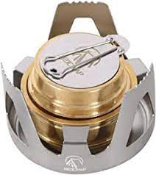
Alternative-fuel Stoves
Denatured Alcohol Stoves
  These stoves appeal most to ultralight backpackers because they weigh only an ounce or two. In addition, you only need to carry a bottle of alcohol sized to meet your trip needs.
Pros:
  Denatured alcohol stoves have few parts that would require maintenance.
  Denatured alcohol is inexpensive and relatively easy to find across the U.S.
  The fuel burns silently.
Cons:
  Alcohol does not burn as hot as canister fuel or white gas, so it takes longer to boil water and requires more fuel.
  A windscreen is often a must.
  Denatured alcohol can be hard to find outside the U.S.

Slide 17
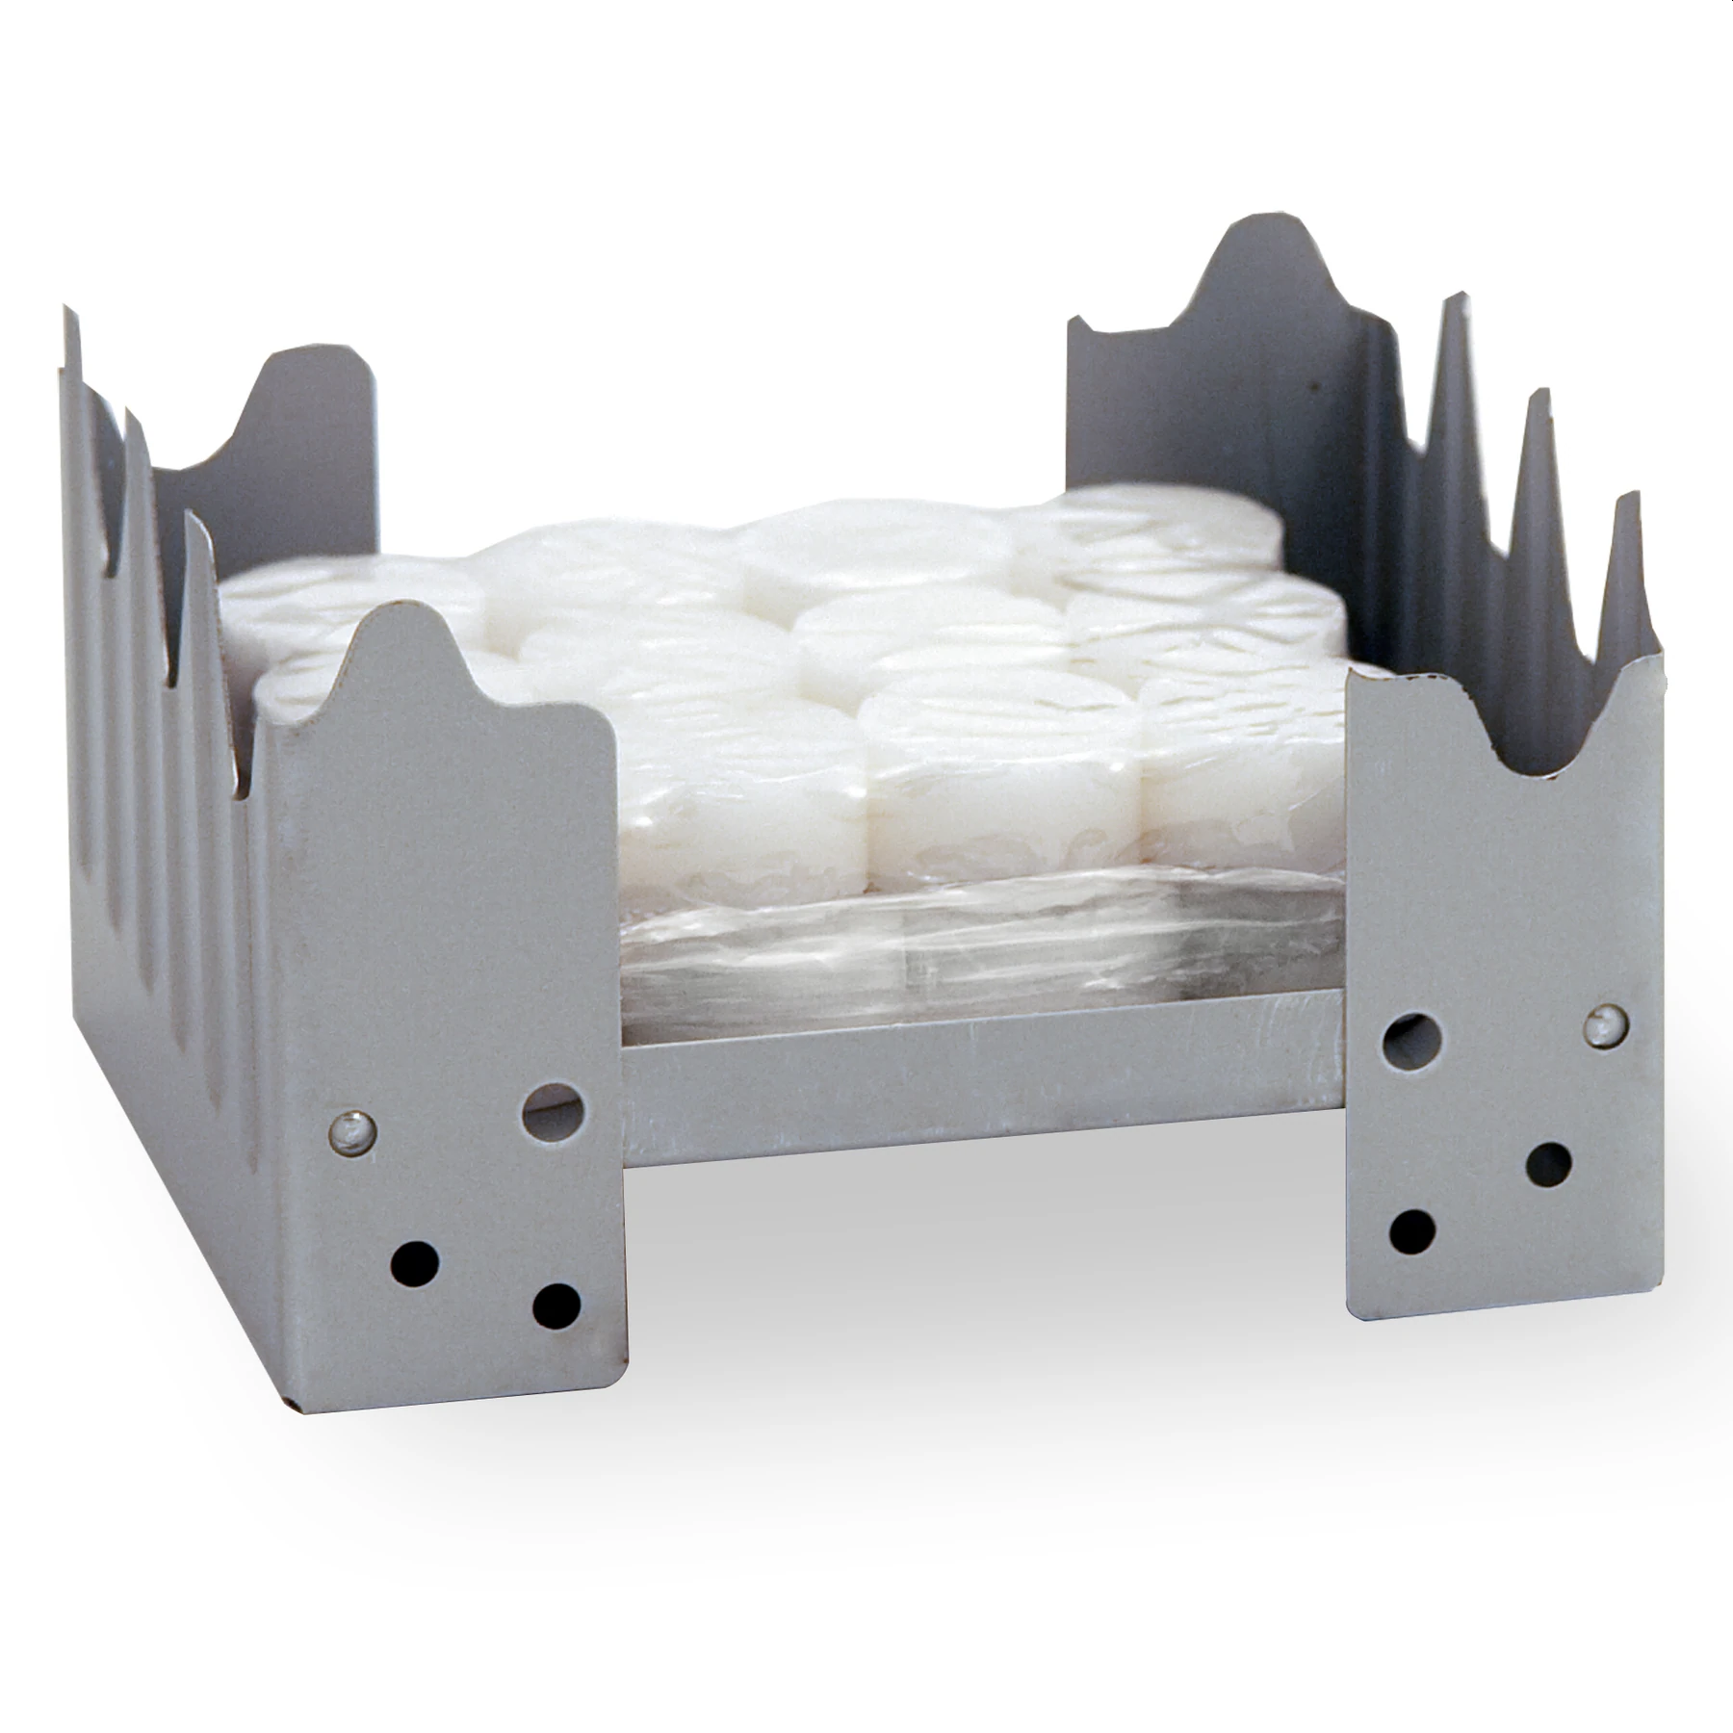
Alternative-fuel Stoves
Solid-fuel Tablet Stoves
  These are also a popular choice with ultralight backpackers. Some models are so small they fold up and fit in your pocket.
Pros:
  Inexpensive
  Low weight: a pocket-size model may weigh 3.25 ounces; a stove/pot combo, 7 ounces.
  Compact size
  Tablets light easily and may be extinguished and reused later.
Cons:
  They are slow to bring water to a boil
  Tablets may have an odor
  Tablets may leave a greasy residue on the pot’s underside.

Slide 18
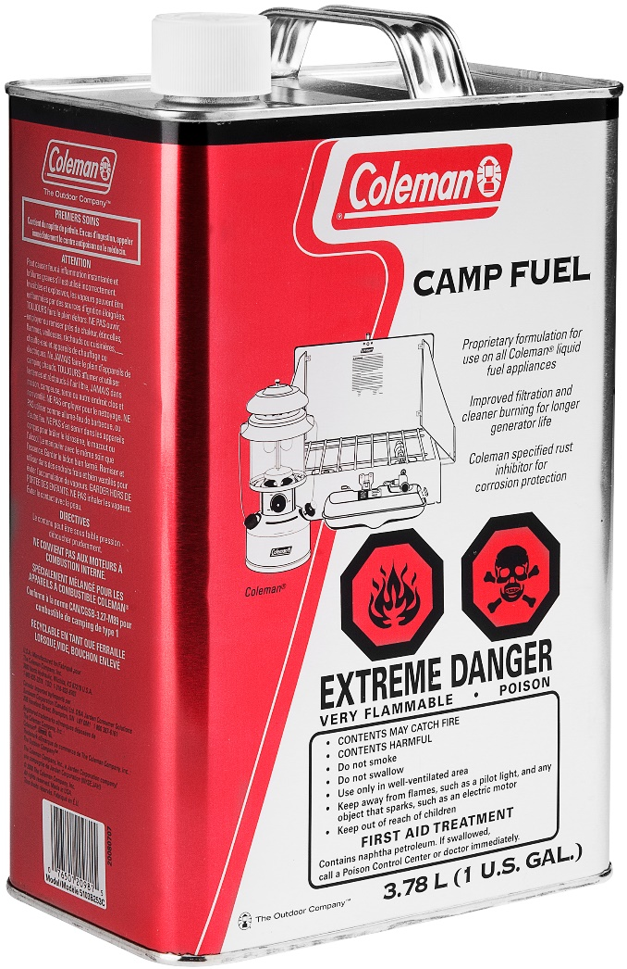
How Much Fuel Should I Carry?
It’s the age-old question answered only by backcountry experience and deep wilderness wisdom: How much backpacking stove fuel do I really need to carry on my next trip?
  Pack too little and you could go hungry.
  Tote too much and you’ll bear the burden of hauling extra weight, which will only slow you down.
So how do you calculate the right amount?
Every adventure is different, but there are a few main variables to consider while packing fuel for your trip.

Slide 19
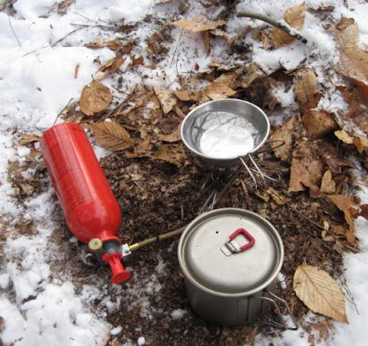
Know Your Numbers
As a baseline for fuel consumption in the backcountry, it’s important to calculate how many people will be on your trip, and how many hot meals and hot drinks the group will require.
As a general guide you should bring enough fuel to boil:
  Breakfast: .5 liters of water per person (oatmeal and coffee)
  Lunch: .25 liters of water per person (Cup-of-Soup)
  Supper: 1 liter of water per person.
If some members take their breakfast or lunch cold, you’ll need less fuel.
This number will give you a rough sense of about how many liters of water you will need to boil.

Slide 20
Know Your Numbers
Once you’ve made this estimate, use the chart to determine how many ounces/grams of fuel your stove uses to boil 1 liter of water.
Then do the math for total ounces/grams of fuel.
Keep in mind that this is a rough estimate, but it gives you a place to start.
MSR’s Conventional Canister Stoves | Water Boiled (per 1 oz. / 28 g of fuel)
MicroRocket | 2L
PocketRocket 2 | 2L
SuperFly | 1.8L
PocketRocket Deluxe | 2.1L
WindPro II | 1.8L
MSR’s Liquid Fuel Stoves | Fuel | Water Boiled (per 1 oz. / 28 g of fuel)
WhisperLite Universal | White Gas | 1.3L
 | Kerosene | 1.6L
 | IsoPro | 1.8L
WhisperLite International | White Gas | 1.3L
 | Kerosene | 1.6L
WhisperLite | White Gas | 1.5L
Dragonfly | White Gas | 1.6L
 | Kerosene | 1.7L
 | Diesel | 1.7L
XGK EX | White Gas | 1.5L
 | Kerosene | 1.7L
 | Diesel | 1.9L

Slide 21
Know Your Numbers
Example Calculation:
5 day trip with 8 people:
  Breakfast – Instant oatmeal and coffee or hot chocolate (.5L/person)
.5L boiled water/person/day x 8 persons x 5 days = 20 Liters
  Lunch – Cup-of-Soup (.25L/person)
.25L boiled water/person/day x 8 persons x 5 days = 10 Liters
  Supper – fully cooked meal (1L/person)
1L boiled water/person/day x 8 persons x 5 days = 40 Liters
Total = 70 Liters
Whisperlite International Stove using White Gas: 1.3L/oz. of fuel
  70L ÷ 1.3L/oz. of fuel = 54 oz. of white gas fuel required for trip
54 oz. of fuel is a bare minimum for this example.
  Having coffee with supper, heating water to wash dishes, adverse weather conditions, etc. will all increase fuel consumption.

Slide 22
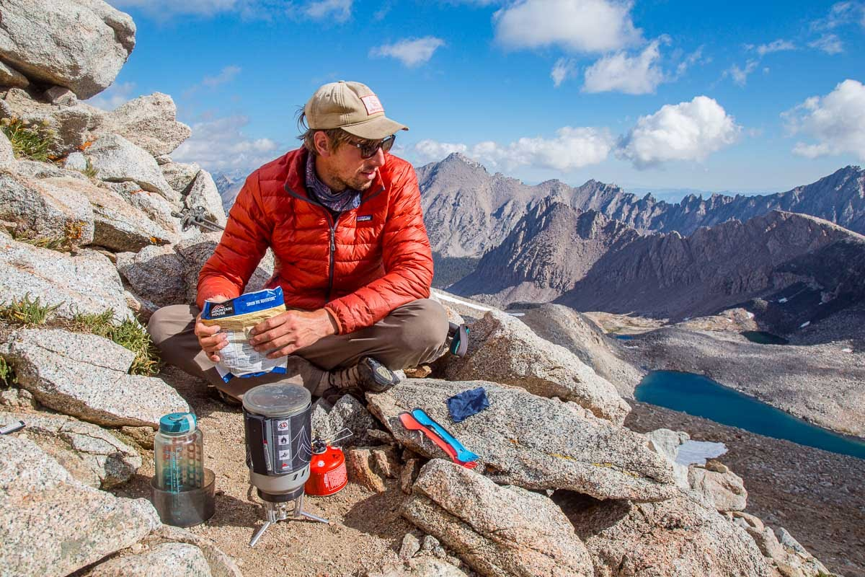
Conditions that Affect Fuel Consumption
Altitude:
  The higher you go, the faster water will boil due to a lower boiling point.
  However, raw food cooks slower at lower temperatures.
  For every 18°F (-8°C) drop in boiling point (roughly the change from sea level to 10,000 feet / 3,048 meters), cook time will double as well as the fuel consumption.
Wind:
  A 5 mph (8kph) wind can cause as much as three times more fuel use in a given cooking period.
Water temperature:
  Water from cold glacial streams and ponds will increase boil time.

Slide 23
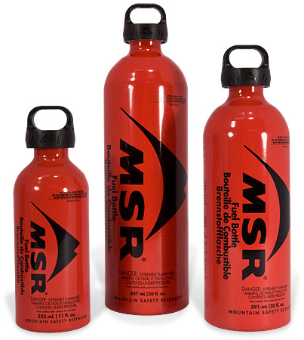
Final Thoughts on Fuel
After adjusting for factors that will affect your fuel consumption, you should always plan on carrying one extra day of fuel reserve to be on the safe side.
  In the previous example, one extra day of fuel would be about 11 ounces (54 oz. ÷ 5 days).
With fuel it’s better to come home with some extra than to run out.

Slide 24
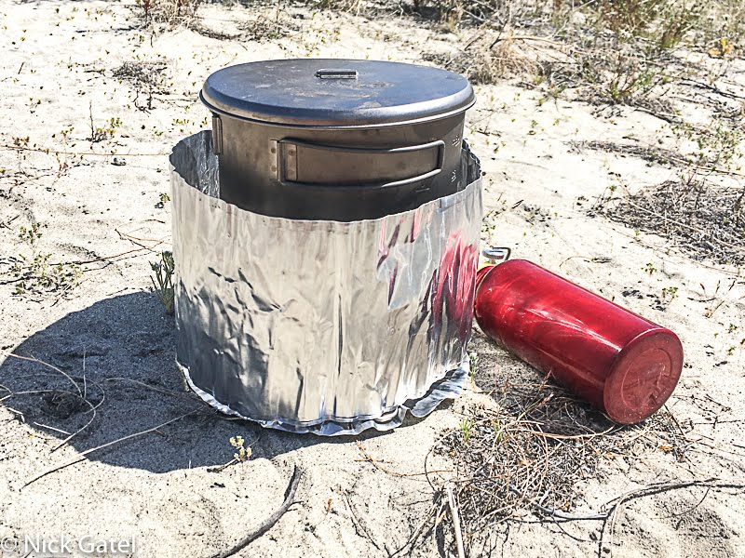
Tips for Getting the Most Out of Your Stove
Be ready with your supplies.
  Have pouch-cook meals open and oxygen absorbers taken out before the water boils.
Always use a windscreen with liquid fuel stoves and wrap it close to the cookware (about ½” all the way around the cookware diameter) to increase the stove’s efficiency.
  The screen direct hot exhaust gases around the sides of the pot instead of losing that heat to the air, and it protects from winds blowing heat away from the pot.
Use a lid, and resist checking the water frequently (you can usually hear a difference in the sound or will see steam).
Placing a fuel canister in warm water before using it will help in cold temps.

Slide 25
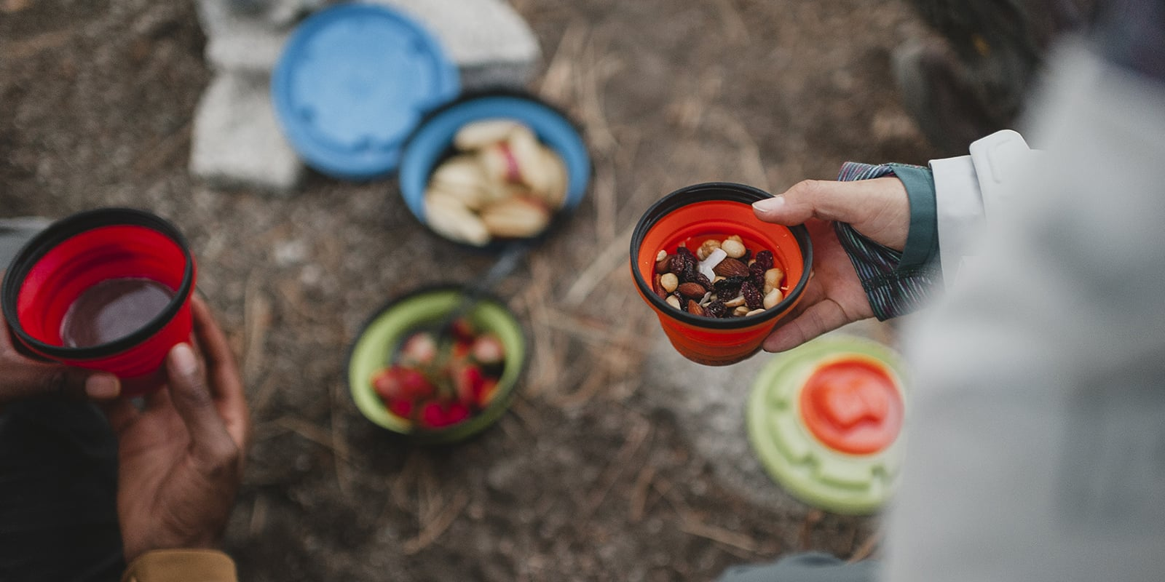
How to Choose Cookware
Backpackers who take short trips or prefer simple, no-fuss menus require only basic cookware—perhaps as little as a cup and a spork.
Larger groups and longer journeys usually require more pieces.
Backcountry setups are quite different from what we would take along to a drive-in campsite.
Weight is a paramount consideration for backpacking cookware.
If it doesn’t cook an egg evenly is not important when most meals are centered around boiling water.

Slide 26
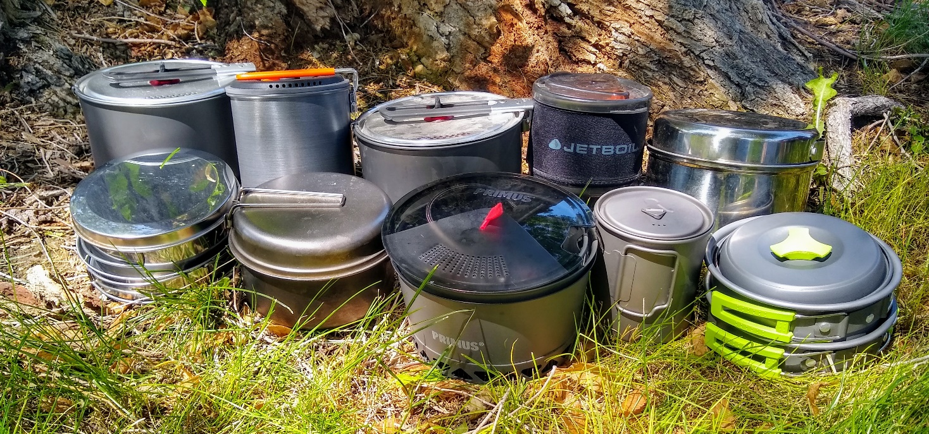
Cookset or Individual Pieces?
You can buy a complete cookset or cookware items piece by piece.
Cooksets are collections of pots, pans and lids designed to nest together.
  Some cooksets include extras such as cups, mugs or plates that nest within the pots.
Individual pieces allow you the freedom to build your set exactly the way you want it.
  This method may not be ideal if you're looking to save weight but is a great way to build versatility into your cookware collection.

Slide 27
Cookware Material Options
Aluminum
  Pros: Lightweight, affordable and a good conductor of heat. Good for simmering foods without scorching.
  Cons: Breaks down slowly when exposed to acidic foods. Dents and scratches easily.
Hard-anodized aluminum
  Pros: This oxidized material resists scratches and abrasion and is long lasting.
  Cons: None.
Stainless steel
  Pros: Tougher, more scratch-resistant than aluminum.
  Cons: Heavier than aluminum, doesn't conduct heat as uniformly (can cause hot spots that scorch food).
Titanium
  Pros: Super lightweight—it's your lightest option without compromised strength. Highly corrosion-resistant, heats up quickly and operates effectively without maximum heat.
  Cons: $$$ More expensive than other options. Conducts heat less evenly than stainless steel. Take care not to overheat it.

Slide 28
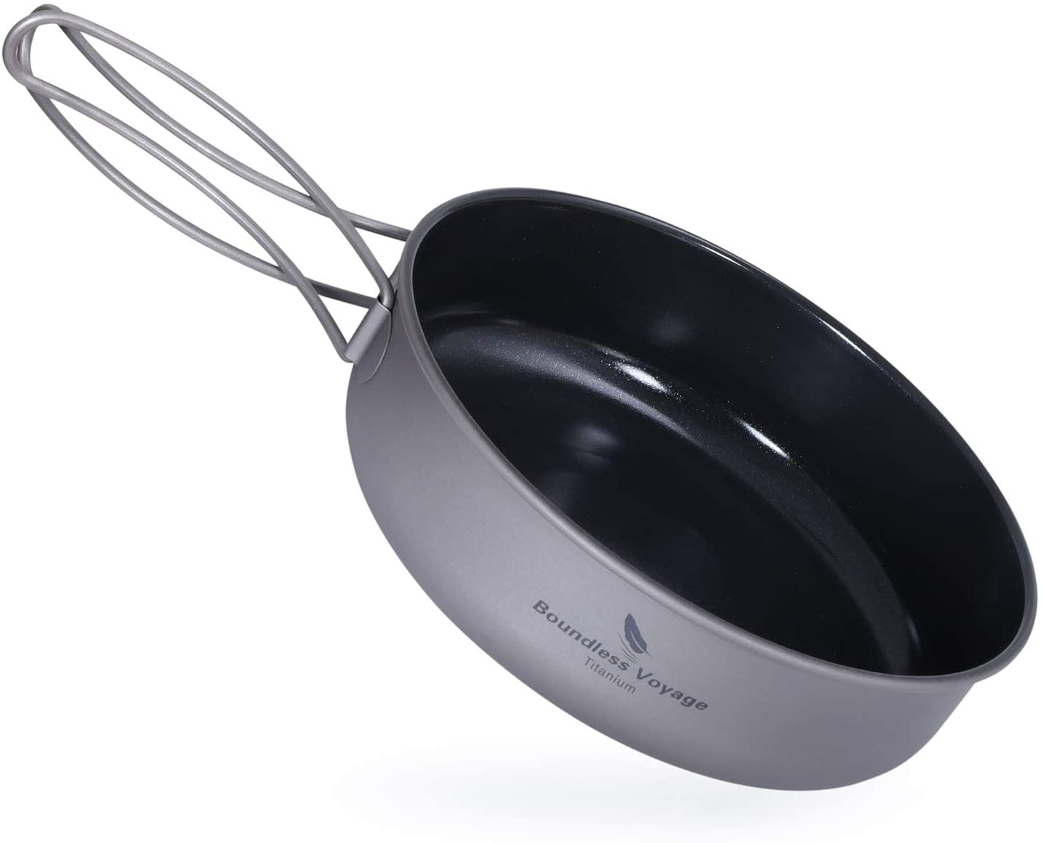
Cookware Material Options (continued)
Cast iron
  Pros: It's tough and ideal for baking or cooking.
  Cons: Very heavy; not for backpacking. Requires proper care.
Nonstick coatings (available on some metal cookware)
  Pros: Make clean up a breeze.
  Cons: Less durable than regular metal surfaces. Most can be scratched by metal utensils.
Plastic
  Pros: Lightweight, cheap, non-abrasive. Perfect for utensils and air-tight food containers.
  Cons: Not as durable or heat-resistant as metal. Some plastics can pick up and retain food flavors/odors.

Slide 29
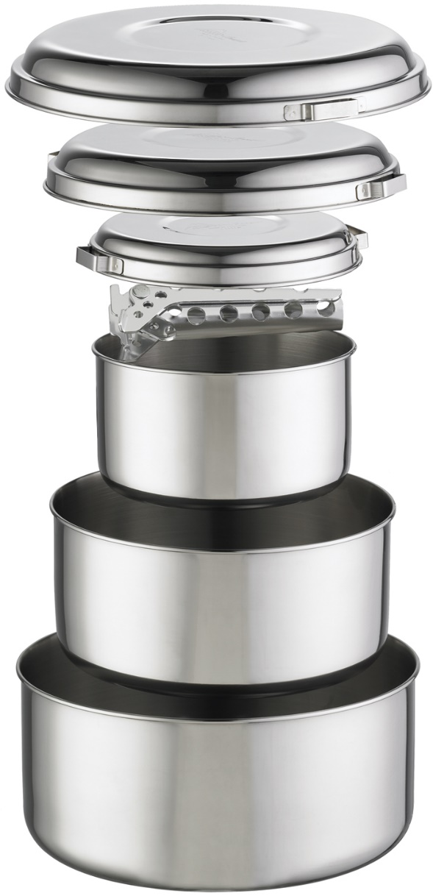
Other Cookware Considerations
Pot size: The largest pot in your cook set should hold approximately 1 pint per backpacker or camper in your party.
Number of pots: This depends on the type of cooking you plan to do and how many campers are in your party. If you plan to cook dehydrated foods for 2 backpackers, then 1 pot is sufficient. More elaborate meals and larger groups require additional pots and pans.
Lids: Lids reduce cooking time, save fuel and reduce splatter. Some cooksets feature a lid for every pot, while others have a single lid that can be used on several different-sized pots. Others can even double as frypans. Certain lids can also serve as plates, which can lighten your load.

Slide 30
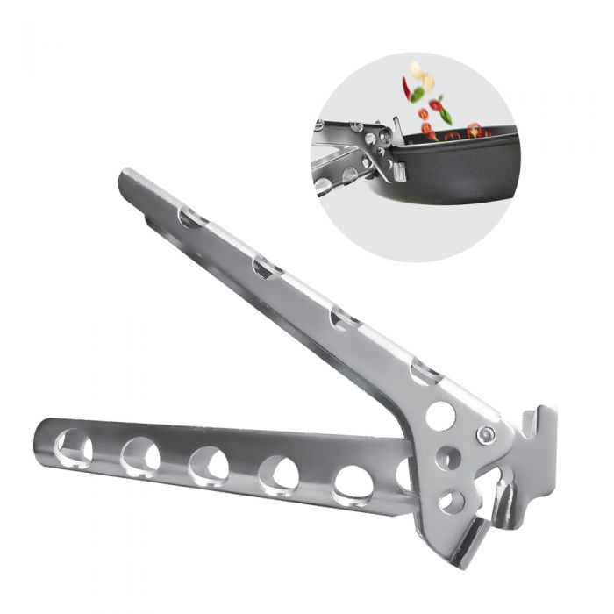

Other Cookware Considerations
Pot lifters or grippers: Make sure you have some way to pick up your pots and pans safely. Most cooksets include 1 gripper for all their pots. Just remember to pack it with you.
Wooden Spoon: For group cooking, wooden spoons are durable and light. Lexan spoons can snap when cooking or serving a heavy load of mashed potatoes or other foods.

Slide 31
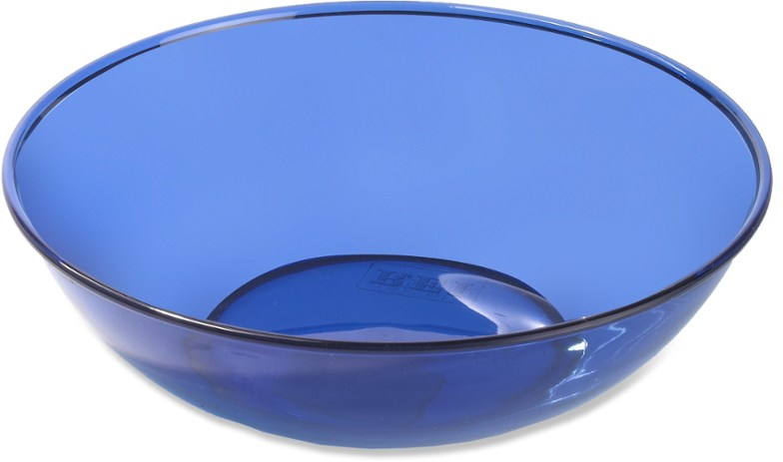
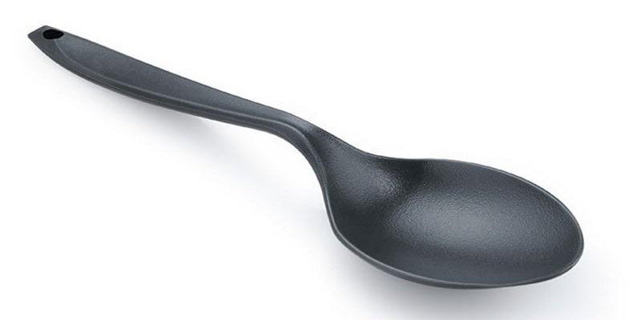
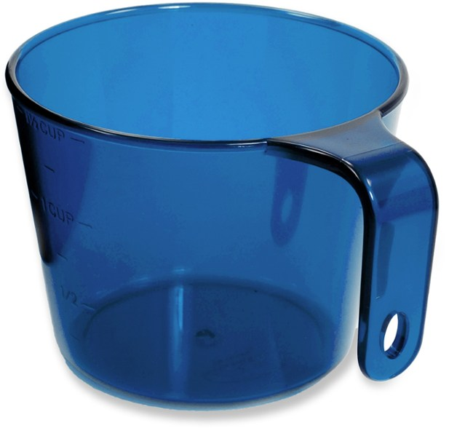
Personal Dinnerware
What to eat off of?
  The only dish needed is a camping bowl. Anything that can be eaten on a plate, can also be eaten from a bowl.
What utensil to use?
  A spoon is the only utensil needed.
What to use to drink?
  To drink, use your water bottle.
  However, a cup is useful for mixing up smaller quantities of drinks (Tang, Hot Chocolate, Coffee).
  It is also useful to serve meals when in a larger group.
  The measuring marks can also be helpful when cooking.

Slide 32
02
“Bearmuda” Triangle
Bear Canisters vs. Bear Bagging
Camp Layout and Setup

Slide 33
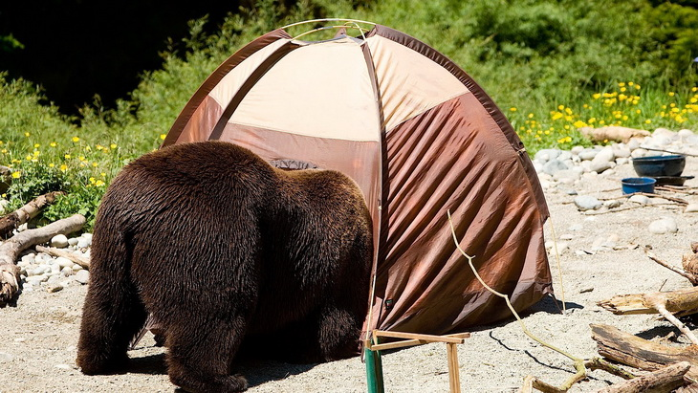
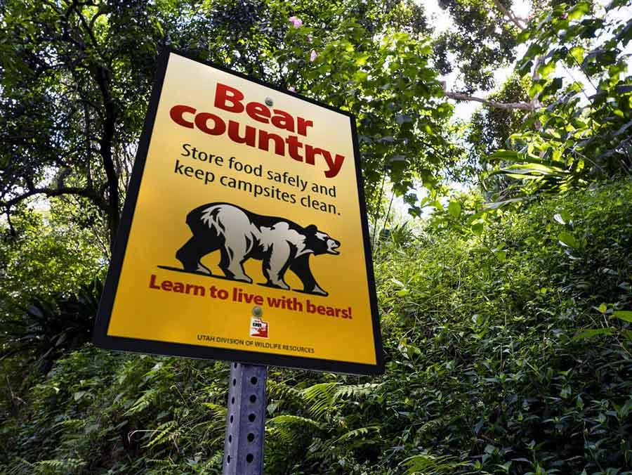
“Bearmuda Triangle”
The basic idea behind the “Bearmuda Triangle” is to separate your sleeping site from the other areas of your camp that are more likely to be interesting to bears – namely the food storage and the cooking area.
A black bear’s sense of smell is 100 times better than a dog’s and that's why things like lip balm and food-splattered shirts should be considered smellables even when you can't smell a thing.
Don’t bring any edibles, smellables, or trash into your sleeping area.
Practicing proper care of smellables within your camp will help protect both you and the bear.
Stay safe and help keep bears wild.

Slide 34
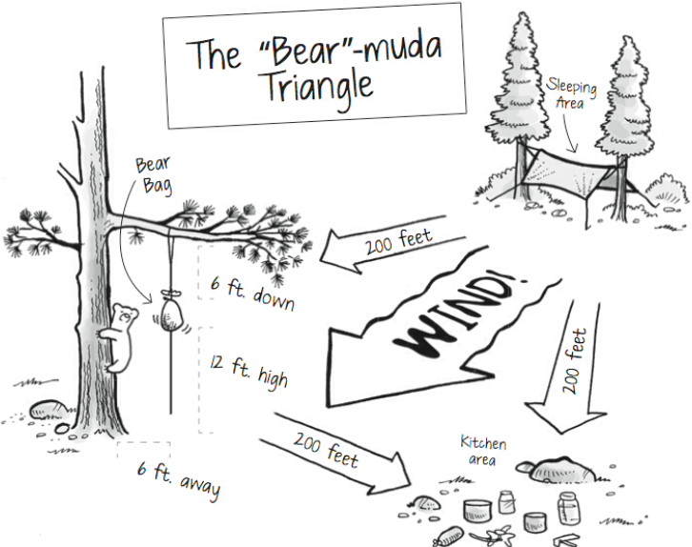
“Bearmuda Triangle”
The Bearmuda Triangle is formed by the cooking area, food storage/bear canister area, and the tenting area.
Group your tents together upwind from where you will cook and store food so that the wind blows interesting smells away from your sleeping area.
Pace at least 200 feet (70-75 steps) away from your sleeping site and hang your edibles and smellables in a bear bag in a tree or in bear canisters on the ground.
Pace at least 200 feet (70-75 steps) perpendicular to the line between sleeping and food areas and that’s where the cooking/dishwashing area goes.
Using the Bearmuda Triangle keeps you safely sleeping in your tent even if a bear comes into the area sniffing for dinner.

Slide 35
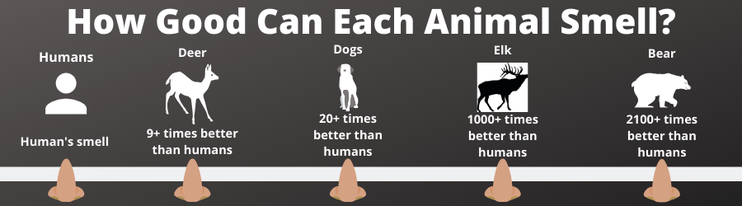
Bear Canisters
In many areas where bear-human conflict repeatedly occurs, use of bear-resistant containers has been made mandatory.
When the prize is your food and the setting is the wilderness, never bet against the bears.
Resourceful black bears, driven by a powerful sense of smell, have become some of the cagiest, most determined creatures on earth when it comes to snitching food from humans.
Increasingly drastic measures are needed to protect your food in some North American wilderness areas—and to protect bears from being put to death when their desire for human food makes them too aggressive.
Other than standing guard by your trail mix all night, the preferred solution is to store food inside a bear-resistant container.

Slide 36
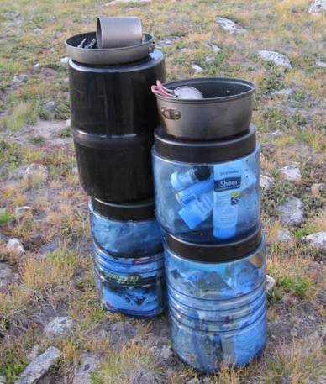
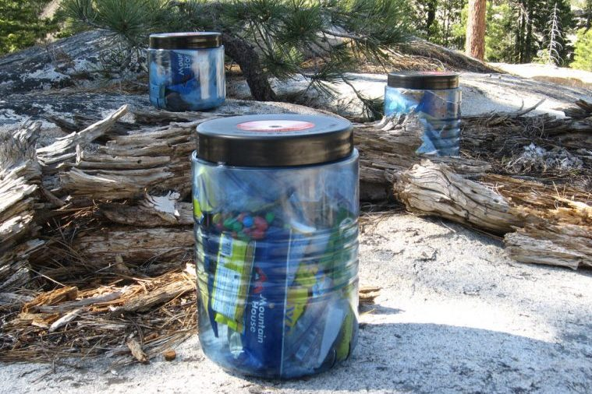
Packing a Bear Canister
With forethought and planning, it’s amazing how much food you can fit into a canister.
If you choose the right foods and repackage them into baggies or small containers, you can maximize canister space.
By measuring out every meal, you can make sure you are not packing more than you need.
Remember, when you are using a canister ALL scented items – food, toiletries and garbage – must fit inside the canister throughout your entire trip unless you are in attendance or actively preparing your food.
At the trailhead, make sure that ALL food, trash, toiletries and scented items will fit inside the canister the first night.
  Carry the first two meals outside of the canister: lunch and dinner.
Place the canister at least 200 feet from your tent (downwind if possible) in a depression or between rocks or logs so it cannot be rolled away.

Slide 37
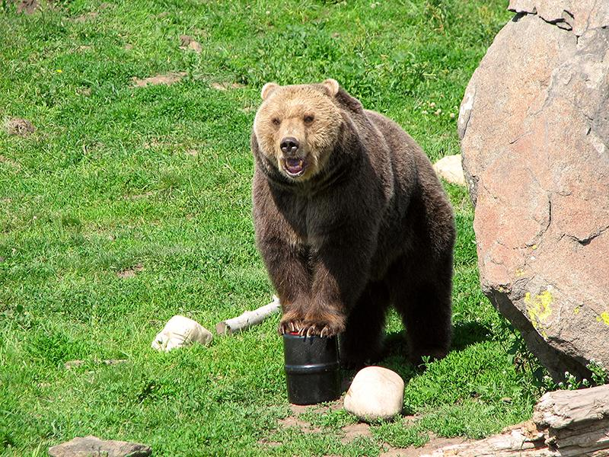
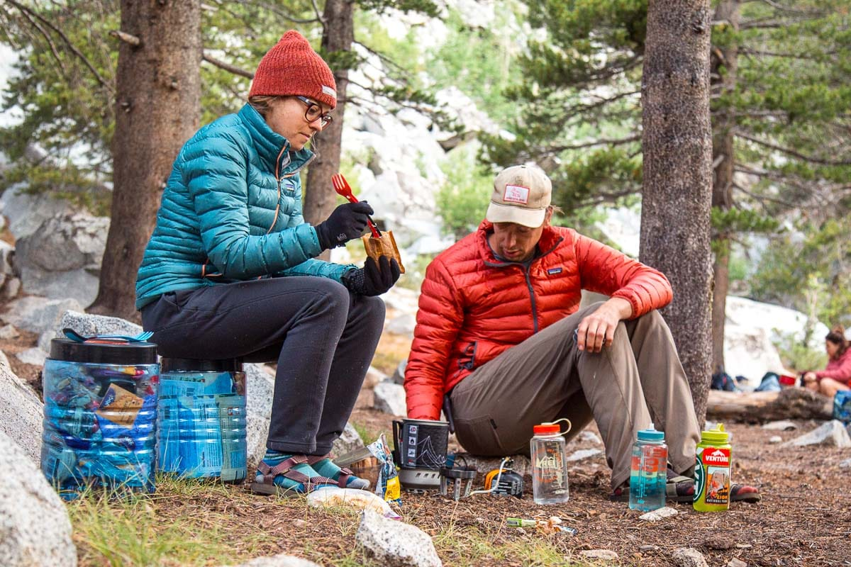
Benefits of Using a Canister
Less stress, increased peace of mind.
More time at camp to relax instead of thinking of ways to store food.
Guaranteed food supply if bears or other animals visit your camp.
No aborted trips because bears ate your food.
Freedom to camp anywhere: above tree line or away from food storage lockers.
No need to search for the right tree or carry ropes and food sacs for counter-balancing.
More time at camp to relax instead of thinking of ways to store food.
A small table to use, something to sit on.
Increased safety for you and protection of wild animals.

Slide 38
03
Duty Roster
The Finer Points
Backpacking Etiquette

Slide 39
Duty Roster
Crew Leaders:
 | Day 1 | Day 2 | Day 3 | Day 4 | Day 5 | Day 6 | Day 7
Navigator
Trashman
Fireman
AM Waterman 1
AM Waterman 2
AM Cook
PM Waterman 1
PM Waterman 2
Mr. Clean
PM Cook 1
PM Cook 2
PM Cook 3
KP 1
KP 2
KP 3

Slide 40
Duty Roster Job Description
Crew Leaders: Ensure all participants are aware of their duties and that the duties are carried out. The crew leaders also participate in the duties.
Navigator: Goes over the maps the evening before their assignment with the adult leaders. Reports the next day's hike details to the group prior to bedtime. Leads crew decision making at trail crossings.
Trashman: Compacts and carries the day’s trash. Responsible for organizing the clean-up of the campsite before leaving in the morning.
AM Cook: Immediately upon waking up, set up a stove and heat water for breakfast.
Fireman: Check fuel level in fuel bottles and adjust as necessary. Set up and light stoves at the appropriate time for cooking under orders of the cooks. Break down and store stoves and fuel bottles after KP is done.

Slide 41
Duty Roster Job Description
Watermen (AM): Prior to breakfast, collect and fill all crew water bottles as necessary.
Watermen (PM): Immediately after camp is set up, fill crew water bladders with filtered water as necessary. Collect and fill all crew water bottles as necessary. Be available if needed during cooking and KP.
Mr. Clean: Responsible for filling and hanging shower/wash bags in an appropriate area immediately after setting up camp. After bathing is done, empty the bags, turn inside out, and set out to dry.
PM Cooks: Cook 1 is in charge. Lead the other cooks, fireman and watermen in getting dinner done. Rehydrate food and get water boiling in a timely manner. Cook according to package instructions. Serve food to the crew, being careful of not spilling food. Control the cooking area. Keep others out of the way unless they are assisting.
KP: KP 1 is in charge. Clean out all cooking pots as completely as possible before dish washing begins. Prepare large pot of water for heating. Use a large cooking pot as wash pot and another pot as a rinse pot. Wash all personal gear before crew gear. Dispose of wash water appropriately. Lay out all cookware to dry overnight.

Slide 42
Crew Duties
Crew duties sequence upon reaching camp:
  Locate the "bearmuda" triangle at camp - bear canisters, cooking, and sleeping area.
  Set up the crew fly in the cooking area, if necessary.
  Place all crew gear and bear canisters in the cooking area.
  Set up personal tents and stow all personal gear.
Crew duties before going to bed:
  Place all personal smellables in the bear canisters and store for the night.
  Pack all personal and non-smellable crew gear possible.
Crew duties before hiking in the morning:
  Immediately upon awakening pack all personal gear, take down and pack tents.
  After breakfast, pack bear canisters and crew gear.
  Take down crew fly.
**Any crew gear you carry is yours to carry for the entire trek. Remember what you are carrying in case it is needed in an emergency.

Slide 43
Backpacking Etiquette - The Finer Points
A good high adventure team is like a powerful, well-oiled, finely-tuned marriage. Members cook meals together, face challenges together, and finally go to bed together. A bad adventure, on the other hand, is an awkward, ugly, embarrassing thing characterized by bickering, filth, frustration, and crispy meals.
Nearly all bad adventures have one thing in common: poor behavior. This is true even if team members follow the stated rules, such as Don't Wear Muddy Boots into the Tent, Separate Fuel and Food, No Soap in the River, Wash your Hands Before Cooking, Keep your Trekking Pole Out of My Eye, etc.
Unfortunately, too many rules of backpacking etiquette remain unspoken. Leaders seem to assume that their team members already have strong and generous characters like their own. But judging from a few of the backpackers we've encountered, more rules ought to be spelled out. Here are ten of them.

Slide 44
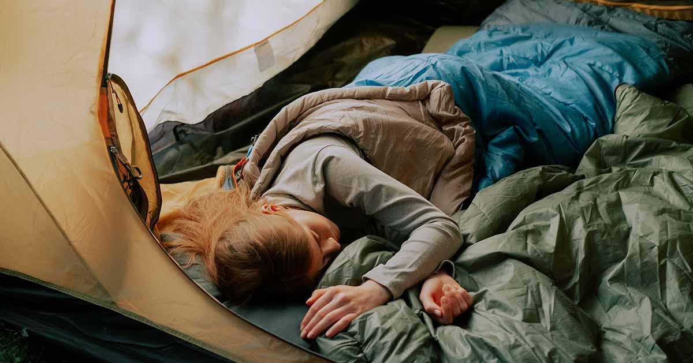
Backpacking Etiquette Rule #1
Get Your Butt Out of Bed.
Suppose your team members get up early to fetch water and fire up the stove while you lie comatose in your sleeping bag. As they run an extensive equipment check, pack gear, and fix your breakfast, they hear you snoring. Last night you were their buddy; now they're drawing up lists of things about you that make them want to spit. They will devise cruel punishments for you. You have earned them. The team concept is now defunct. Had you gotten out of bed, nobody would have had to suffer.

Slide 45
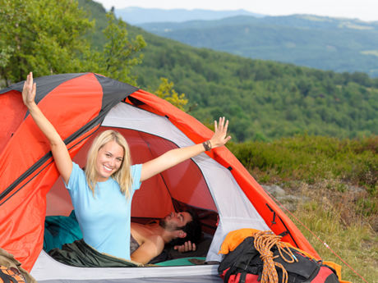
Backpacking Etiquette Rule #2
Do Not Be too Cheerful Before Breakfast.
Some people wake up perky and happy as fluffy bunny rabbits. They put stress on those who wake up mean as rabid wolverines. Exhortations such as "Rise and shine, sugar!" and "Greet the dawn, pumpkin!" have been known to provoke pungent expletives from wolverine types. These curses, in turn, may offend fluffy bunny types. Indeed, they are issued with the sincere intent to offend. Thus, the day begins with flying fur and hurt feelings. The best early-morning behavior is simple: Be quiet.

Slide 46
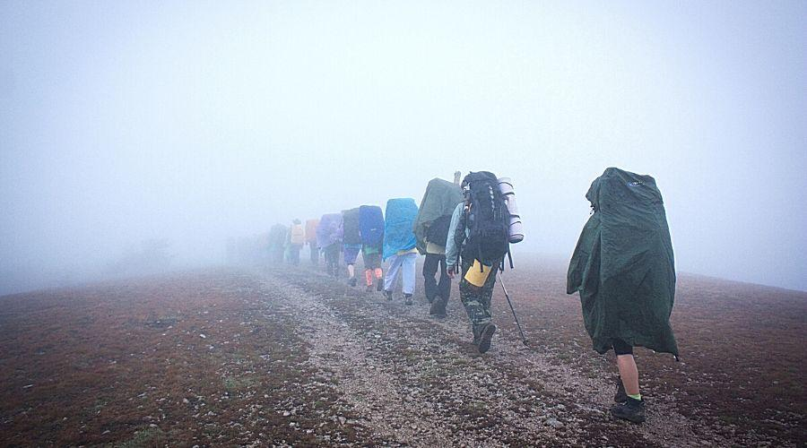
Backpacking Etiquette Rule #3
Do Not Complain about Anything, Ever.
You are cold and wet, visibility is four inches with wind driven sleet granules embedding themselves in your face like shotgun pellets, mosquitoes and black flies are sucking one quart of blood per hour, and the day’s route has an elevation increase of 5000 feet. Must you mention it? Do you think your friends haven't noticed the conditions? Make a suggestion. Tell a joke. Lead a prayer. Do not lodge a complaint. Your pack weighs 87 pounds and your cheap backpack straps are actually cutting into your flesh. Were you promised a personal Sherpa? Did somebody cheat you out of a mule team? If you can't carry your weight, get a motor home.

Slide 47
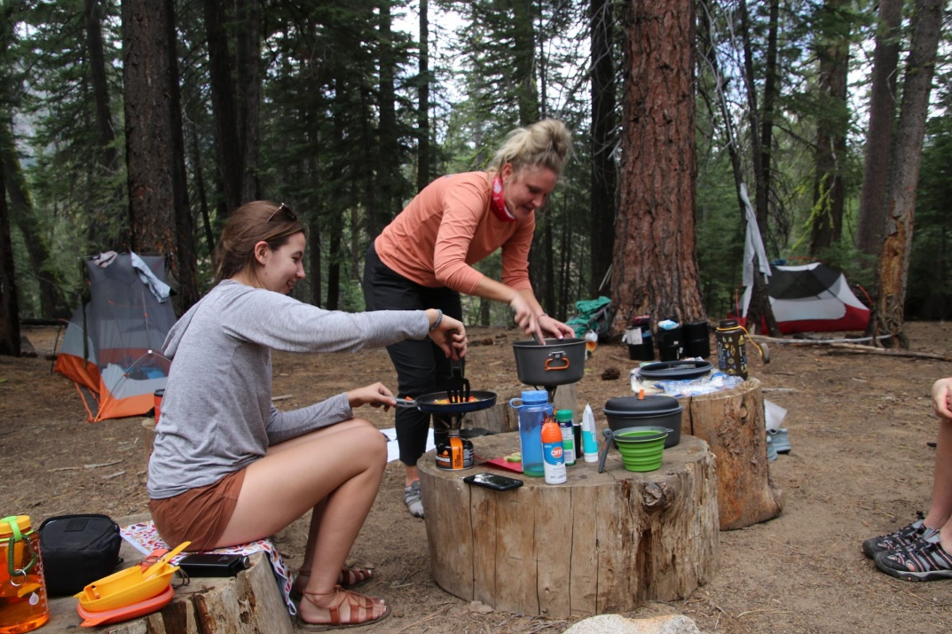
Backpacking Etiquette Rule #4
Learn to Cook at Least One Thing Right.
One expedition trick is so old that it is no longer amusing: on the first cooking assignment, the clever cook prepares a dish that resembles “Burnt Sock in Toxic Waste Sauce”. The cook hopes to be relieved permanently from cooking duties. This is the childish approach to a problem that's been with us since people first started throwing lizards on the fire. Tricks are not a part of a team spirit. If you don't like to cook, say so. Offer to wash dishes and to prepare the one thing you do know how to cook, even if it's only boiled water. Remember that talented camp cooks sometimes get invited to join major expeditions in Nepal, all expenses paid.

Slide 48
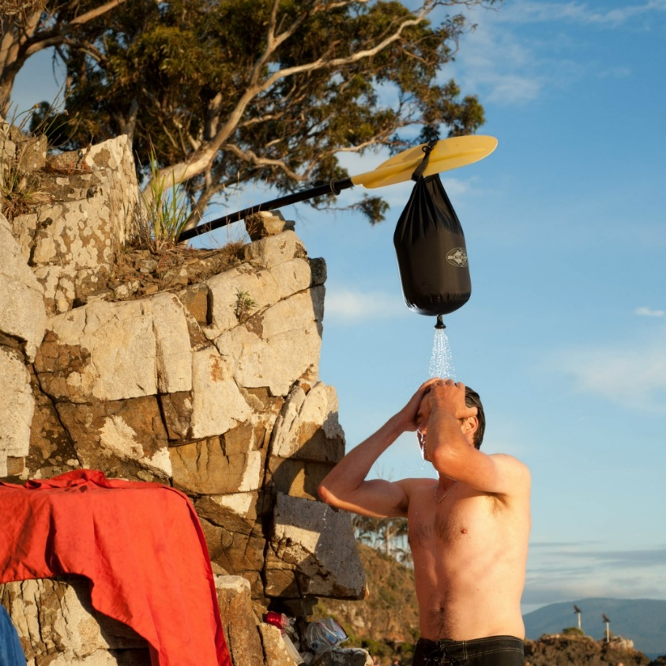
Backpacking Etiquette Rule #5
Either A) Bathe, or B) Accept an Unflattering New Nickname.
After a week or so on the trail, without bathing, hair forms angry little clumps and wads and the body odor is extreme. This leaves the person looking and smelling like an escapee from the basement of a mental ward outhouse. Such an appearance could shake a team's confidence in your judgment let alone your tentmate’s willingness to share space with you. If you can't bathe, be prepared for others to do it for you when you least expect it.

Slide 49
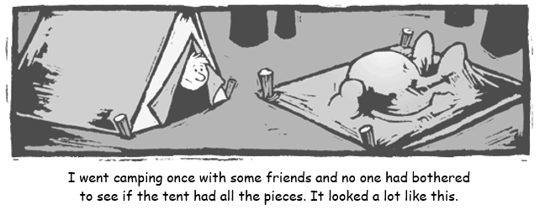
Backpacking Etiquette Rule #6
Do Not Ask if Anybody's Seen Your Stuff.
Experienced backpackers have systems for organizing their gear. They very rarely leave it strewn around camp or lying back on the trail. One of the stupidest things you can do is ask your tentmate if they've seen the tent poles you thought you packed 15 miles ago. Even in the unlikely event you get home alive, you will not be invited on the next trip. Should you ever leave the tent poles 15 miles away, do not ask if anybody's seen them. Simply announce, with a good-natured chuckle, that you are about to set off in the dark on a 30-mile hike to retrieve them, and that you are sorry. Also, it's unprofessional to lose personal items such as your spoon or your toothbrush. If something like that happens, don't mention it to anyone.

Slide 50
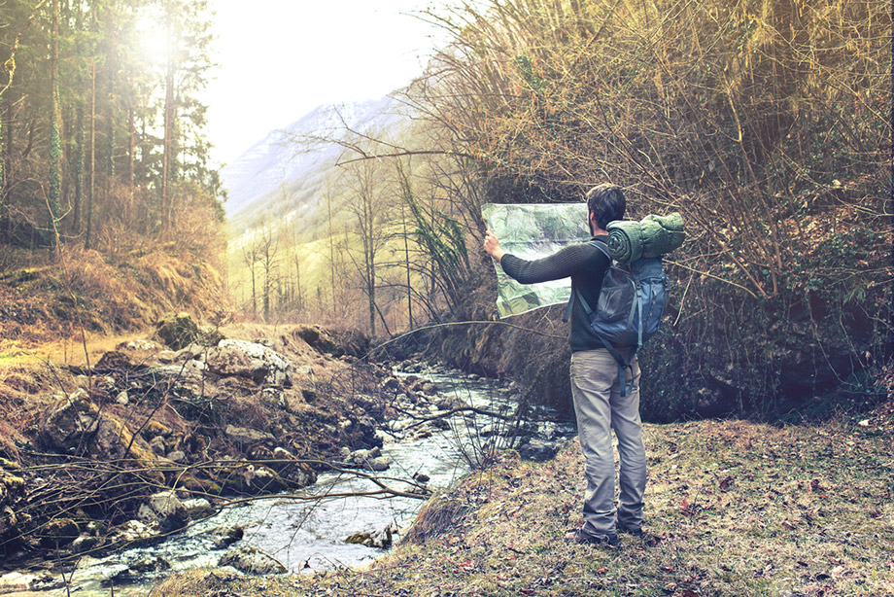
Backpacking Etiquette Rule #7
Never Ask Where You Are.
If you want to know where you are or how much farther the destination is, look at the map. Don’t verbalize your question. Everyone is encouraged and welcome to participate in the evening or morning route planning sessions, or you may want the challenge to try to figure it out yourself. Go for it. If you're still confused, feel free to discuss the identity of landmarks around you and how they correspond to the cartography. But if at some point you: A) suspect that a mistake has been made, B) have experience in interpreting topographical maps, or C) are certain that your group leader is a novice or on drugs, speak up. Otherwise, follow the group like sheep.

Slide 51
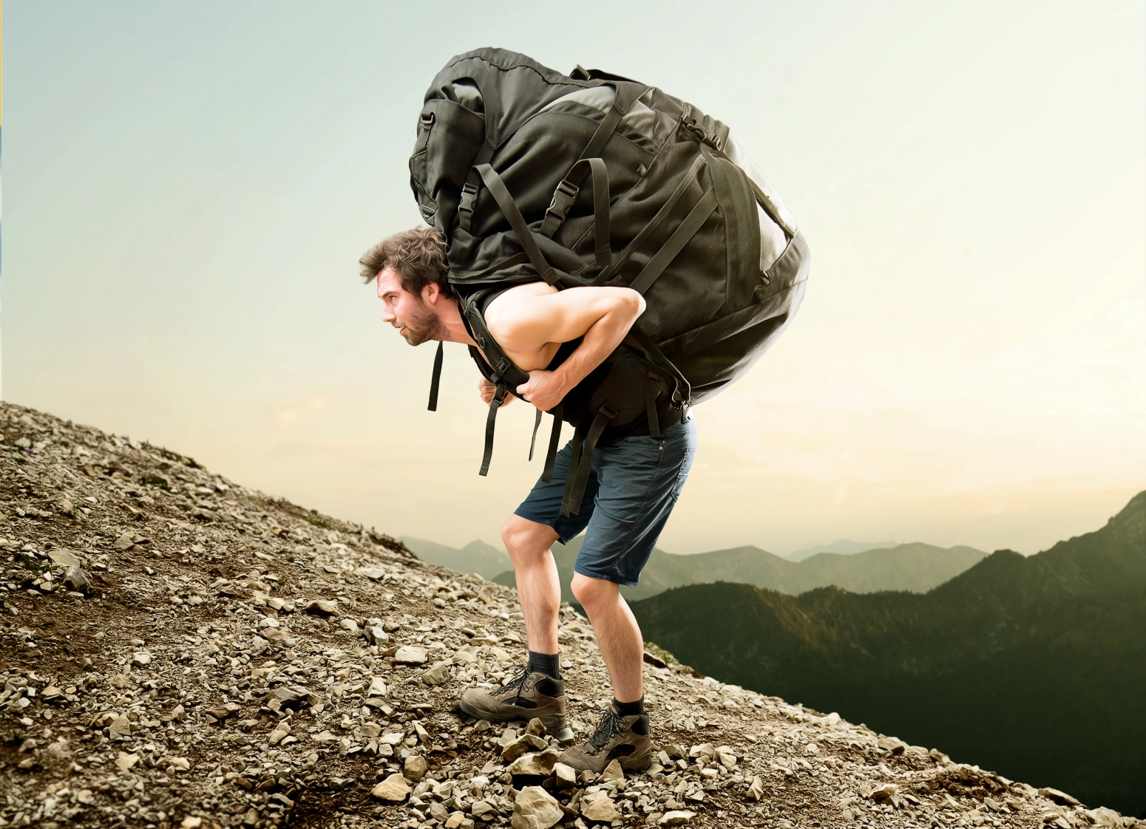
Backpacking Etiquette Rule #8
Always Carry More than Your Fair Share.
When the trip is over, would you rather be remembered as a stud or a sissy? Keep in mind that a pound or two of extra weight in your pack won't make your back hurt any more than it already does. In any given group of flatlanders, somebody is bound to try and lighten their overall weight by not carrying their fair share; usually by stating that their bear canister or pack has no more room. When an argument begins, take the extra weight yourself. Then shake your head and gaze with pity upon the slothful one. This is the mature response to childish behavior. On the trail that day, during a break, load the offender's pack with a few extra pounds of rocks or gravel.

Slide 52
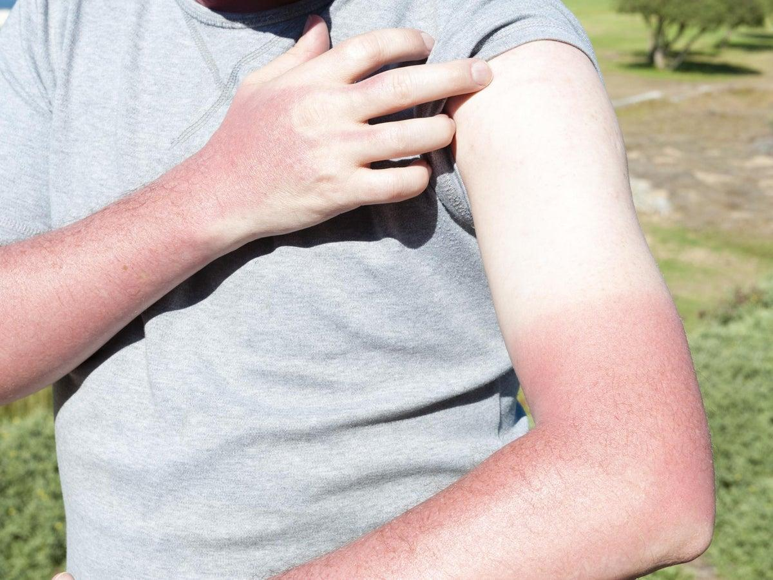
Backpacking Etiquette Rule #9
Do Not Get Sunburned.
Sunburn is not only painful and unattractive. It's also an obvious sign of inexperience. Most newbies wait too long before applying sunscreen. Once you've burned on an expedition, you may not have a chance to get out of the sun. Then the burn gets burned, skin peels away, blisters sprout on the already swollen lips. Anyway, you get the idea. Wear SPF 30 protection. It gives you just about 100% protection. It does get on your sunglasses, all over your clothes and in your mouth. But that's OK. Unlike sunshine, sunscreen is non-toxic.

Slide 53
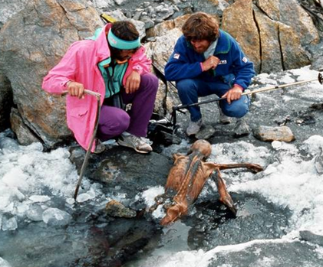
Backpacking Etiquette Rule #10
Do Not Get Killed.
Suppose you make the summit of Mount Everest solo, without bottled oxygen, and carrying the complete works of Hemingway in hardcover. Pretty macho, huh? Suppose now that you take a vertical detour down a crevasse and never make it back to camp. Would you still qualify as a hero? And would it matter? Nobody's going to run any fingers through your new chest hair. The worst thing to have on your outdoor resume is a list of the possible locations of your body. Besides, your demise might distract your team members from enjoying what's left of their vacations.

Slide 54
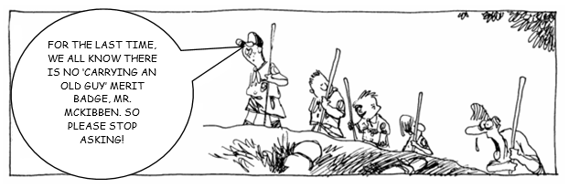
Backpacking Etiquette
All backpacking etiquette really flows from this one principle:
Think of your team, the beautiful machine, first. You are merely a cog in that machine. If you can’t think about others first, forget about joining the high adventure. Your team will never have more than one member.

Slide 55
Questions?
Terry McKibben
Troop 344/9344
Pemberville, OH
troop344leaders@gmail.com

