Slide 1

Space Exploration
Merit Badge
Troop 344 and 9344
Pemberville, OH

Slide 2
Space Exploration
Requirements
Tell the purpose of space exploration and include the following:
  Historical reasons,
  Immediate goals in terms of specific knowledge,
  Benefits related to Earth resources, technology, and new products.
  International relations and cooperation
Design a collector's card, with a picture on the front and information on the back, about your favorite space pioneer. Share your card and discuss four other space pioneers with your counselor.

Slide 3
Space Exploration
Requirements
Build, launch, and recover a model rocket.* Make a second launch to accomplish a specific objective. (Rocket must be built to meet the safety code of the National Association of Rocketry. See the "Model Rocketry" chapter.) Identify and explain the following rocket parts:
  Body tube
  Engine mount
  Fins
  Igniter
  Launch lug
  Nose cone
  Payload
  Recovery system
  Rocket engine

Slide 4
Space Exploration
Requirements
Discuss and demonstrate each of the following:
  The law of action-reaction.
  How rocket engines work.
  How satellites stay in orbit.
  How satellite pictures of Earth and pictures of other planets are made and transmitted.

Slide 5
Space Exploration
Requirements
Do TWO of the following:
  Discuss with your counselor a robotic space exploration mission and a historic crewed mission. Tell about each mission's major discoveries, its importance, and what was learned from it about the planets, moons, or regions of space explored.
  Using magazine photographs, news clippings, and electronic articles (such as from the Internet), make a scrapbook about a current planetary mission.
  Design a robotic mission to another planet, moon, comet, or asteroid that will return samples of its surface to Earth. Name the planet, moon, comet, or asteroid your spacecraft will visit. Show how your design will cope with the conditions of the environments of the planet, moon, comet, or asteroid

Slide 6
Space Exploration
Requirements
Describe the purpose and operation of ONE of the following:
  Space shuttle or any other crewed orbital vehicle, whether government owned (U.S. or foreign) or commercial
  International Space Station
Design an inhabited base located within our solar system, such as Titan, asteroids, or other locations that humans might want to explore in person. Make drawings or a model of your base. In your design, consider and plan for the following:
  Source of energy
  How it will be constructed
  Life-support system
  Purpose and function
Discuss with your counselor two possible careers in space exploration that interest you. Find out the qualifications, education, and preparation required and discuss the major responsibilities of those positions.

Slide 7
Requirement 1
Tell the purpose of space exploration and include the following:
  Historical reasons,
  Immediate goals in terms of specific knowledge,
  Benefits related to Earth resources, technology, and new products.
  International relations and cooperation

Slide 8
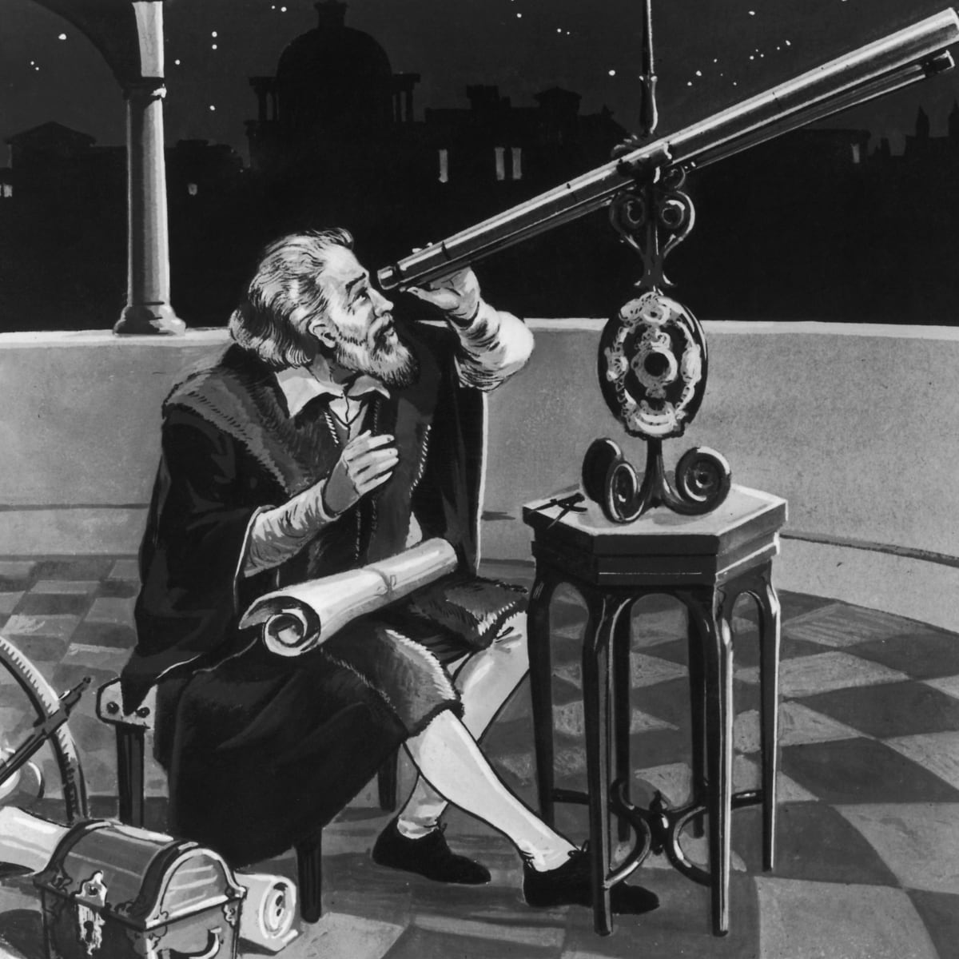
Requirement 1a
Historical Reasons for Space Exploration
Space has beckoned us, from the early observers such as the Greeks, Chinese, and Aztecs; to early seafarers like Christopher Columbus and astronomers including Copernicus and Galileo.
The stars and planets in the sky have helped us shape our beliefs, tell time, guide our sailing ships, make discoveries, invent devices, and learn about our world.

Slide 9
Requirement 1
Tell the purpose of space exploration and include the following:
  Historical reasons,
  Immediate goals in terms of specific knowledge,
  Benefits related to Earth resources, technology, and new products.
  International relations and cooperation

Slide 10
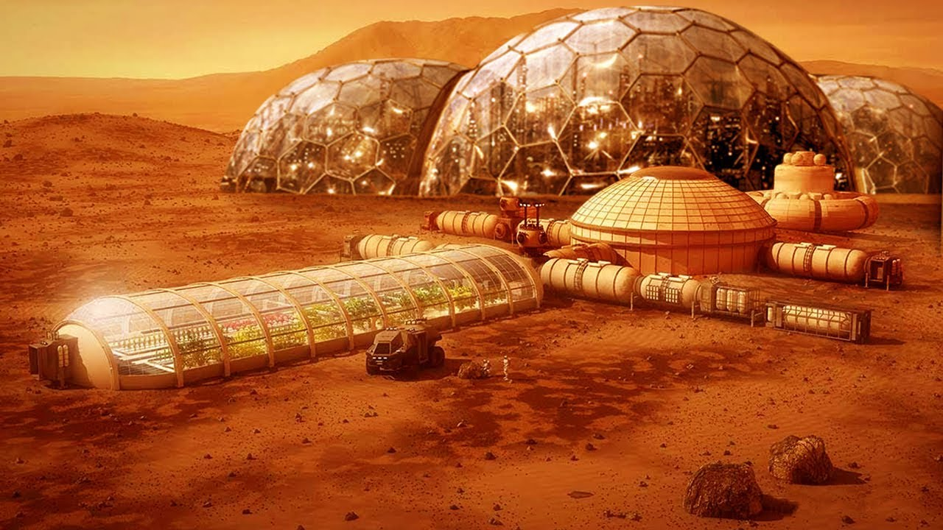
Requirement 1b
Immediate Goals of Space Exploration
Colonization of the Moon and Mars.
Determine if there is extra- terrestrial life.
Encourage research and development.
Encourage discovery.
Inspiration and national moral.

Slide 11
Requirement 1
Tell the purpose of space exploration and include the following:
  Historical reasons,
  Immediate goals in terms of specific knowledge,
  Benefits related to Earth resources, technology, and new products.
  International relations and cooperation

Slide 12
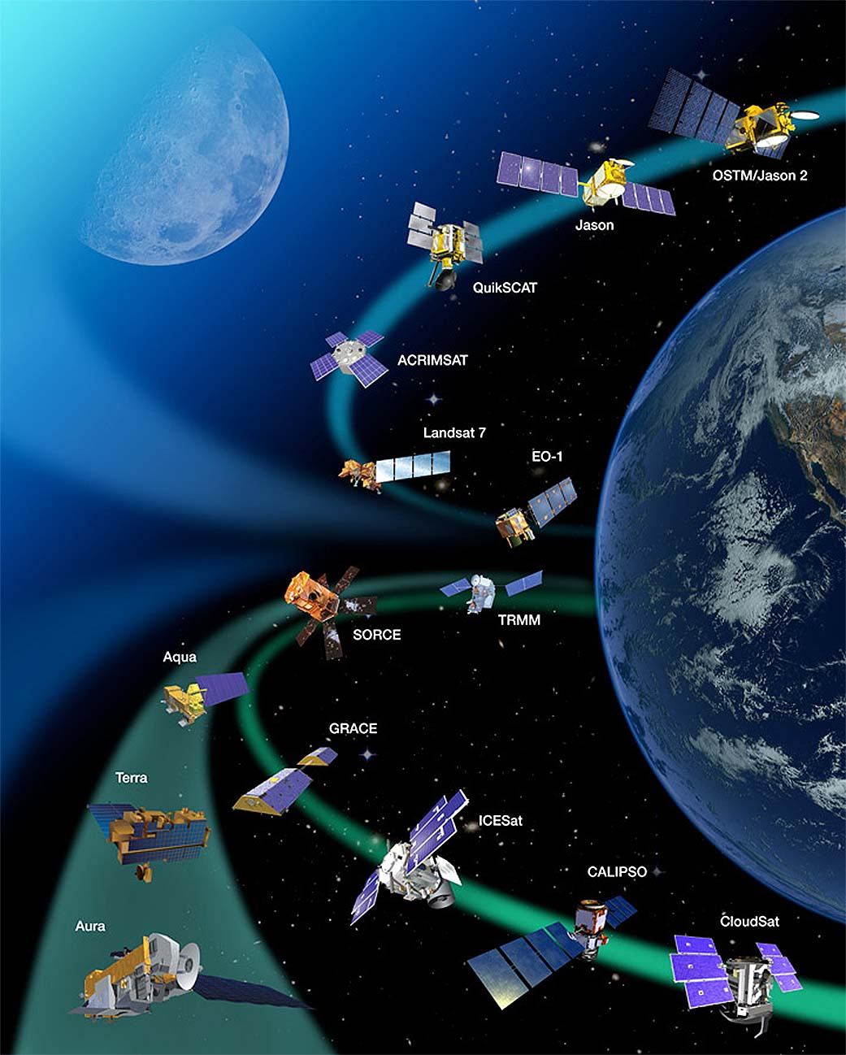
Requirement 1c
Benefits of Space Exploration
Our ability to place satellites in orbit gives us many benefits.
  Weather forecasts
  Locating natural resources
  Mapping environmental problems
  Communications through phones, internet, television
  GPS
  National Security

Slide 13
Requirement 1c
Benefits of Space Exploration
Spinoffs from the space program has provided us with new materials, products, and technologies that have also led to new industries and jobs. Below are just a few of the many spinoffs.
  Cell phone cameras
  Memory foam
  Scratch resistant sunglasses
  Cordless vacuums
  Precision GPS
  LED lights
  Technical fabrics
  Space blankets
  Cloud computing
  Smoke detectors
  Airplane wing design
  Advanced water filtration
  Invisible braces
  Satellite television
  Ear thermometers
  Modern insulation
  CAT scanners
  Firefighting equipment
  Solar cells
  Landmine removal
  Space age swimsuits
  Freeze dried food

Slide 14
Requirement 1
Tell the purpose of space exploration and include the following:
  Historical reasons,
  Immediate goals in terms of specific knowledge,
  Benefits related to Earth resources, technology, and new products.
  International relations and cooperation.

Slide 15
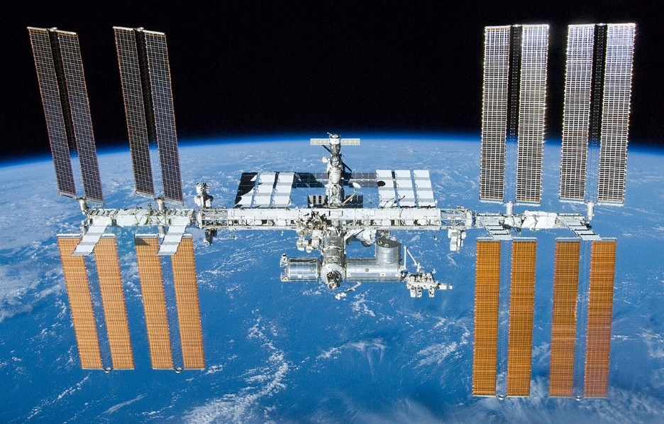
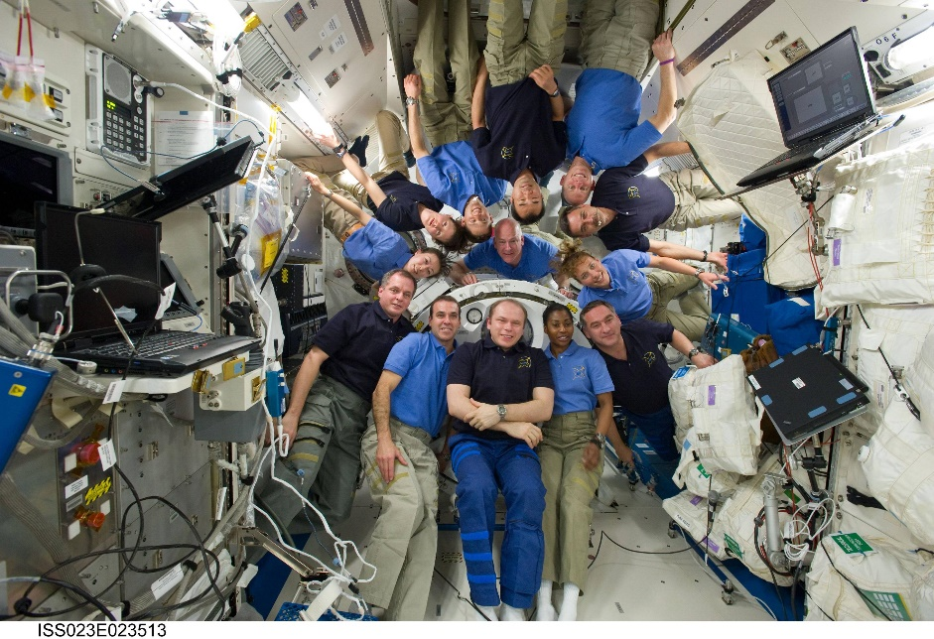
Requirement 1d
International Relations and Cooperation
One of the benefits of space exploration is improved inter- national relations and cooperation.
Although the Age of Space began in a fiercely competitive mode, political and funding realities have now shifted the balance toward cooperation.
This is particularly true in the case of the International Space Station, with its 16 partner nations.
Half of the last 60 space science missions operated by NASA have had international participation.

Slide 16
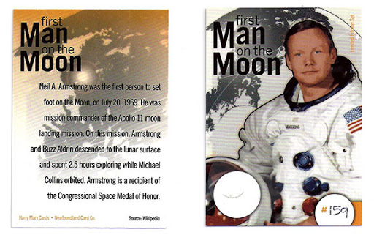

Requirement 2
Design a collector's card, with a picture on the front and information on the back, about your favorite space pioneer. Share your card and discuss four other space pioneers with your counselor.

Slide 17
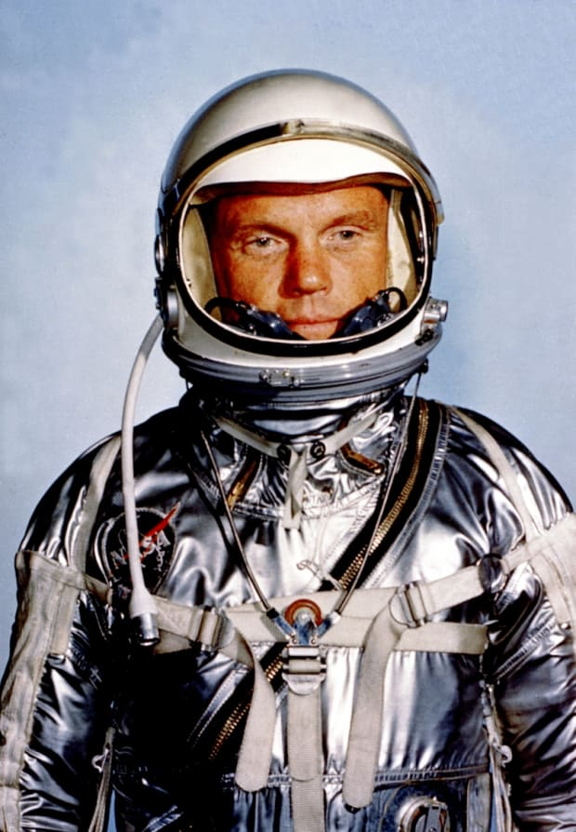
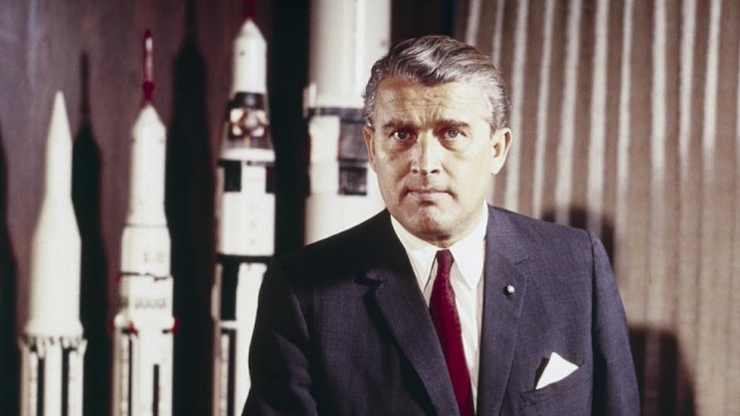
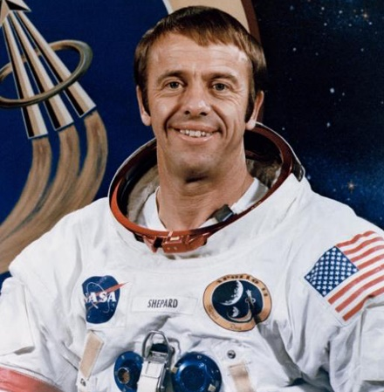
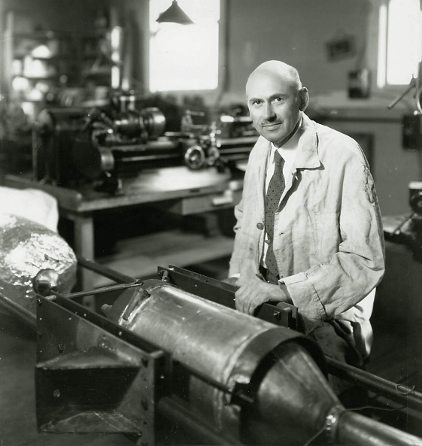
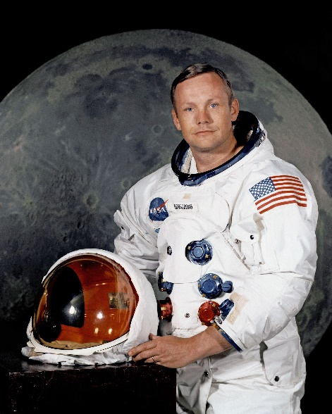
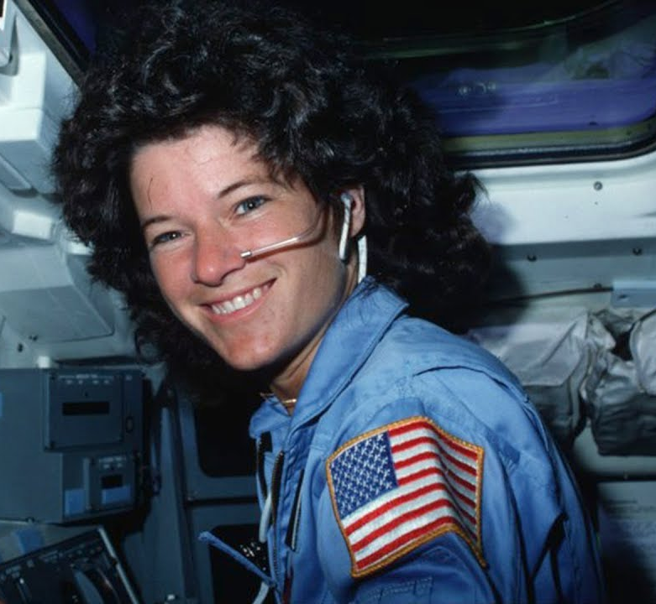
Requirement 2
Space Pioneers
Wernher Von Braun
Alan Shepard
John Glenn
Robert Goddard
Neil Armstrong
Sally Ride

Slide 18
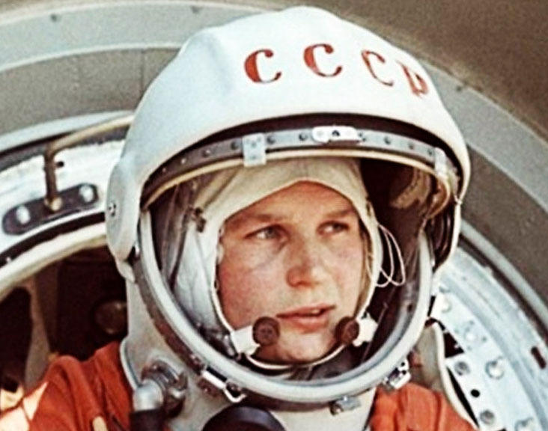
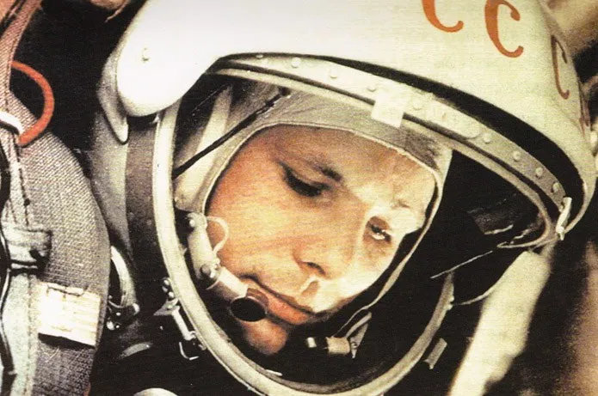
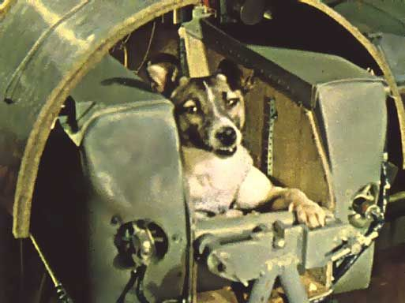
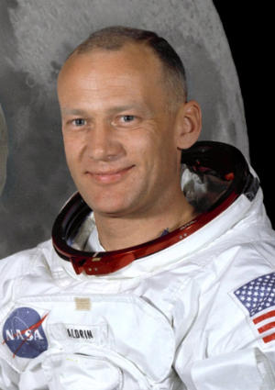
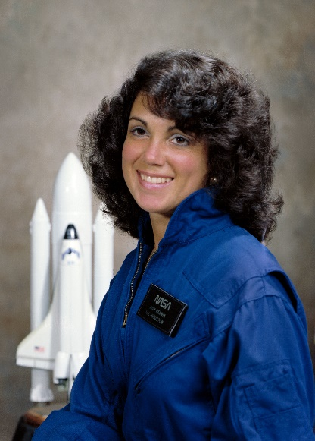
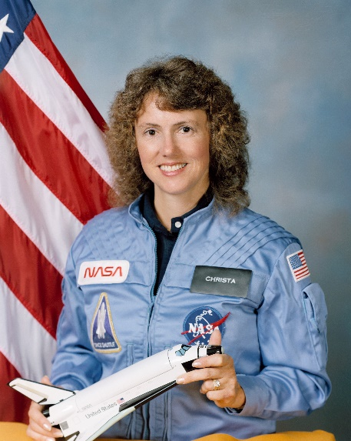
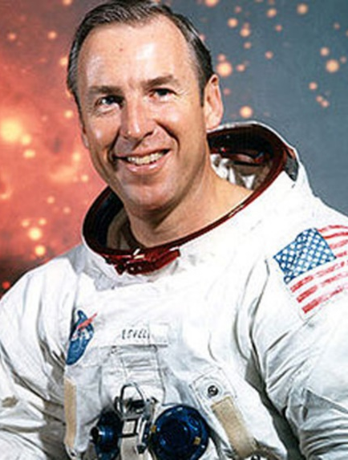
Requirement 2
Space Pioneers
Valentina Tereshkova
Yuri Gagarin
Laika
Buzz Aldrin
Judith Resnick
Krista McAullife
Jim Lovell

Slide 19
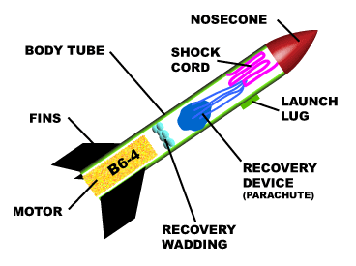
Requirement 3
Build, launch, and recover a model rocket. Make a second launch to accomplish a specific objective. (Rocket must be built to meet the safety code of the National Association of Rocketry. See the "Model Rocketry" chapter.) Identify and explain the following rocket parts:
  Body tube
  Engine mount
  Fins
  Igniter
  Launch lug
  Nose cone
  Payload
  Recovery system
  Rocket engine

Slide 20
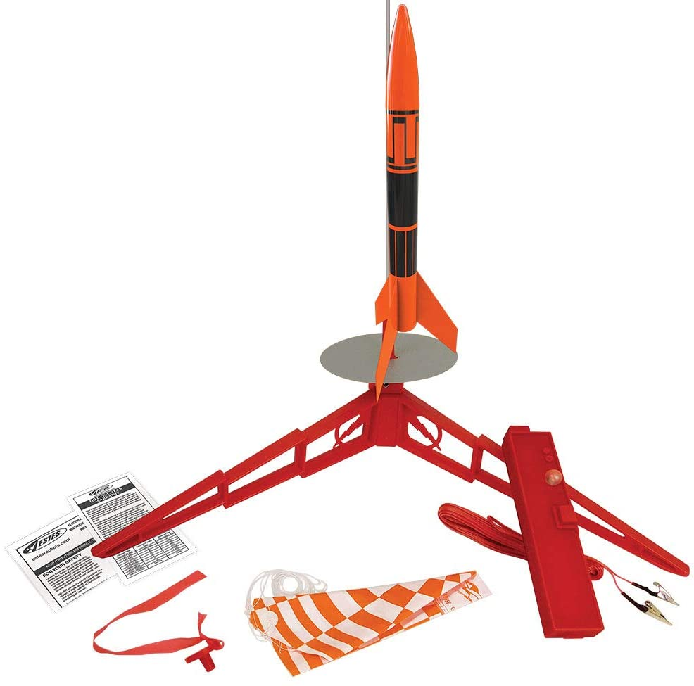
Build, Launch, and Recover a Model Rocket
If you have never built a model rocket before, it is best to start with a simple kit such as the Estes Alpha Model Rocket.
The kit will consist of a body tube, nose cone, fins, engine mount, and parachute or some other recovery system that will gently lower your rocket to the ground at the end of its flight.
Engines must be purchased separately from the rocket.
Be sure to buy the recommended engines for your kit.
Follow the instructions in the kit in building your rocket.

Slide 21
Requirement 3
Build, Launch, and Recover a Model Rocket
Stability Check Your Rocket
Stability checks before a launch assure you that your rocket will fly properly
Unstable rockets tumble in the air and may head back toward the launch pad at high speed.
Stability checks require a long piece of string and a piece of tape.
Prepare the rocket for flight and insert a live engine.
Tie a slipknot around the body of the rocket and slide it to the point where the rocket is perfectly balanced on the string. Tape the string in place.

Slide 22
Requirement 3
Build, Launch, and Recover a Model Rocket
Stability Check Your Rocket
Hold the string in one hand over your head and begin to twirl your rocket.
If your rocket is stable, it will travel around you without tumbling, nose cone first.
If the rocket tumbles, it is too dangerous to fly.
Correct this by putting on larger fins or adding weight to the rocket’s nose with a lump of clay.
Retest stability.
Repeat this process until the rocket is stable.

Slide 23
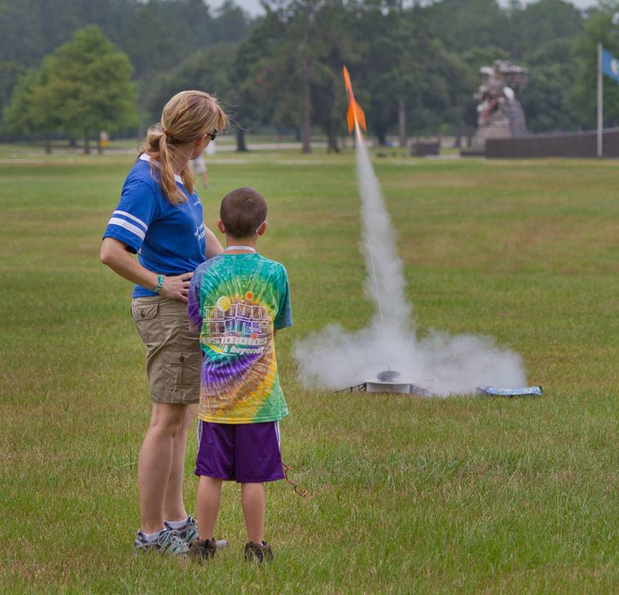
Requirement 3
Build, Launch, and Recover a Model Rocket
Launching Your Rocket
Choose a proper launching site as outlined in the Model Rocket Safety Code.
A launching pad is required and you can purchase one or build your own (see the attached “Low Cost Rocket Launcher Plans”).
Your launch system must be electric and have a switch that closes only when you press it and then opens again automatically.
It also must have a master switch, or a way to disconnect the batteries, while you set up your next flight.
The wires from your batteries should extend about 15 feet to small alligator clips at the ends.
These clips will be attached to the wires of the igniter.
Never use a flame to ignite your rocket.

Slide 24
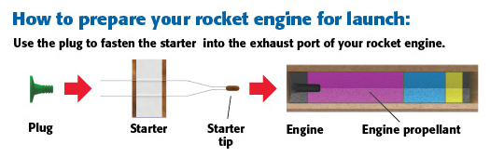
Requirement 3
How to prepare a rocket engine for launch.

Slide 25
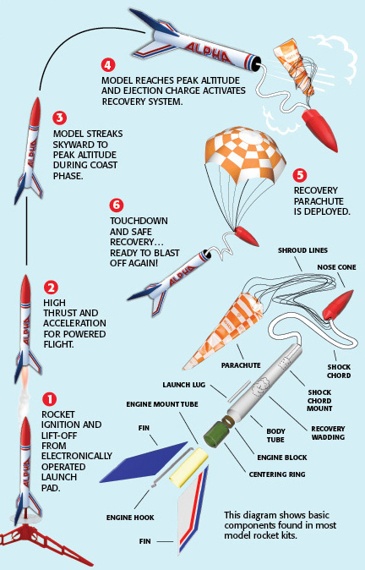
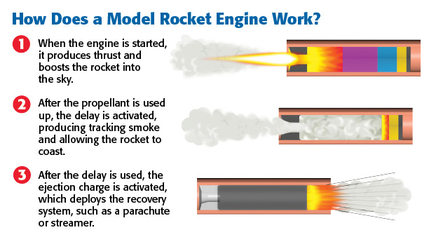
Requirement 3
s
s

Slide 26
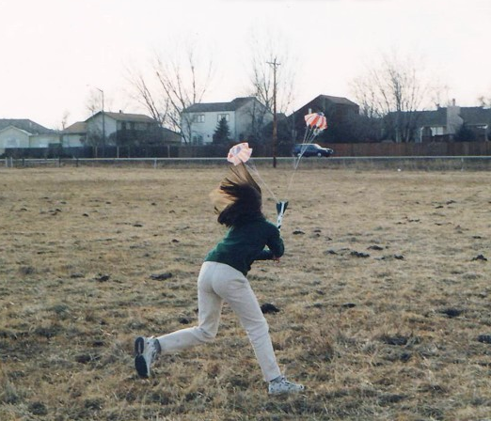
Requirement 3
Build, Launch, and Recover a Model Rocket
Accomplish a Launch Objective
After you have made your first launch, make a second launch with a specific objective.
For example, try to spot-land the rocket within a 50 foot circle. You must make allowances for wind drift and aim your rocket accordingly.

Slide 27
Requirement 3
Model Rocket Safety Code
Materials. I will use only lightweight, non-metal parts for the nose, body, and fins of my rocket.
Motors. I will use only certified, commercially-made model rocket motors, and will not tamper with these motors or use them for any purposes except those recommended by the manufacturer.
Ignition System. I will launch my rockets with an electrical launch system and electrical motor igniters. My launch system will have a safety interlock in series with the launch switch, and will use a launch switch that returns to the “off” position when released.
Misfires. If my rocket does not launch when I press the button of my electrical launch system, I will remove the launcher’s safety interlock or disconnect its battery, and will wait 60 seconds after the last launch attempt before allowing anyone to approach the rocket.

Slide 28
Requirement 3
Model Rocket Safety Code
Launch Safety. I will use a countdown before launch, and will ensure that everyone is paying attention and is a safe distance of at least 15 feet away when I launch rockets with D motors or smaller, and 30 feet when I launch larger rockets. If I am uncertain about the safety or stability of an untested rocket, I will check the stability before flight and will fly it only after warning spectators and clearing them away to a safe distance. When conducting a simultaneous launch of more than ten rockets I will observe a safe distance of 1.5 times the maximum expected altitude of any launched rocket.
Launcher. I will launch my rocket from a launch rod, tower, or rail that is pointed to within 30 degrees of the vertical to ensure that the rocket flies nearly straight up, and I will use a blast deflector to prevent the motor’s exhaust from hitting the ground. To prevent accidental eye injury, I will place launchers so that the end of the launch rod is above eye level or will cap the end of the rod when it is not in use.
Size. My model rocket will not weigh more than 1,500 grams (53 ounces) at liftoff and will not contain more than 125 grams (4.4 ounces) of propellant or 320 N-sec (71.9 pound- seconds) of total impulse.

Slide 29
Requirement 3
Model Rocket Safety Code
Flight Safety. I will not launch my rocket at targets, into clouds, or near airplanes, and will not put any flammable or explosive payload in my rocket.
Launch Site. I will launch my rocket outdoors, in an open area at least as large as shown in the accompanying illustration, and in safe weather conditions with wind speeds no greater than 20 miles per hour. I will ensure that there is no dry grass close to the launch pad, and that the launch site does not present risk of grass fires.
Recovery System. I will use a recovery system such as a streamer or parachute in my rocket so that it returns safely and undamaged and can be flown again, and I will use only flame-resistant or fireproof recovery system wadding in my rocket.
Recovery Safety. I will not attempt to recover my rocket from power lines, tall trees, or other dangerous places.

Slide 30
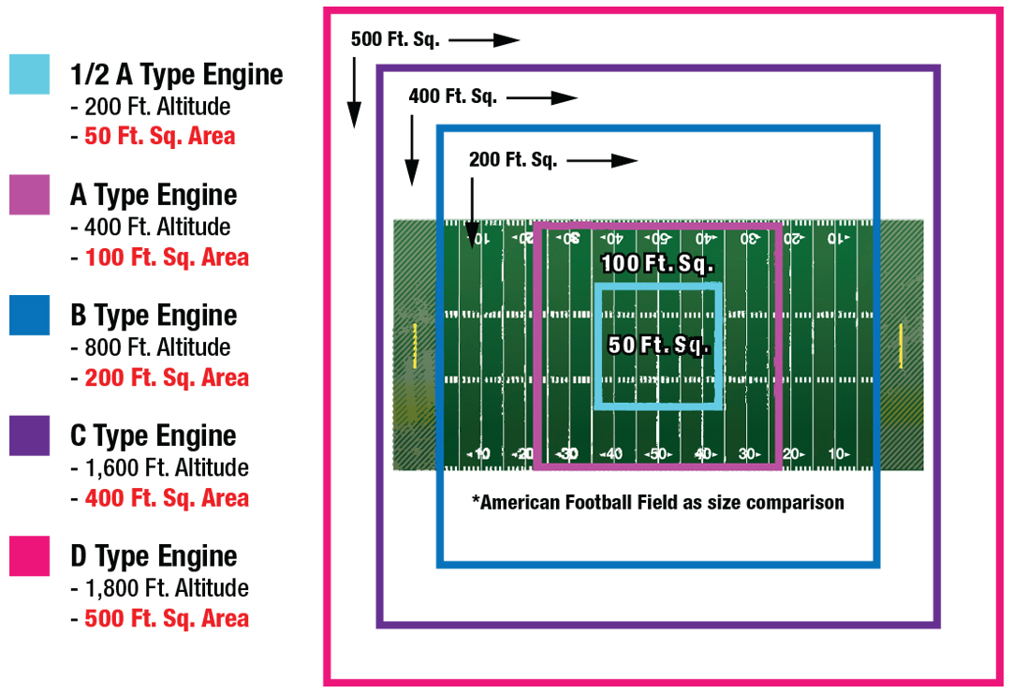
Requirement 3
Choose a large field away from power lines, buildings, tall trees, and low flying aircraft. The larger the launch area, the better your chance of recovering your rocket.

Slide 31
Requirement 3
Identify and Explain the Parts of a Rocket
Body Tube refers to the main cylindrical body of a model rocket. Body tubes are typically made from lightweight wound cardboard tubing to keep the weight of the rocket down, since the weight of the rocket is the major factor limiting how high the rocket can fly.
Nose Cone is the tip of the rocket. The nose cone plays several roles for the model rocket. First, it is the aerodynamic leading edge for the rocket, so it has a significant impact on the flight characteristics for the rocket. It is attached by a shock cord so that it is not lost during the deployment of the recovery system.

Slide 32
Requirement 3
Identify and Explain the Parts of a Rocket
Fins The fins are one of the most important factors in the stability of the model rocket. The fins are typically done in sets of three, which is the minimum required for stability, or sets of four. The fins are placed on the body tube as close to the end with the model rocket engine as possible, and often extend below the bottom of the body tube.
Engine Mount is the portion of the model rocket kit that houses the model rocket engine.

Slide 33
Requirement 3
Identify and Explain the Parts of a Rocket
Igniters are simple devices which permit you to launch your model rocket by remote control.
Launch lug is a small cylindrical tube attached to the body tube of a model rocket, allowing the rocket to be guided along the launch rod during the rocket launch.

Slide 34
Requirement 3
Identify and Explain the Parts of a Rocket
Payload section holds instruments or a camera.
Recovery system is typically a parachute or streamer that is used to help the rocket land safely.
Rocket engine is used to power the flight of a model rocket in much the same way a real rocket motor powers the flight of space rockets and the space shuttle.

Slide 35
Requirement 4a
Discuss and demonstrate each of the following:
  The law of action-reaction.
  How rocket engines work.
  How satellites stay in orbit.
  How satellite pictures of Earth and pictures of other planets are made and transmitted.

Slide 36
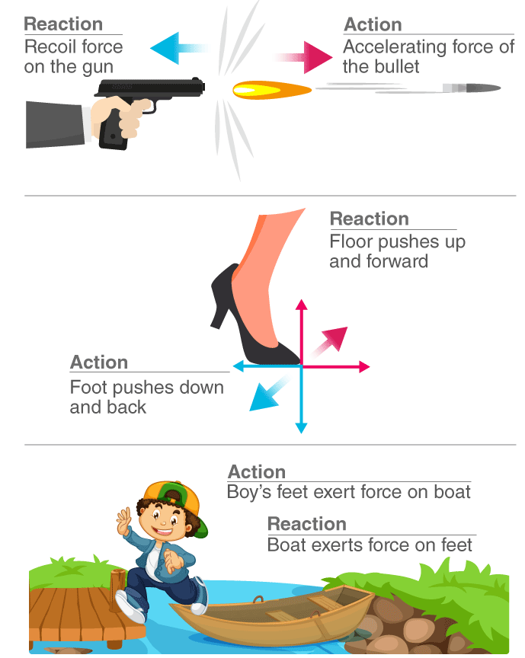
Requirement 4a
Newton’s Third Law of Motion
For every action, there is an equal and opposite reaction.

Slide 37
Requirement 4b
Discuss and demonstrate each of the following:
  The law of action-reaction.
  How rocket engines work.
  How satellites stay in orbit.
  How satellite pictures of Earth and pictures of other planets are made and transmitted.

Slide 38
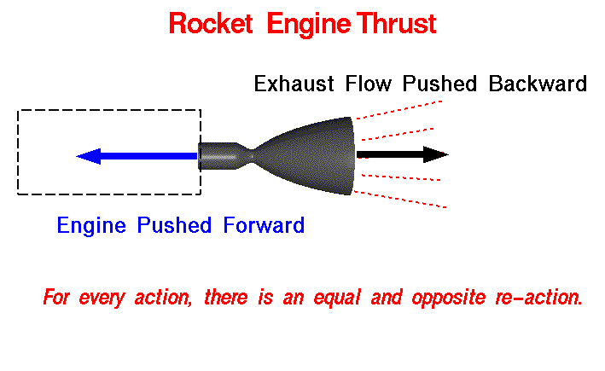
Requirement 4b
How Rocket Engines Work

Slide 39
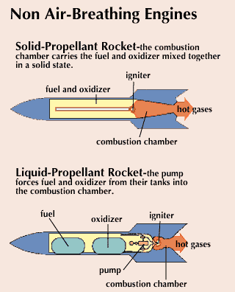
Requirement 4b
How Rocket Engines Work
Solid Propellant rocket engines use a fuel and oxidizer mixed together in a solid form that will burn but not explode. The powder is burned at one end of a tube, and the exhaust escapes out the other end providing thrust.
Liquid Propellant rocket engines have a fuel and oxidizer, both liquids carried in separate tanks. The fuel and oxidizer are pumped into a combustion chamber where the fuel is burned. The exhaust is forced out of the combustion chamber through a nozzle and produces thrust. Examples are liquid hydrogen (fuel) and liquid oxygen (oxidizer).

Slide 40
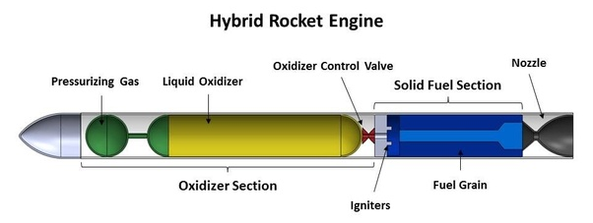
Requirement 4b
How Rocket Engines Work
Hybrid Propellant rocket engines combine a solid fuel with a liquid oxidizer. The solid fuel is contained within the combustion chamber . The oxidizer is fed into the combustion chamber. The exhaust is forced through a nozzle creating thrust.

Slide 41
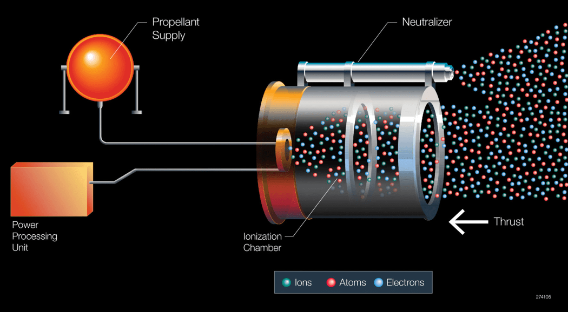
Requirement 4b
How Rocket Engines Work
Ion Drive engines accelerate ions to produce thrust. They are the most efficient rocket engines today. They produce a low thrust, but operate for a long time.

Slide 42
Requirement 4c
Discuss and demonstrate each of the following:
  The law of action-reaction.
  How rocket engines work.
  How satellites stay in orbit.
  How satellite pictures of Earth and pictures of other planets are made and transmitted.

Slide 43
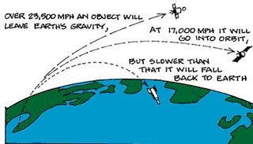
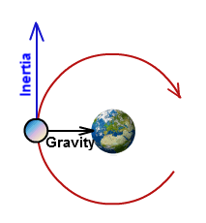
Requirement 4c
How Satellites Stay in Orbit
Satellites are able to enter orbit around the planet because they are locked into speeds that are fast enough to defeat the downward pull of gravity.
A satellite maintains its orbit by balancing two factors: its velocity (the speed it takes to travel in a straight line) and the gravitational pull that Earth has on it.

Slide 44
Requirement 4d
Discuss and demonstrate each of the following:
  The law of action-reaction.
  How rocket engines work.
  How satellites stay in orbit.
  How satellite pictures of Earth and pictures of other planets are made and transmitted.

Slide 45
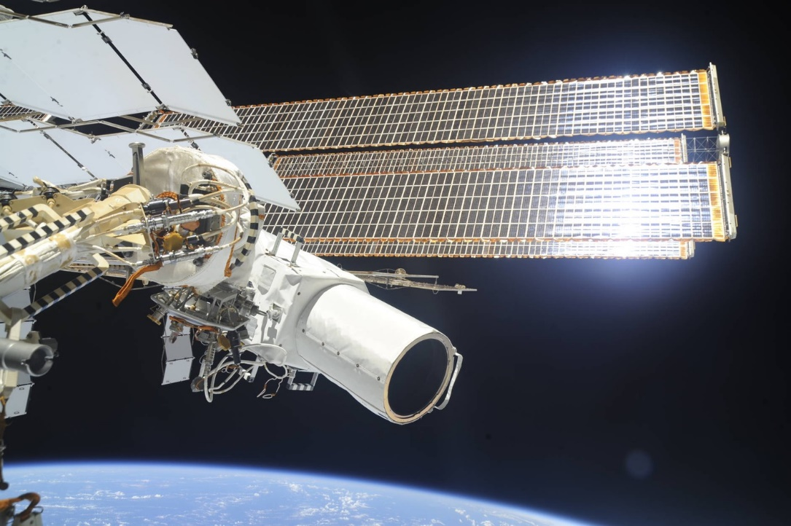
Requirement 4d
How satellite pictures of Earth and pictures of other planets are made and transmitted.
Observation satellites are equipped with a camera or sensor onboard to capture all the reflected light from the area of interest on the planet being photographed.
This is then converted into binary information and then to short wave radio signals and then transmitted back to earth.
The ground station captures these radio signals, processes it back to binary information and reconstructs it into the image.

Slide 46
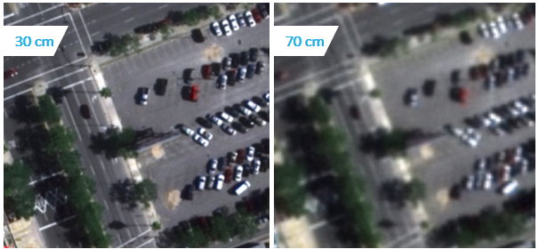
Requirement 4d
Satellite Imagery Resolution
Resolution refers to the smallest size an object or detail can be represented in an image.
Higher resolution means that pixel sizes are smaller, providing more detail.
The best commercial satellite resolution is 30cm.
This means that 30cm resolution satellite imagery can capture details on the ground that are greater than or equal to 30cm by 30cm (about 1 foot by 1 foot).

Slide 47
Requirement 5
Do TWO of the following:
  Discuss with your counselor a robotic space exploration mission and a historic crewed mission. Tell about each mission's major discoveries, its importance, and what was learned from it about the planets, moons, or regions of space explored.
  Using magazine photographs, news clippings, and electronic articles (such as from the Internet), make a scrapbook about a current planetary mission.
  Design a robotic mission to another planet, moon, comet, or asteroid that will return samples of its surface to Earth. Name the planet, moon, comet, or asteroid your spacecraft will visit. Show how your design will cope with the conditions of the environments of the planet, moon, comet, or asteroid.

Slide 48
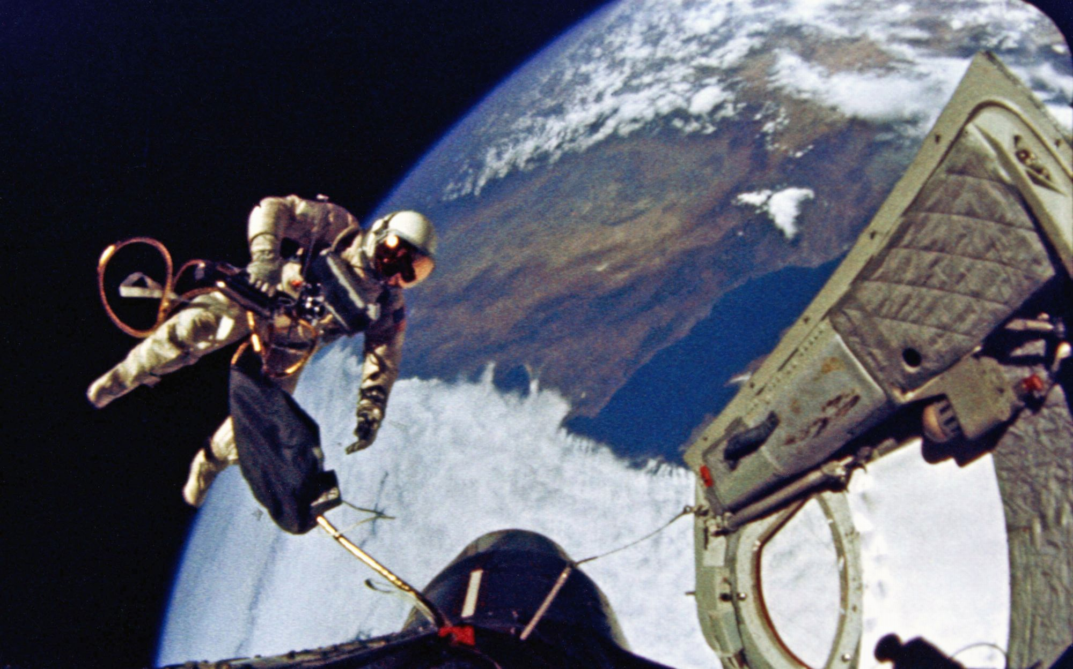
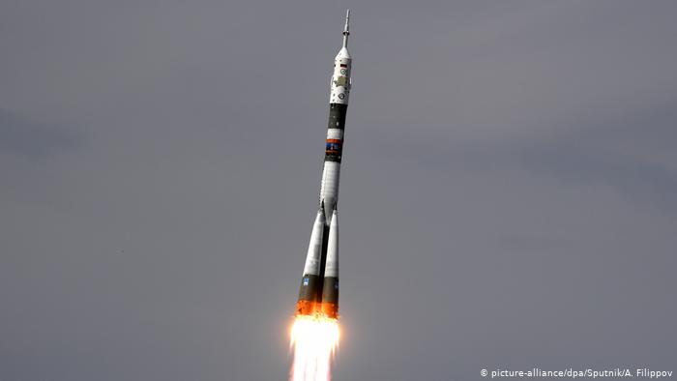
Requirement 5a
Historic Crewed Missions
Vostok program (USSR, 1956–1964) The Vostok program was a project that succeeded in putting a person into orbit for the first time.
Project Mercury (USA, 1959–1963) Project Mercury was the first human spaceflight program of the United States.
Project Gemini (USA, 1965–1966) Project Gemini was the second human spaceflight program of NASA.
Soyuz program (USSR/Russia, 1967–ongoing) The Soyuz program is a human spaceflight program that was initiated by the Soviet Union in early 1967. It was originally part of a Moon landing program intended to put a Soviet cosmonaut on the Moon.
Gemini 4 Spacewalk
Soyuz Rocket

Slide 49
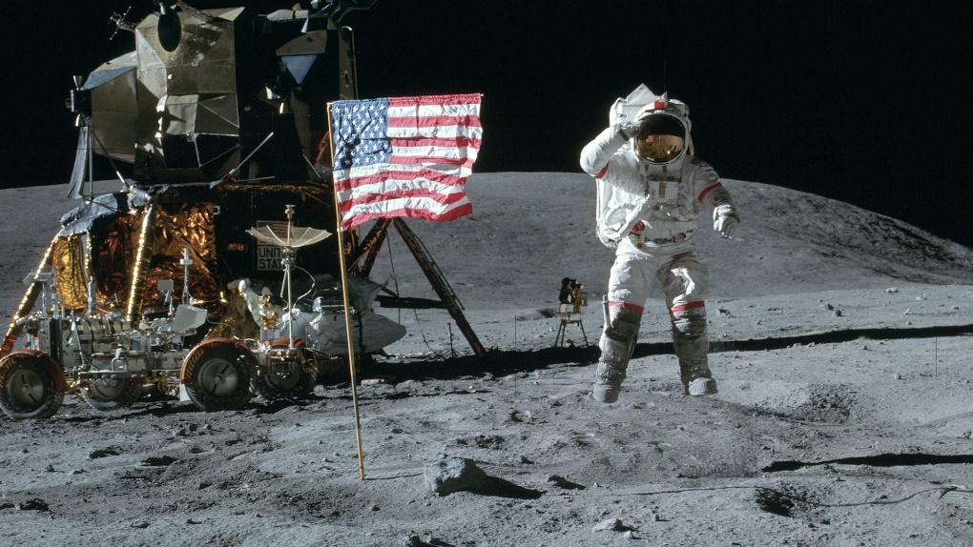
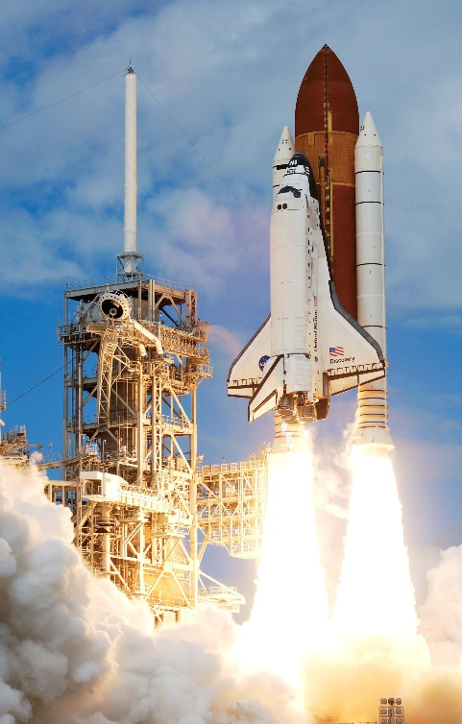
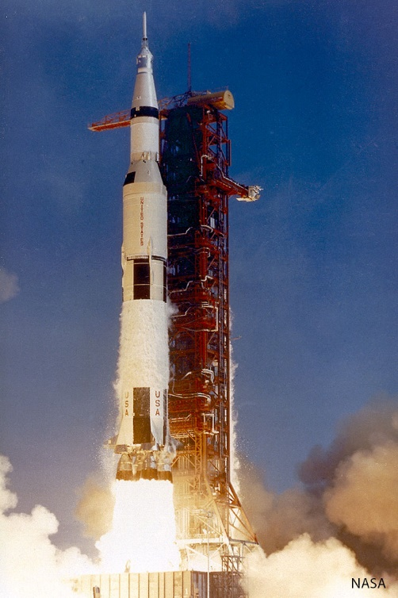
Requirement 5a
Historic Crewed Missions
Apollo Program (USA, 1961–1975) The Apollo Program was undertaken by NASA during the years 1961–1975 with the goal of conducting crewed Moon landing missions. It was accomplished on July 20, 1969 during the Apollo 11 mission. Five other Apollo missions also landed astronauts on the Moon, the last one in 1972.
Space Shuttle (USA, 1972–2011) NASA's Space Shuttle is the U.S. government's most recent crewed launch vehicle and was retired from service in 2011. The Space Shuttle was the only winged crewed spacecraft to achieve orbit and land, and the only reusable space craft that ever made multiple flights into orbit.

Slide 50
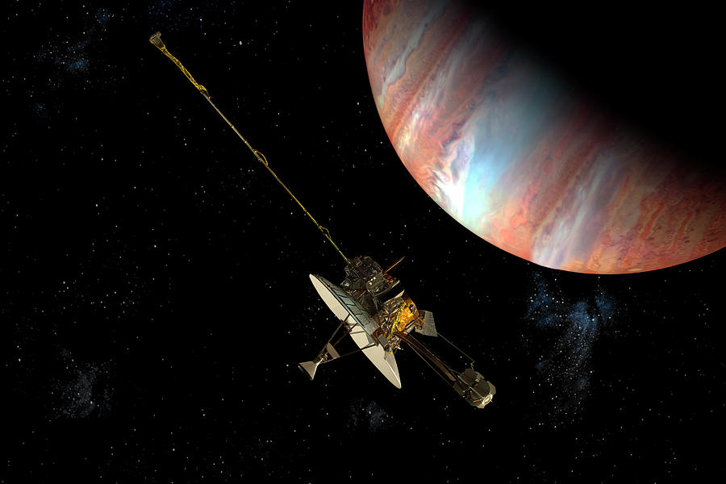
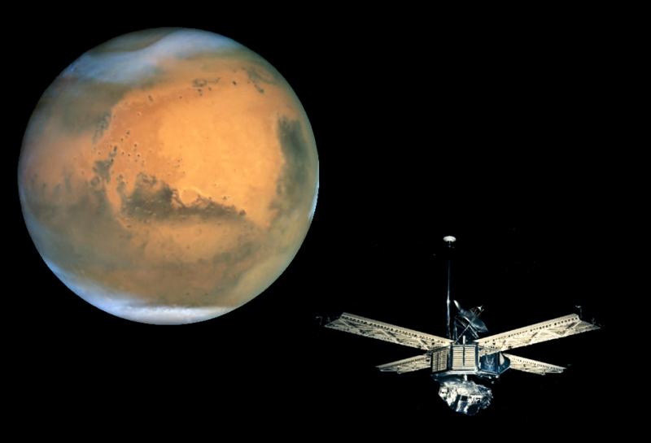
Requirement 5a
Robotic Space Exploration
Pioneer program (1958–1978) The Pioneer program was a series of NASA space missions designed for planetary exploration. There were a number of missions in the program, most notably Pioneer 10 and Pioneer 11, which explored the outer planets and left the solar system.
Mariner program (1962–1973) The Mariner program conducted by NASA launched a series of robotic interplanetary probes designed to investigate Mars, Venus and Mercury. The program included a number of firsts, including the first planetary flyby, the first pictures from another planet, the first planetary orbiter, and the first interplanetary gravity assist maneuver.

Slide 51
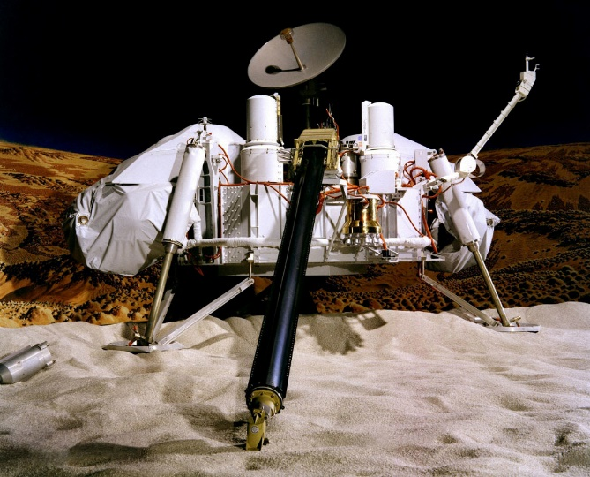
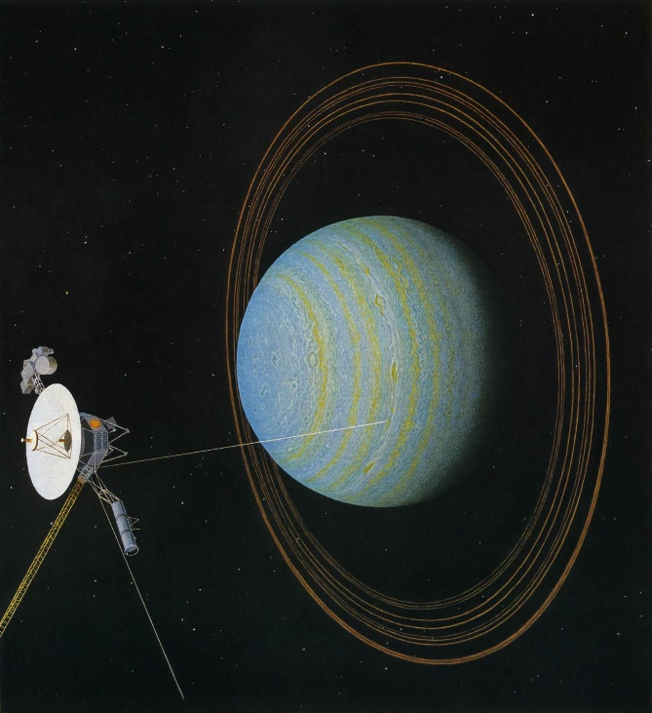
Requirement 5a
Robotic Space Exploration
Viking program (1975) The Viking program consisted of a pair of space probes sent to Mars—Viking 1 and Viking 2. Each vehicle was composed of two main parts, an orbiter designed to photograph the surface of Mars from orbit, and a lander designed to study the planet from the surface.
Voyager program (1977–present) The Voyager program consists of a pair of scientific probes, Voyager 1 and Voyager 2. They were launched in 1977 to take advantage of a favorable planetary alignment of the late 1970s. Although they were originally designated to study just Jupiter and Saturn, Voyager 2 was able to continue to Uranus and Neptune. Both missions have gathered large amounts of data about the gas giants of the solar system, of which little was previously known. Both probes have achieved escape velocity from the Solar System and will never return. Voyager 1 entered interstellar space in 2012.

Slide 52
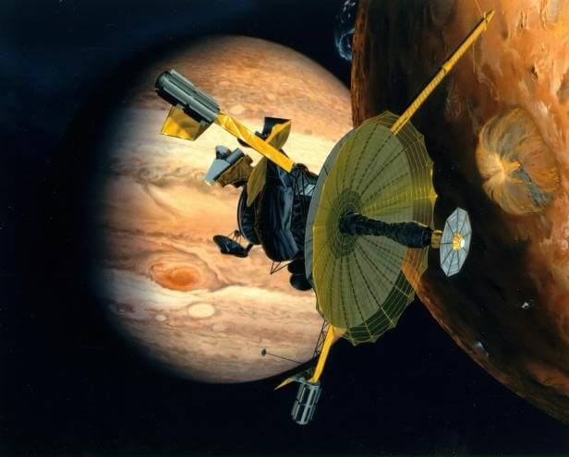
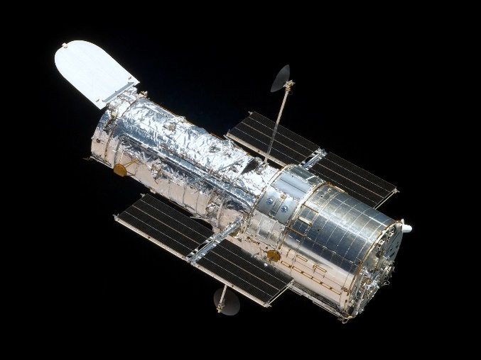
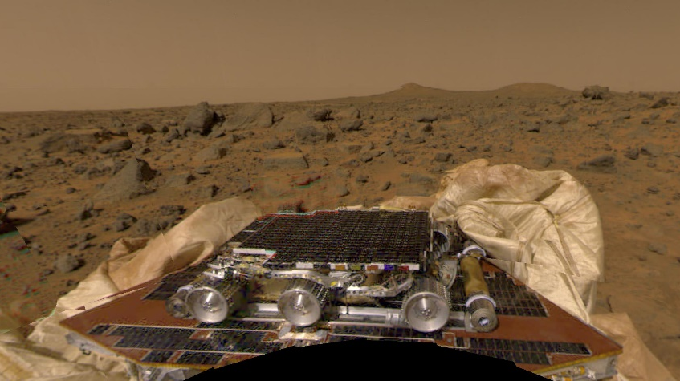
Requirement 5a
Robotic Space Exploration
Galileo (1989) Galileo was a spacecraft sent by NASA to study the planet Jupiter and its moons.
Hubble Space Telescope (1990) The Hubble Space Telescope is a space telescope that was carried into orbit by a Space Shuttle.
Mars Pathfinder was launched on December 4, 1996. On board the lander was a small rover called Sojourner that executed many experiments on the Martian surface.

Slide 53
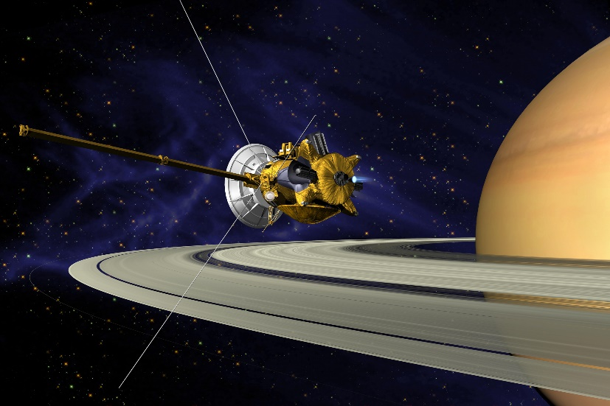
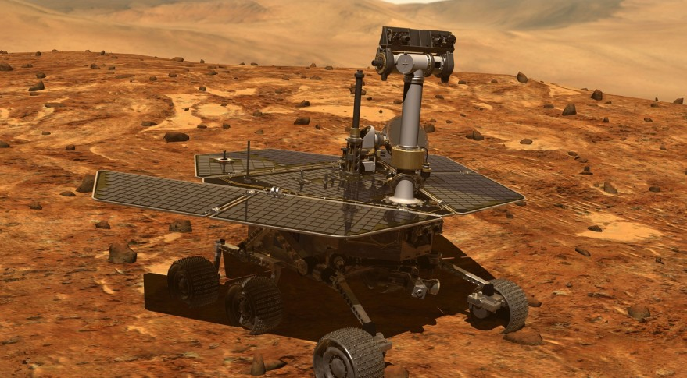
Requirement 5a
Robotic Space Exploration
Cassini–Huygens (1997–2017) Cassini–Huygens was a joint NASA/ESA/ASI spacecraft mission studying the planet Saturn and its many natural satellites. It included a Saturn orbiter and an atmospheric probe/lander for the moon Titan. The Titan probe, Huygens, entered and landed on Titan in 2005.
Mars Exploration Rover (2003-2019) Mars Exploration Rover Mission (MER), was a robotic space mission involving two rovers exploring the planet Mars.

Slide 54
Requirement 5
Do TWO of the following:
  Discuss with your counselor a robotic space exploration mission and a historic crewed mission. Tell about each mission's major discoveries, its importance, and what was learned from it about the planets, moons, or regions of space explored.
  Using magazine photographs, news clippings, and electronic articles (such as from the Internet), make a scrapbook about a current planetary mission.
  Design a robotic mission to another planet, moon, comet, or asteroid that will return samples of its surface to Earth. Name the planet, moon, comet, or asteroid your spacecraft will visit. Show how your design will cope with the conditions of the environments of the planet, moon, comet, or asteroid.

Slide 55

Requirement 5b
This link to the Jet Propulsion Laboratory has information about all of the current missions NASA is operating.

Slide 56
Requirement 5
Do TWO of the following:
  Discuss with your counselor a robotic space exploration mission and a historic crewed mission. Tell about each mission's major discoveries, its importance, and what was learned from it about the planets, moons, or regions of space explored.
  Using magazine photographs, news clippings, and electronic articles (such as from the Internet), make a scrapbook about a current planetary mission.
  Design a robotic mission to another planet, moon, comet, or asteroid that will return samples of its surface to Earth. Name the planet, moon, comet, or asteroid your spacecraft will visit. Show how your design will cope with the conditions of the environments of the planet, moon, comet, or asteroid.

Slide 57

Requirement 5c
Why do we send robots to space?
Robots can do lots of things that humans can’t. Some can withstand harsh conditions, like extreme temperatures or high levels of radiation.
We can send robots to explore space without having to worry so much about their safety. Of course, we want these carefully built robots to last. We need them to stick around long enough to investigate and send us information about their destinations. But even if a robotic mission fails, the humans involved with the mission stay safe.
Sending a robot to space is also much cheaper than sending a human. Robots don’t need to eat or sleep or go to the bathroom. They can survive in space for many years and can be left out there—no need for a return trip!

Slide 58

Requirement 5c
What are some of the robots NASA is currently developing?
This spiky cube of a robot is being developed by NASA with Stanford University and MIT.
Hedgehog is designed to explore small bodies, such as asteroids or comets. These have very little gravity and extremely rough terrain. Instead of rolling, Hedgehog hops and tumbles.
What if it lands upside-down? No big deal. It can operate on any of its sides. It could even get itself out of a deep crater using a tornado-like maneuver that launches the robot into the air.

Slide 59

Requirement 5c
What are some of the robots NASA is currently developing?
BRUIE, the Buoyant Rover for Under-Ice Exploration. This robot can float in the water and roll its wheels along the underside of an icy surface, all while taking pictures and collecting data.
Scientists hope to someday use a robot like this to search for signs of life on icy bodies elsewhere in the solar system. For example, the underground oceans of Jupiter’s moon Europa or Saturn’s moon Enceladus.

Slide 60
Requirement 6
Describe the purpose and operation of ONE of the following:
  Space shuttle or any other crewed orbital vehicle, whether government owned (U.S. or foreign) or commercial.
  International Space Station.

Slide 61

Requirement 6a
Space Shuttle (Retired)
The Space Shuttle was a partially reusable low Earth orbital spacecraft system that was operated from 1981 to 2011 by NASA.
It took satellites to space so they could orbit Earth. The shuttle carried large parts into space to build the International Space Station. The space shuttle was also like a science lab. Astronauts did experiments there.
The Space Shuttle was composed of an orbiter launched with two reusable solid rocket boosters and a disposable external fuel tank. It carried up to eight astronauts and up to 50,000 lbs. of payload into low Earth orbit. When its mission was complete, the orbiter would reenter the Earth's atmosphere and land like a glider at either the Kennedy Space Center or Edwards Air Force Base.

Slide 62

Requirement 6a
SpaceX Crew Dragon
Dragon 2 is a class of reusable spacecraft developed and manufactured by American aerospace manufacturer SpaceX.
The spacecraft launches atop a Falcon 9 rocket and returns to Earth via an ocean splashdown.
The spacecraft can dock itself to the ISS.
It has two variants; Crew Dragon, a human rated capsule capable of ferrying up to seven astronauts, and Cargo Dragon, which is expected to supply cargo to the ISS.

Slide 63

Requirement 6a
Boeing CST-100 Starliner
The Boeing CST-100 Starliner is a reusable crew capsule manufactured by Boeing as its participation in NASA's Commercial Crew Development program.
Its primary purpose is to transport crew to the International Space Station and to private space stations such as the proposed Bigelow Aerospace Commercial Space Station.

Slide 64
Requirement 6
Describe the purpose and operation of ONE of the following:
  Space shuttle or any other crewed orbital vehicle, whether government owned (U.S. or foreign) or commercial.
  International Space Station.

Slide 65

Requirement 6b
International Space Station (ISS)
The International Space Station is a modular space station in low Earth orbit.
The ISS program is a multi-national collaborative project between five participating space agencies: NASA, Roscosmos, JAXA, ESA, and CSA.
The ISS serves as a microgravity and space environment research laboratory in which scientific experiments are conducted in astrobiology, astronomy, meteorology, physics, and other fields.
The station is suited for testing the spacecraft systems and equipment required for possible future long-duration missions to the Moon and Mars.
It is the largest artificial object in space and the largest satellite in low Earth orbit, regularly visible to the naked eye from Earth's surface.

Slide 66
Requirement 7
Design an inhabited base located within our solar system, such as Titan, asteroids, or other locations that humans might want to explore in person. Make drawings or a model of your base. In your design, consider and plan for the following:
  Source of energy.
  How it will be constructed.
  Life-support system.
  Purpose and function.

Slide 67

Requirement 7a
Source of Energy
Two energy sources that will be utilized for space colonies will be sunlight and miniature nuclear reactors.

Slide 68

Requirement 7b
How would it be constructed?
One particularly low-tech but surprisingly effective proposal is simply to pound the ground with the equivalent of a ten pound hammer. Scientists at the University of California, San Diego, found that this almost ridiculously easy technique could be used to make Martian bricks that are stronger than steel reinforced concrete.
Another possibility being explored is the use of 3D printing to create structures primarily out of ‘regolith’ – the loose rocks, dust and soil on the planet’s surface.

Slide 69

Requirement 7c
Life-support system
Space colonies will probably use a Life Support Unit that is rigged with extra technologies that will utilize the natural resources available on site.
Potable water would be created through the heating of water ice in the ground soil. A portion of the water would be stored while the rest would be used to produce oxygen. Nitrogen would be extracted from the atmosphere or soils and injected into the habitable space as an inert gas. Remember, 80% of what we breathe on Earth is the element nitrogen.
The Life Support Unit would also be in charge of the water purification and removal of waste gas (carbon dioxide) from the Living Unit atmosphere.

Slide 70

Requirement 7d
Purpose of an inhabited base in our solar system.
An inhabited base in our solar system would allow continued exploration of the body it is on.
We can search for valuable materials.
We also could set up an astronomical observatory.
Businesses might be able to mine material for a profit.
Someday a hotel or resort could be built, followed by a colony.

Slide 71
Requirement 8
Discuss with your counselor two possible careers in space exploration that interest you. Find out the qualifications, education, and preparation required and discuss the major responsibilities of those positions.

Slide 72
Requirement 8
Careers in Space Exploration | Typically needed to enter the occupation |  | Typically needed to attain competency in the occupation
 | Education | Work experience in a related occupation | On-the-job training
Astronomers | Doctoral or professional degree | None | None
Atmospheric and space scientists | Bachelor's degree | None | None
Physicists | Doctoral or professional degree | None | None
Aerospace engineers | Bachelor's degree | None | None
Computer hardware engineers | Bachelor's degree | None | None
Electronics engineers | Bachelor's degree | None | None
Mechanical engineers | Bachelor's degree | None | None
Aerospace engineering and operations technicians | Associate's degree | None | None
Avionics technicians | Associate's degree | None | None
Life, physical, and social science technicians | Associate's degree | None | None

